Slide 1
Hunting for
Averages
By: Prakul Ramesh
School:Ganit kreeda

Slide 2
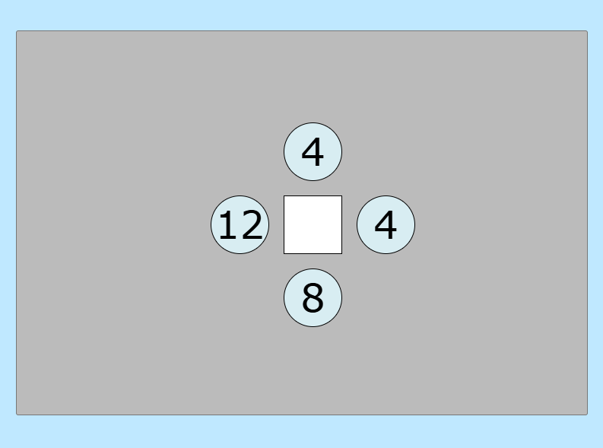
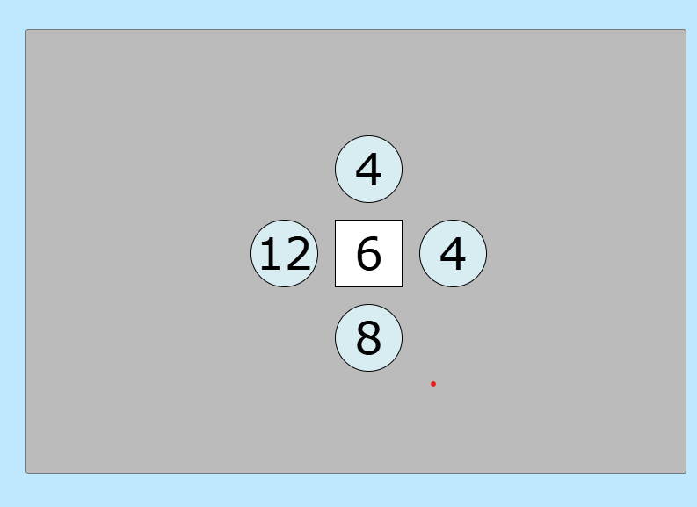
1x1Grid
To find the mean, I add the numbers Surrounding the mean and divide the solution by four. Because the numbers surrounding the mean is four.

Slide 3
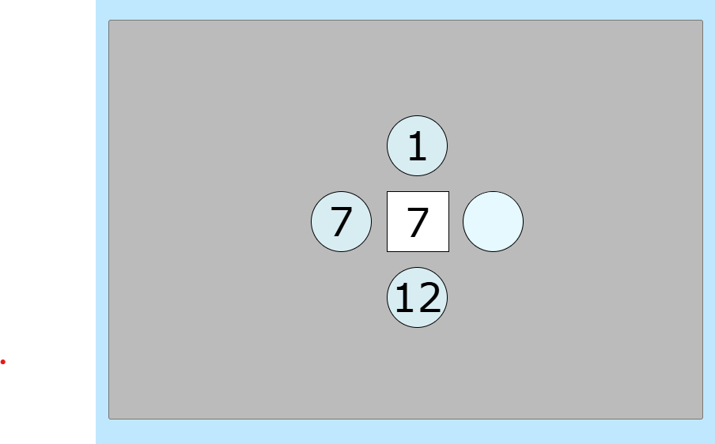
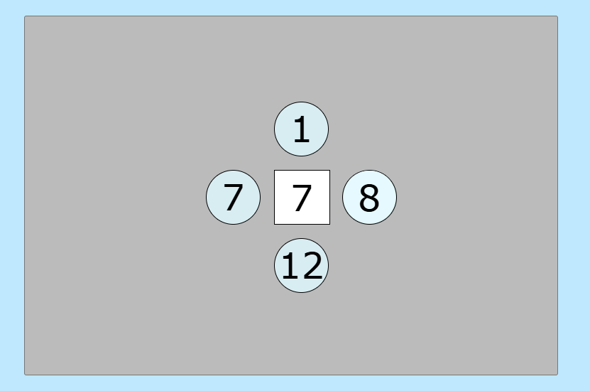
As I know that to find the mean, I add the numbers Surrounding the mean and divide the solution by four. Because the numbers surrounding the mean is four.
To find the missing number I can multiply the mean by four as multiplication and division are reverse operations and then subtract the sum of the other three numbers. That is the solution.

Slide 4
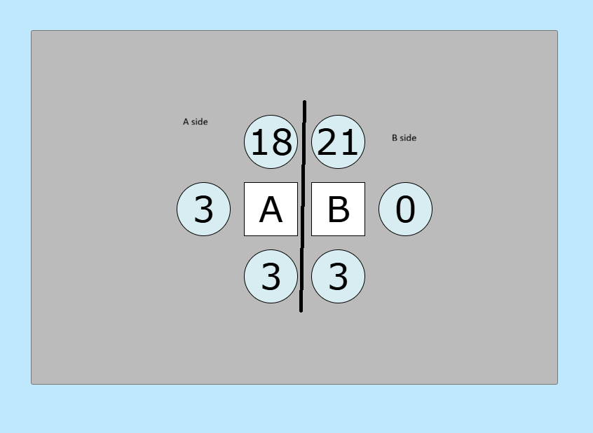
1x2 Grid
In this grid there are two methods. In which is based on trial and error and the other method works all the time and it has a formula.
But one thing is common in both the methods. We name all the squares . We name them as given in the picture in the right.

Slide 5
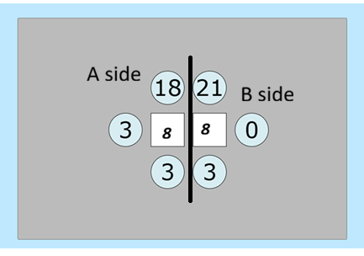
trial and error method
This method is the easiest. This method is the method used to solve anything x 1 grid. But this method does provide the final answer, but you might have to change the identified final numbers to get the answer.
Now we can start solving the problem. The problem we are going to solve is given below.
First we have to solve the A side. But to find the A side we need to find the other side which is B. All we know about A side is that the sum of the NOS surrounding it is equal to 24. We know that A has to be divisible by 4 and the Nos surrounding B is equal to 24
and B has to be also divisible by 4. Now we have to assume
that B is equal to the next closest multiple of 4. But to add 4
we need to keep A as 4.
Then the numbers surrounding B will be 28. That is the only
way the sum of B can be equal to28 then B has to be 7.
But the sum around A is not proper so we go to the next multiple of 4 then we must also change A by 4. the sum around B is equal to 32 then the average is 8 for B and A and the answer is correct.

Slide 6
Formila method
This works because we have to find the average of A. We multiply A side by 4 because A side /4 should be=A. Then we have to add B side because A is a number which surrounds B. Then we divide by 15 because it is the mean we are tying to find.
There is a formula which will work every time . The formula is sum of A side x 4 + sum of B side/ by 15 = A. Then we can find B the same way we found in the 1x1 Grid.
Thank you

