Slide 1
Answer on next page
:)

Slide 2
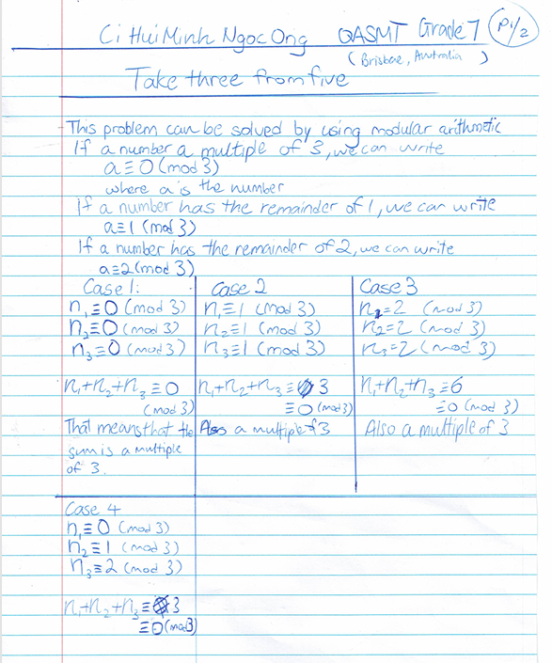

Slide 3
