Slide 1
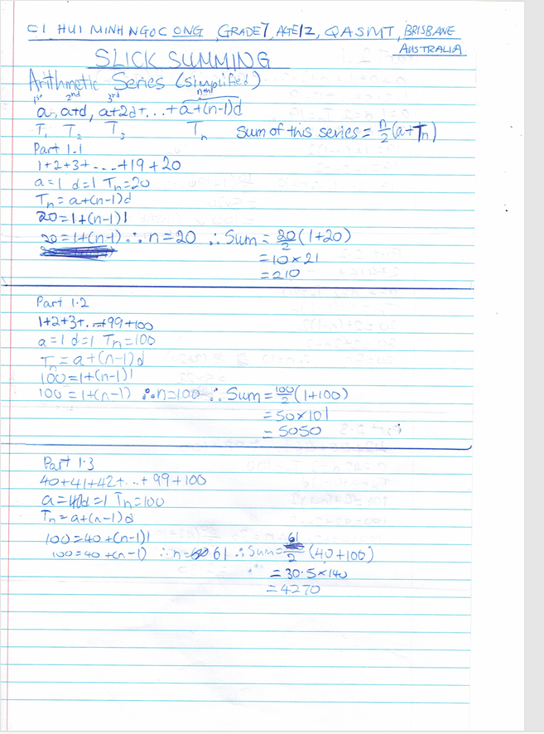
SLICK SUMMING by
Ci HUI MINH NGOC ONG, Grade7, Age 12, QASMT Brisbane, Australia

Slide 2
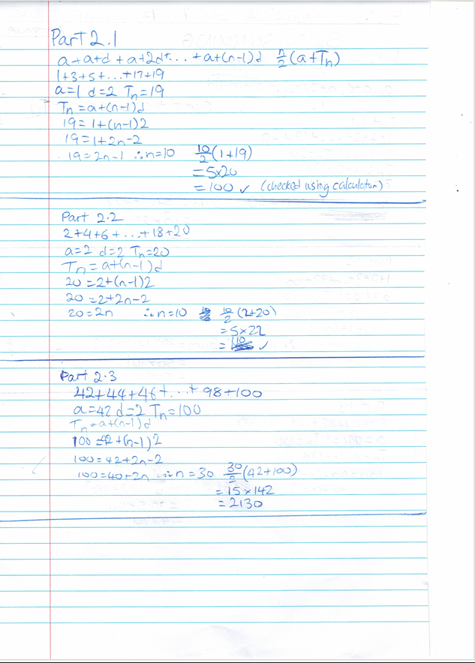

Slide 3
