Slide 1
Problem Solving with NRICH
PiXL 2024
Charlie Gilderdale
NRICH Mathematics Project

Slide 2
Think about a personal goal or ambition
that you succeeded in achieving …
How did you achieve it?

Slide 3
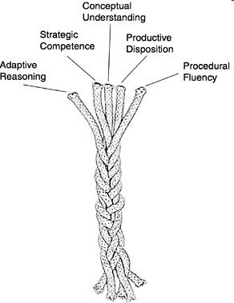
NRICH tasks aim to strengthen these
five strands of mathematical proficiency
Nurturing Successful Mathematicians
https://nrich.maths.org/ropemodel
Kilpatrick et al
NRC (2001)
Adding it up:
Helping children learn mathematics

Slide 4
Conceptual understanding -
comprehension of mathematical concepts, operations, and relations
Procedural fluency -
skill in carrying out procedures flexibly, accurately, efficiently, and appropriately
Strategic competence -
ability to formulate, represent, and solve mathematical problems
Adaptive reasoning -
capacity for logical thought, reflection, explanation, and justification
Productive disposition -
habitual inclination to see mathematics as sensible, useful, and worthwhile, coupled with a belief in diligence and one’s own efficacy.

Slide 5
nrich.maths.org/pixl2024

Slide 6
… some take-away messages…

Slide 7
The most exciting phrase to hear in science, the one that heralds new discoveries, is not Eureka!, but rather,
“hmmm… that’s funny…”
Isaac Asimov
Engaging learners
mathematics

Slide 8
Mathematics is not a spectator sport
Exploring
→ Noticing Patterns
→ Conjecturing
→ Generalising
→ Explaining
→ Justifying
→ Proving
Notes:
Low Threshold, High Ceiling tasks:Offer students genuine choice Give all students the chance to work mathematically
Creativity in English – reading others’ work and writing work of your own. Creativity in maths – as well as being exposed to important mathematical results, creating mathematics of your own. LTHC – everyone has the right to get stuck and make mistakes in a safe environment, everyone has an entitlement to work mathematically.

Slide 9
What can we offer students?
Low Threshold, High Ceiling tasks
A conjecturing culture where it is OK to make mistakes
Opportunities to exhibit and refine their understanding
Opportunities to discuss mathematical ideas
A careful use of guiding questions and prompts
Opportunities to practice skills in an engaging way: purposeful practice
Teachers who model and value mathematical behaviours

Slide 10
When you return to school…
… consider becoming a Problem-solving School
nrich.maths.org/problem-solving-schools

Slide 11
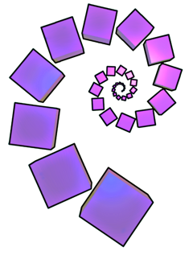
Thank you
Charlie Gilderdale
secondary.nrich@maths.org

