Slide 1
Please, sit next to someone, who you haven’t worked with before,
with whom you can
talk, share, discuss...
Thank you

Slide 2
Every student has the right to succeed, and every student has the right to struggle – the NRICH approach at Primary school level
Trondheim 2022 Charlie Gilderdale
cfg21@cam.ac.uk
http://nrich.maths.org/enriching

Slide 3
Models of provision
DIP: Define → Identify → Provide
PIP: Provide → Identify → Provide
Notes:
Discuss advantages / disadvantages of each

Slide 4
Exploring → Noticing Patterns
→ Conjecturing
→ Generalising
→ Explaining
→ Justifying
→ Proving
Notes:
Low

Slide 5
HOTS not MOTS Higher order thinking skills not More of the same

Slide 6
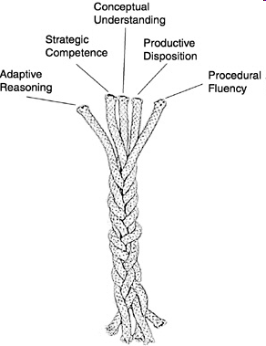
NRC (2001) Adding it up: Helping children learn mathematics

Slide 7
Peter Liljedahl’s 14 teaching Practices
Number 9: How we use hints and extensions in a thinking classroom

Slide 8
We could start by asking younger students…
Solve the following:
154 + 722
345 + 678
572 - 125
1064 - 14
and when appropriate, we could follow up with…

Slide 9
We could start by asking older students…
3, 5, 6, 3, 3
Mean = ?
Mode = ?
Median = ?
and when appropriate, we could follow up with…

Slide 10
What can we offer our students?
An engaging challenge and time to work on it
A chance to share views, strategies and insights in a conjecturing atmosphere
Opportunities to test, refine and apply strategies in a variety of contexts
A context in which to generate generalisations

Slide 11
…a teacher of mathematics has a great opportunity. If he fills his allotted time with drilling his students in routine operations he kills their interest, hampers their intellectual development, and misuses his opportunity. But if he challenges the curiosity of his students by setting them problems proportionate to their knowledge, and helps them to solve their problems with stimulating questions, he may give them a taste for, and some means of, independent thinking.“ Polya, G. (1945) How to Solve it

