Slide 1
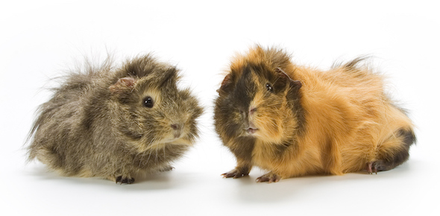

The Trouble with Quizzles
5th April 2022

Slide 2
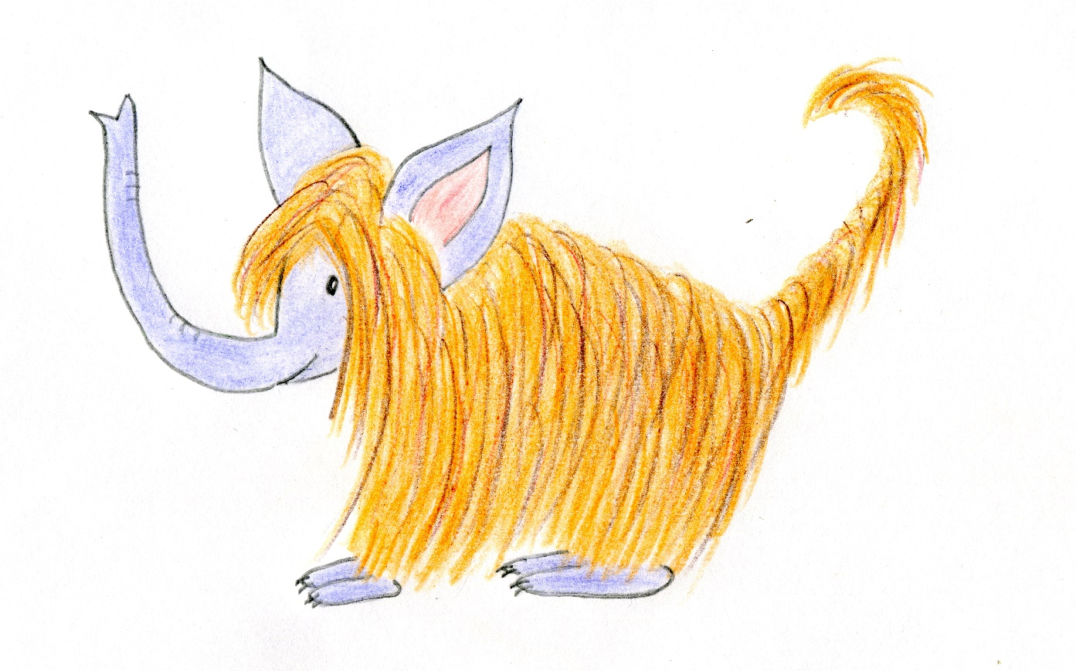

Slide 3
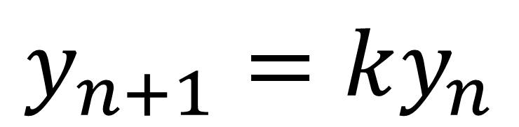
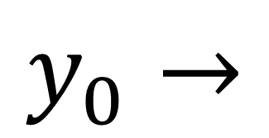
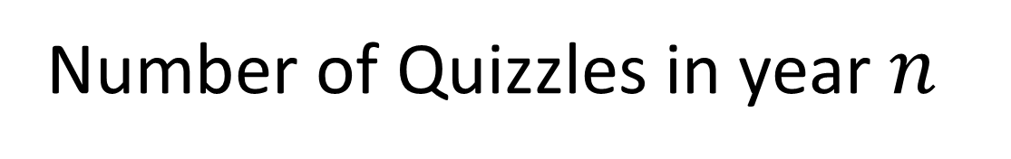
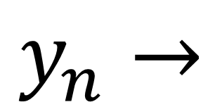
$$y_{n}→$$
Number of Quizzles in year $n_{}$
$$y_{0}→$$
Starting number of Quizzles
$$y_{n+1}=ky_{n}$$

Slide 4
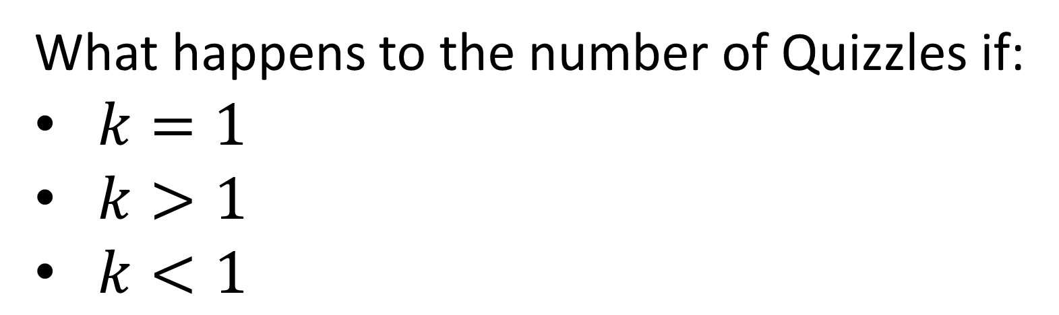
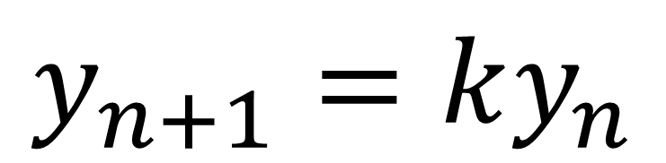
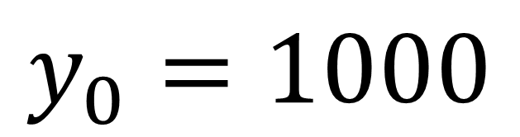
$$y_{0}=1000$$
$$y_{n+1}=ky_{n}$$
What happens to the number of Quizzles if:
$k=1$
$k>1$
$k<1$

Slide 5
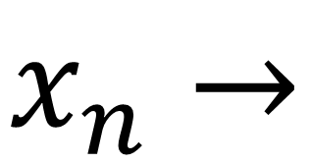
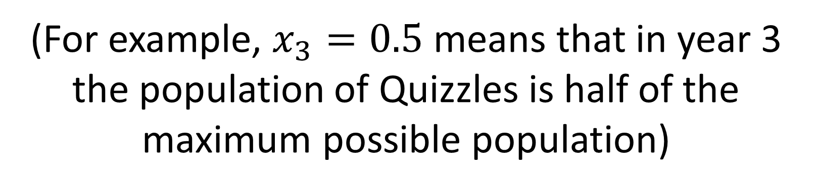
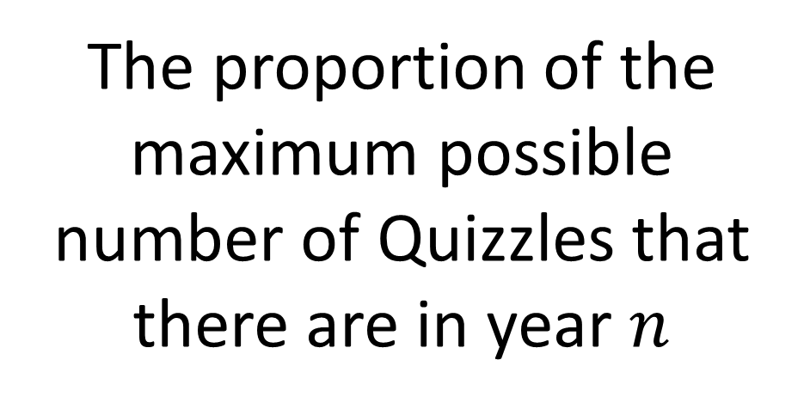
$$x_{n}→$$
The proportion of the maximum possible number of Quizzles that there are in year $n$
(For example, $x_{3}=0.5$ means that in year 3 the population of Quizzles is half of the maximum possible population)

Slide 6
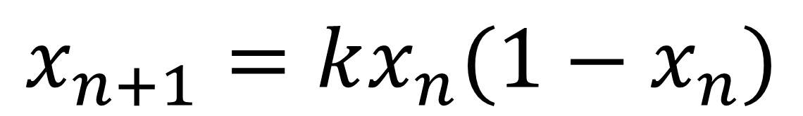
$$x_{n+1}=kx_{n}(1−x_{n})$$

Slide 7
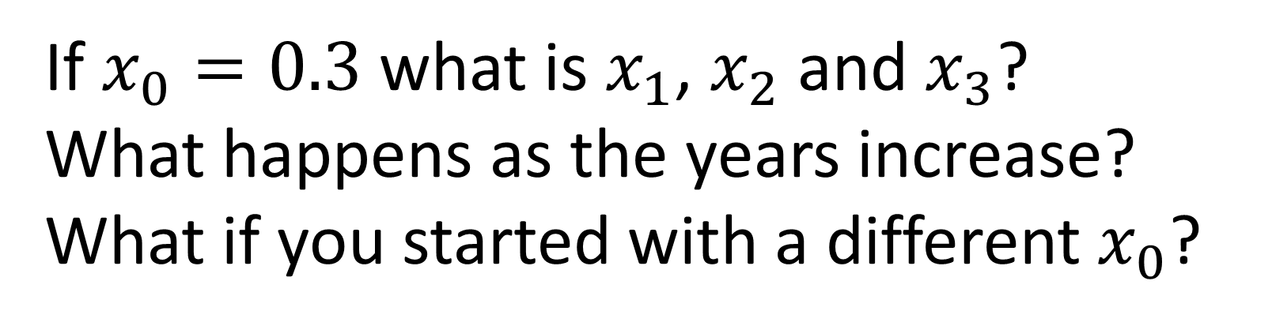
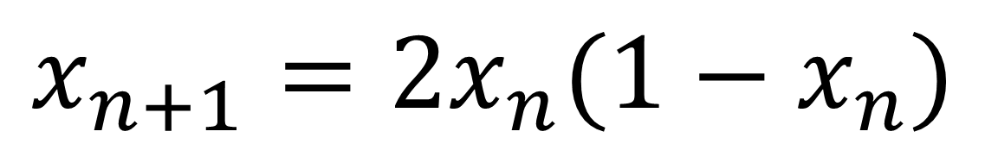
$$x_{n+1}=2x_{n}(1−x_{n})$$
If $x_{0}=0.3$ what is $x_{1}$, $x_{2}$ and $x_{3}$?
What happens as the years increase?
What if you started with a different $x_{0}$?

Slide 8
Can you find a parameter (k value) where the population dies out?
Can you find a parameter so that the population settles to a non-zero constant value (which is not 0.5)?
Can you find a parameter so that the population eventually oscillates between two values? Or eventually cycles between three or four values?
Why have we chosen 0 and 4 as limits for the k slider?

Slide 9

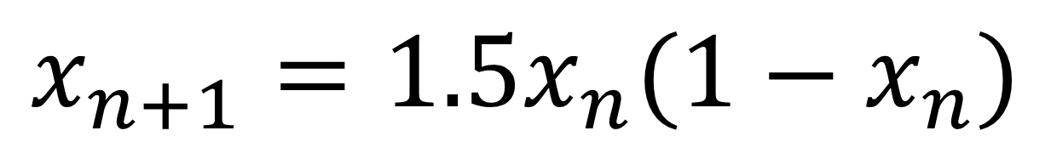
$$x_{n+1}=1.5x_{n}(1−x_{n})$$
$$0.6{≤x}_{0}≤0.8$$

Slide 10
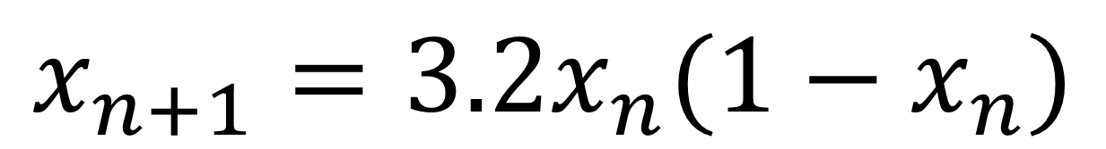
$$x_{n+1}=3.2x_{n}(1−x_{n})$$
$$0.6{≤x}_{0}≤0.8$$

Slide 11
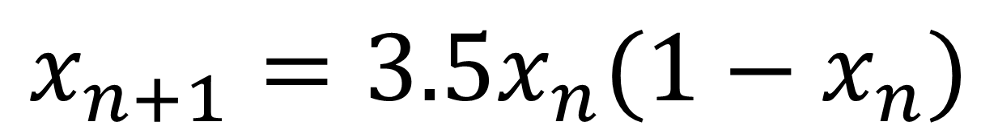
$$x_{n+1}=3.5x_{n}(1−x_{n})$$
$$0.6{≤x}_{0}≤0.8$$

Slide 12
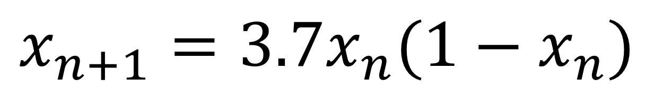
$$x_{n+1}=3.7x_{n}(1−x_{n})$$
$$0.6{≤x}_{0}≤0.8$$

Slide 13

$$x_{n+1}=3.7x_{n}(1−x_{n})$$
$$0.69{≤x}_{0}≤0.71$$

Slide 14

$$x_{n+1}=3.7x_{n}(1−x_{n})$$
$$0.699{≤x}_{0}≤0.701$$

Slide 15

Logistic Map
$$x_{n+1}=kx_{n}(1−x_{n})$$

Slide 16
Twitter: @stepsupportcam, @nrichmaths

