Slide 1

Felixstowe Transition Project
Year 2, Day 1
6 February 2019
Multiplicative Reasoning
Charlie Giilderdale cfg21@cam.ac.uk
Liz Woodham emp1001@cam.ac.uk
@nrichmaths

Slide 2
Aims of the project
To strengthen mathematics teaching and learning during the key transition years in primary and secondary education
To establish and support a local network of schools to explore effective teaching and learning of fluency, reasoning and problem solving

Slide 3
Project Overview
2017/18 – three days plus celebration in Cambridge
2018/19 – three days
6 February
18 March
nrich.maths.org/felixstowe

Slide 4
Mixing Lemonade (6870)
I mixed up some lemonade in two glasses.
The first glass had 200ml of lemon juice and 300ml of water.
The second glass had 100ml of lemon juice and 200ml of water.
Which mixture has the stronger tasting lemonade?
How do you know?

Slide 5
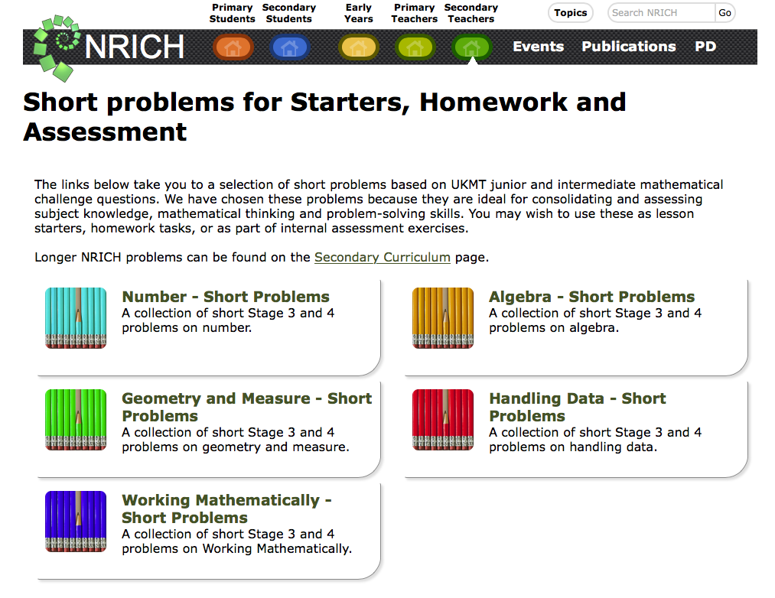
Short Problems (11652)

Slide 6
What strategies have you used?
Which strategies are most elegant / effective?
How can we move students on to use the most effective strategies?

Slide 7
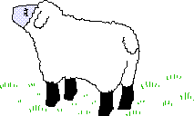

Heads and Feet (924)
On a farm there were some hens and sheep.
Altogether there were 8 heads and 22 feet.
How many hens were there?

Slide 8
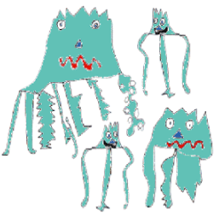
Zios and Zepts (1005)
On the planet Vuv there are two sorts of creatures.
The Zios have 3 legs and the Zepts have 7 legs.
The great planetary explorer Nico,
who first discovered the planet, saw a
crowd of Zios and Zepts. He managed to
see that there was more than one of each
kind of creature before they saw him.
Suddenly they all rolled over onto their
backs and put their legs in the air.
He counted 52 legs.
How many Zios and how many Zepts were there?
Do you think there are any different answers?

Slide 9
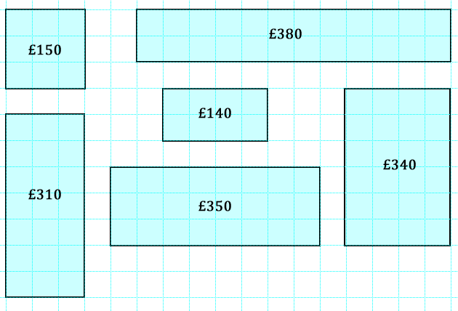
Through the Window (10344)
The store in my town which sells windows calculates the price of windows according to the area of glass used and the length of frame needed.
Can you work out how they arrived at the prices of the windows below?

Slide 10
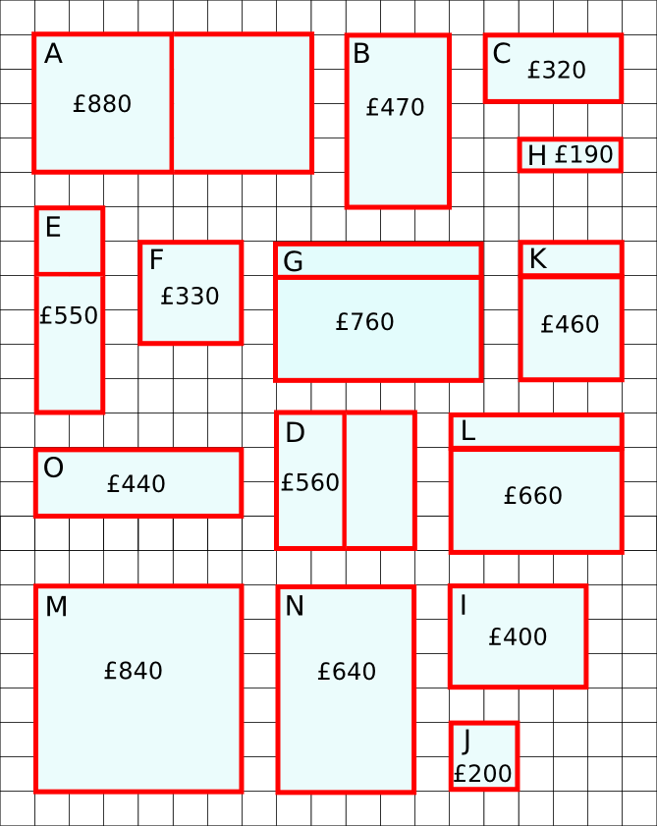
Warmsnug Double Glazing (4889)
Warmsnug calculate the prices of their windows according to the area of glass used and the length of frame needed.
Can you work out how Warmsnug
arrived at the prices of the windows
in the picture?
Which window has been given an
incorrect price?

Slide 11

Dicey Operations in Line (13261)
Each of you might draw a multiplication layout like this:
Throw the dice four times each until all the cells are full.
Whoever has the product closest to 1000 wins.

Slide 12
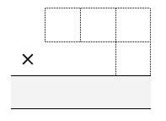
Dicey Operations (6606)
Each of you might draw a multiplication layout like this:
Throw the dice four times each until all the cells are full.
Whoever has the product closest to 1000 wins.

Slide 13
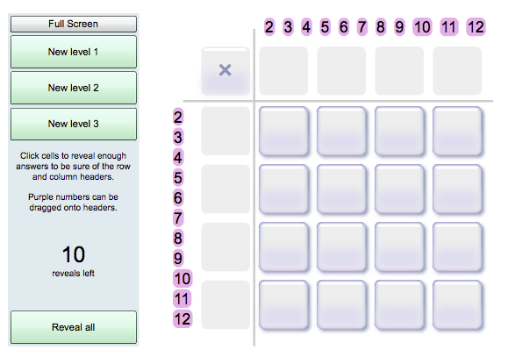
Missing Multipliers (7382)

Slide 14
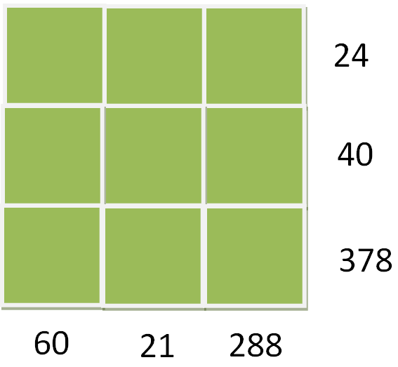
Gabriel’s Problem (11750)
Gabriel wrote the numbers 1-9 in a 3x3 grid.
He then multiplied together all the numbers in each row and wrote the resulting product next to that row.
He also multiplied the numbers in each column together, and wrote the product under that column.
He then rubbed out the numbers 1-9.
Can you work out where Gabriel
placed the numbers 1-9?
Did you have more information than you
needed?

Slide 15
Teacher takeaway
Try at least one of the tasks from today with your class/some of your students
Please be prepared to talk about it next time

Slide 16
References
Askew, M. (2018) Multiplicative reasoning: teaching primary pupils in ways that focus on functional relations, The Curriculum Journal, 29:3, 406-423, available online at https://doi.org/10.1080/09585176.2018.1433545

