Slide 1
Purposeful practice:
Consolidating understanding using rich tasks
Alison Kiddle

Slide 2
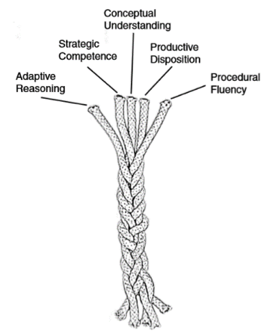
Strands of Mathematical Proficiency
Kilpatrick, J. Swafford, J. & Findell, B.(eds.)(2001). Adding it up: Helping children learn mathematics. Mathematics Learning Study Committee: National Research Council.

Slide 3
Consolidating with rich tasks
To:
  Deepen understanding
  Build connections
  Develop fluency

Slide 4
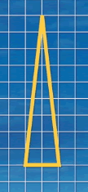
Isosceles Triangles
Draw some isosceles triangles with an area of 9 cm² and a vertex at (20, 20).
If all the vertices have whole number coordinates, how many is it possible to draw?
Can you explain how you know that you have found them all?

Slide 5
Unequal Averages
Here's an interesting set of five numbers:
2,5,5,6,7
Mean, mode, median and range are all 5.
Can you find other sets of five positive whole numbers where:
Mean = Median = Mode = Range

Slide 6
Unequal Averages
Can you find sets of five positive whole numbers that satisfy the following properties?
Mode < Median < Mean
Mode < Mean < Median
Mean < Mode < Median
Mean < Median < Mode
Median < Mode < Mean
Median < Mean < Mode

Slide 7
There are many more NRICH tasks that offer opportunities for consolidation…

Slide 8
Number and Algebra
Dicey Operations
American Billions
Keep it Simple
Arithmagons
Pair Products
Temperature
Painted Cube
Factors and Multiples Puzzle
Factors and Multiples Game
What Numbers Can We Make?
Peaches Today, Peaches Tomorrow…
What’s Possible?
Attractive Tablecloths
How Old Am I?

Slide 9
Geometry and Measures
Isosceles Triangles
Can They Be Equal?
Translating Lines
Opposite Vertices
Coordinate Patterns
Route to Infinity
Pick’s Theorem
Cuboid Challenge
Semi-regular Tessellations
Warmsnug Double Glazing

Slide 10
Handling Data
M, M and M
Which List is Which?
Odds and Evens
Which Spinners?

Slide 11
Interactive tasks
GOT IT
Dozens
Mixing Lemonade
Missing Multipliers
Shifting Times Tables
Finding Factors
Connect Three
Estimating Angles
Square It
Treasure Hunt
Diamond Collector
Charlie’s Delightful Machine
Factors and Multiples Game

Slide 12
…and for even more, see the Curriculum Mapping Document

Slide 13
Using rich tasks to introduce new topics

Slide 14
Start with a rich challenge
To:
  Introduce new ideas
  Develop understanding of new curriculum content
  Discover important mathematical results

Slide 15
Fruity Totals

Slide 16
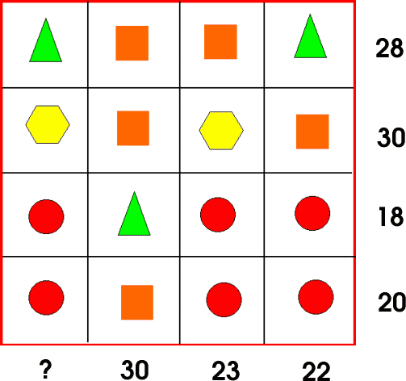
What’s it Worth?
Each symbol has a numerical value.
The total for the symbols is written at the end of each row and column.
Can you find the missing total that should go where the question mark has been put?

Slide 17
Right Angles
Join any two points on the edge to the middle to form a triangle.
Can you work out the angles in your triangle?
Can you join three points on the edge to form a right-angled triangle?

Slide 18
Mathematics is not a spectator sport
Exploring
→ Noticing Patterns
→ Conjecturing
→ Generalising
→ Explaining
→ Justifying
→ Proving

Slide 19
The role of the teacher
Teacher’s role
To choose tasks that allow students to explore new mathematics
To give students the time and space for that exploration
To bring students together to share ideas and understanding, and draw together key mathematical insights

Slide 20
There are many more NRICH tasks that make excellent starting points…

Slide 21
Number and Algebra
Summing Consecutive Numbers
Number Pyramids
What’s Possible?
What’s It Worth?
Perimeter Expressions
Seven Squares
Attractive Tablecloths

Slide 22
Geometry
Painted Cube
Cyclic Quadrilaterals
Semi-regular Tessellations
Tilted Squares
Vector Journeys

Slide 23
Handling Data
Statistical Shorts
Odds and Evens
Which Spinners?

Slide 24
… a teacher of mathematics has a great opportunity. If he fills his allotted time with drilling his students in routine operations he kills their interest, hampers their intellectual development, and misuses his opportunity. But if he challenges the curiosity of his students by setting them problems proportionate to their knowledge, and helps them to solve their problems with stimulating questions, he may give them a taste for, and some means of, independent thinking.
Polya, G. (1945) How to Solve it

Slide 25
I don't expect, and I don't want, all children to find mathematics an engrossing study, or one that they want to devote themselves to either in school or in their lives. Only a few will find mathematics seductive enough to sustain a long term engagement. But I would hope that all children could experience at a few moments in their careers ... the power and excitement of mathematics ... so that at the end of their formal education they at least know what it is like and whether it is an activity that has a place in their future. David Wheeler

Slide 26
Keep in touch
Register for our newsletter:
nrich.maths.org/newsletter
Follow us on Twitter @nrichmaths
Email: ajk44@cam.ac.uk

