Slide 1
Maths Anxiety Causes, Consequences and Cures
Charlie Gilderdale Alison Kiddle

Slide 2
Complete the sentences…
Mathematics is…
Mathematics makes me feel…

Slide 3
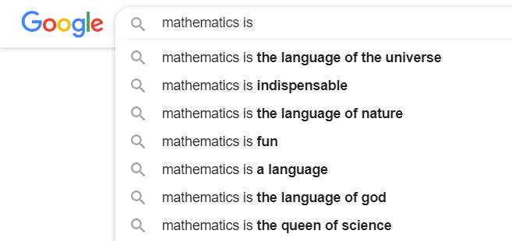
Mathematics is…

Slide 4

Mathematics makes me feel…

Slide 5
“Learning mathematics means memorising facts and procedures”
“Mathematics is about being right or wrong”
Notes:
Do you recognise these views?
In what way have these views affected you?

Slide 6
“Some people just don’t have a maths brain and will always be hopeless at maths”
“Good mathematicians never make mistakes”
Notes:
Do you recognise these views?
In what way have these views affected you?
Growth mindset Carol Dweck

Slide 7
Experiences of Maths Lessons…
“You are put on the spot to answer questions in front of everyone”
“You are regularly ranked, and punished for low scores”
“You often get left behind”
“You are constantly under pressure because maths is so important”
Notes:
Which of these resonate with your experience? What else might you add to this collection?
In what way have these experiences affected you?
One person is a winner and everyone else loses vs Lots of ways to be successful Jo Boaler
Dylan Wiliam – top kids hiding their lolly sticks

Slide 8
Maths is T.I.R.E.D
Tedium
Isolation
Rote Learning
Elitism
Depersonalisation
Nardi, E., & Steward, S. (2003). Is Mathematics T.I.R.E.D? A Profile of Quiet Disaffection in the Secondary Mathematics Classroom.
Notes:
Lots of people opt out of mathematics
Maths anxiety is transmitted intergenerationally

Slide 9
“Mathematics anxiety describes feelings of apprehension, tension or discomfort experienced by many individuals when performing mathematics or in a mathematical context”
(Richardson & Suinn, 1972)
Notes:
Not just weak students. Non-anxious – frustrated, growth mindset, relaxed but engaged.
Anxious – cognitive overload, spending energy worrying about not being able to perform, stereotype threat

Slide 10
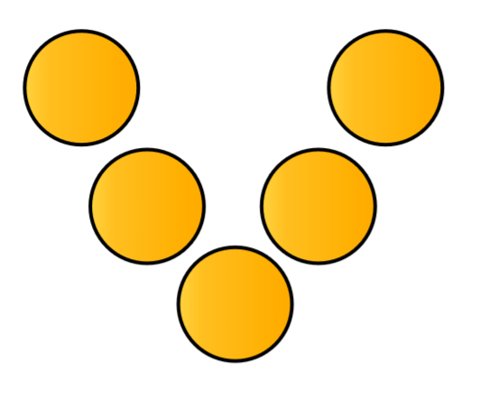
Magic Vs
1, 2, 3, 4, 5

Slide 11
Maths is A.L.I.V.E
Accessible
Linked (to what is already known)
Inclusive
Valued (personally and culturally)
Engaging
Johnston-Wilder, S & Lee, C & Brindley, J & Garton, E. (2015). DEVELOPING MATHEMATICAL RESILIENCE IN SCHOOL-STUDENTS WHO HAVE EXPERIENCED REPEATED FAILURE.

Slide 12
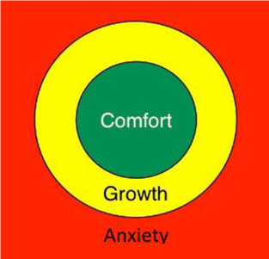
The Growth Zone Model
Lee, C. and Johnston-Wilder, S. (2018). ‘Getting into and staying in the Growth Zone.’

Slide 13
nrich.maths.org/foi2019

