Slide 1
Notes:
Evaluation of how it is used – flexibility When is it used - in or outside school time/tutor time
Recognition for the mentors – badge? Certificate?
D of E
PdF version before sending out
Name?

Slide 2
Which Dog has grown the most?
Caesar has grown from 5 kg to 8 kg
Brutus has grown from 3 kg to 6 kg
Tiberius has grown from 4 kg to 7kg
How would you expect your pupils to respond?
If all the pupils in a class decide that all the dogs have grown equally, how would you respond?
Notes:
What thinking do we want students to bring to this scenario?
What thinking means that they will make errors?
How do we compare and what language do we use?

Slide 3


Supporting Transition in Mathematics
Alison Hopper
MEI Primary Mathematics Specialist
NCETM Assistant Director (Primary)
alison.hopper@mei.org.uk
@AlisonHopper68
Notes:
These resources were developed with Y7 intervention in mind, working with Y10 students in a peer mentoring role.
They are the starting point for work we want to develop to ease the Y6/7 transition so they could be used in Y6 to engage children who still have gaps in key areas of the curriculum.

Slide 4
MEI Primary and Transition
A year ago I was a Y6 teacher
Finding out what is going on
Y7 Intervention Materials
Everything takes time
Articles and conferences
Contact with NRICH (VERY exciting!)
Transition Units Y6 and Y7 (very early days)
NCETM Y5-8 Continuity Work Groups
Teaching for Mastery

Slide 5
Which Dog has grown the most?
Caesar has grown from 5 kg to 8 kg
Brutus has grown from 3 kg to 6 kg
Tiberius has grown from 4 kg to 7kg
How would you expect your pupils to respond?
If all the pupils in a class decide that all the dogs have grown equally, how would you respond?
Notes:
What thinking do we want students to bring to this scenario?
What thinking means that they will make errors?
How do we compare and what language do we use?
Is there one right answer? What do we mean by ‘the most’?
Default thinking is often additive – is this right or helpful?

Slide 6
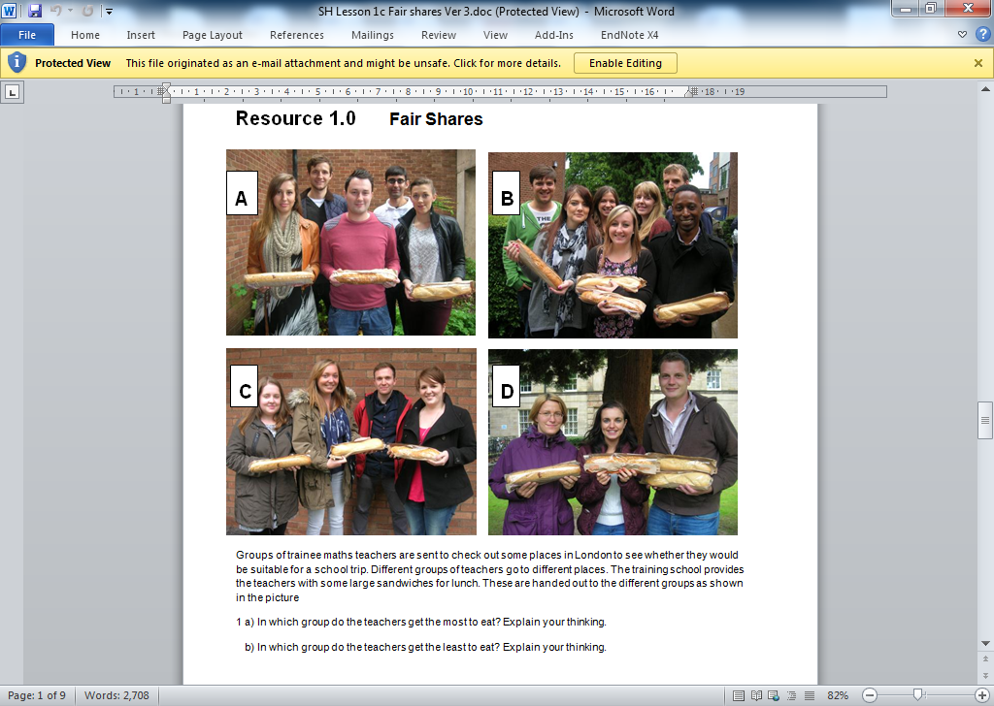
Notes:
Stage 1: Presenting the context - Q1 a & b
Work through Q1a & b as a class. It is worth giving the class a few moments to ponder each question before asking for oral responses.
Some teachers have asked their class to write down what they think, as this helps key them into the range of thinking around in the room. If students provide formal responses such as telling you exactly how much you would get in each case, simply hear this and move on – see supporting commentary.

Slide 7
Draw a picture to show how you would share out the sandwiches in group A
Write down how much each teacher in group A will get
Find a different way to share out the sandwiches in group A. (Again draw a picture and write down how much each teacher will get)
Notes:
Stage 2: Drawing pictures individually to demonstrate solutions - Q2 a, b & c
Students individually draw sandwich sharing pictures to show how they would share 3 sandwiches between 5 people.(Q2 a, b, c) It is important that the students (in some way) denote which people are getting which parts of the sandwiches. Precision is needed in recording how much each person gets. There is likely to be variety in both the drawings and the record of what each person gets.

Slide 8
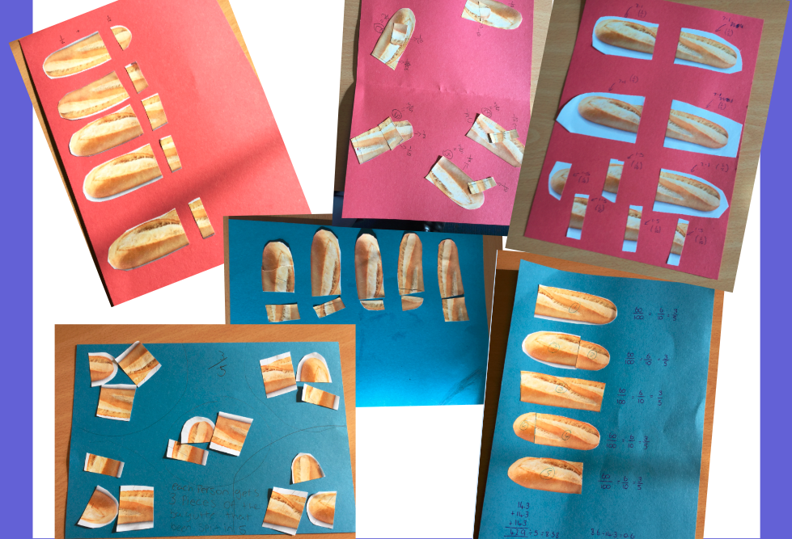
Notes:
This was key for the WG Participants – look at the slides from the lesson to see what the teachers focused on and how the students convinced themselves that they had the same amount.
Noticing the way that children worked was something that they admitted they didn’t do enough of and said that it had really changed the way that they worked in class and structured their lessons. Noticing how told them more about how children were (or weren’t) understanding the maths.
Listening to students and allowing them time to draw their own conclusions was another key learning point arising from interacting with the resources.
Sticking longer with representations to strengthen and deepen understanding.
Stage 3: Reviewing as a class pictures and students’ justifications - Q2 d
As a class review the pictures drawn by students in Q2a,b & c.. Establish that halving leads to each person getting 1/2 + 1/10 whereas sharing out each sandwich one at a time leads to each person getting 1/5 + 1/5 +1/5 (or equivalent). The teacher’s role is to ask whether you get more / the same amount whichever way you do it, and then to work with students responses and direct them to convince you, using the pictures – see supporting commentary.

Slide 9
On a different trip, one of teachers end up with
of a sandwich on their plates.
How many sandwiches and how many teachers might have been in this group?
1
2
1
6
1
6
+
+
https://www.ncetm.org.uk/resources/48093
Notes:
Stage 5: Extension - Q5, Q6, Q7
Questions 5, 6 and 7. These can be attempted individually, but it is likely that you would want to share student ideas as a class. There is potential to go into a second lesson with the ideas generated here.
With a TfM hat on here (a bit of a pedantic one admittedly) I might prefer to think of this as deepening …

Slide 10
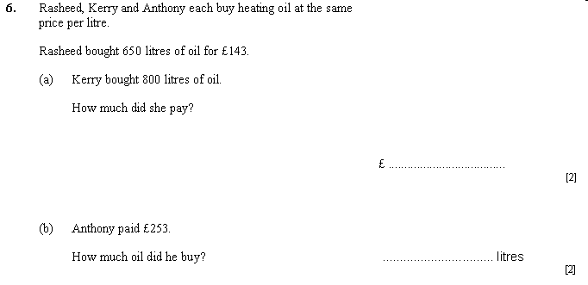
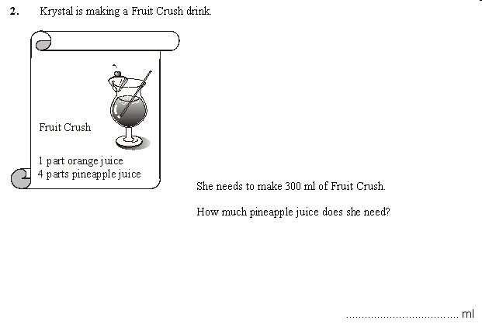
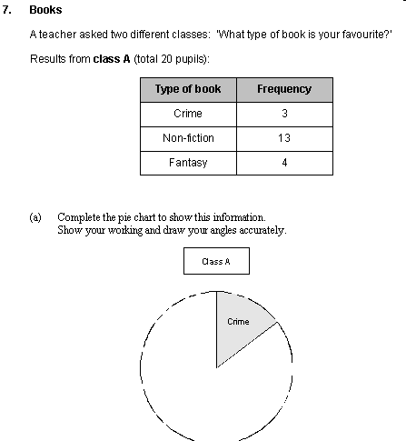
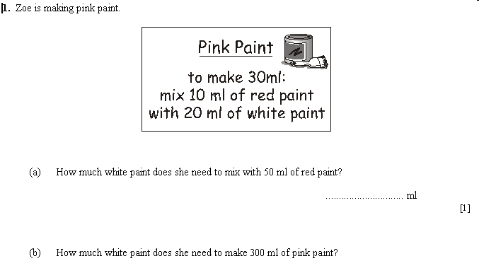
Recipes
What is the cost of …..
Pie charts
Similarity
What is the weight of
enlargement
Conversions
Trigonometry
Percentage changes
Proportional and inverse proportional graphs
fractions
Ratio
Decimals
Notes:
Why some students love maths (not much to remember) but others don’t (too much to remember)
If they don’t see that these are interconnected aspects of maths – do we teach them as such?
To many pupils a jungle of unconnected question and procedures
What would it be like if they realised they were connected in some way,
And that this deeper understanding allowed them to reason and fluently apply methods efficiently and correctly?
Maybe not so much to remember, may be a confidence to attempt a wide range of less familiar problems?
To teachers though many might implicitly recognise that these are connected by the underlying maths this is not reflected explicitly in the teaching as they explained
Could this have the potential to be transformative? Its an exciting thought
Hence the mathematical focus of the project –next slide
Primary NC mentions that ideas of ratio, proportionality, scaling and conversion (line graphs) are there to prepare children for more formal work in this area in KS3/4
If the work in KS2 is preparation then it is clearly important that teachers from secondary settings understand how it is being taught in primary schools so that the understanding can be built on, in line with the EEF recommendation.

Slide 11
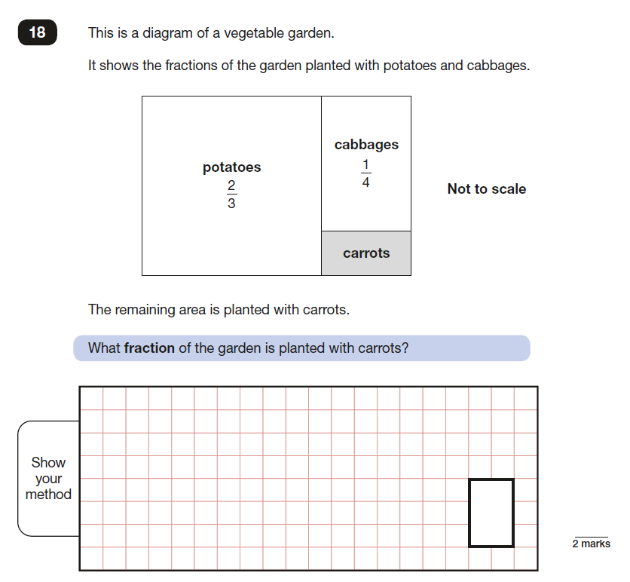
Notes:
Not to scale forces you to use common denominators here so that you can find the whole
Need to reason that ¼ + ? = 1/3
Could you do it by drawing?
Do the squares help?

Slide 12
Can we say that …
2
3
1
4
1
12
+
+
=
1
What else could we say?
1
1
3
1
3
1
4
1
6
1
12
2
3
1
4
1
12
Notes:
Not to scale forces you to use common denominators here so that you can find the whole
Need to reason that ¼ + ? = 1/3

Slide 13
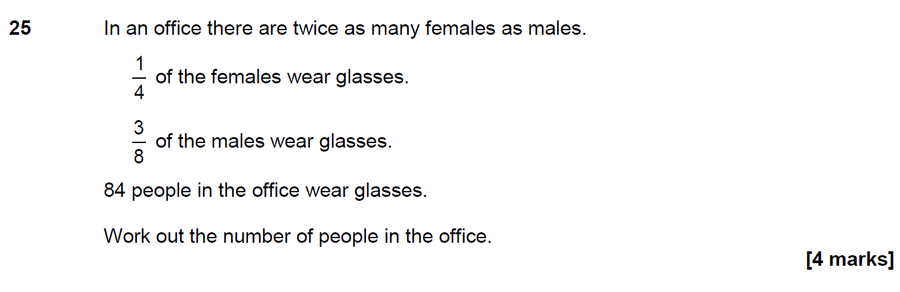
What maths do you see?
What maths would you want the students to see?
What maths might a Y6 see?
Can you represent this pictorially?
Higher tier AQA GCSE question
Notes:
Look at some KS2 SATs and GCSE questions
What is the maths that jumps out of this question?

Slide 14
M
F
F
Notes:
Look at some KS2 SATs and GCSE questions

Slide 15
M
F
F
84 people
Notes:
Look at some KS2 SATs and GCSE questions

Slide 16
M
F
F
84 people
Notes:
Look at some KS2 SATs and GCSE questions

Slide 17
7
24
84 people is
of the people in the office
7
24
=
84
?
7 x 12 = 84
24 x 12 = 288
There are 288 people in the office
M
F
F
12
84 people
Notes:
Look at some KS2 SATs and GCSE questions

Slide 18
24 x 12 = 288
There are 288 people in the office
M
F
F
12
84 people
Notes:
Look at some KS2 SATs and GCSE questions

Slide 19
Focus of the NCETM Year 5 – 8 Continuity Work Group
Improved teacher curriculum knowledge through collaboration
Shared pedagogical approaches through collaborative work
Systems established to continue and develop collaboration
Clear understanding of expectations for pupils
Children making continued progress
Children with positive attitudes to mathematics
Notes:
2 models running but with this common set of expectations which drove a common evaluation at the end of the project
Feedback has been positive so far and the final meeting of all the WG leads is next week
Project is going to run again next year so if you are interested then contact your local maths hub. Most are running the project. If not then please get in touch and I am happy to support a group of schools in a similar way.

Slide 20
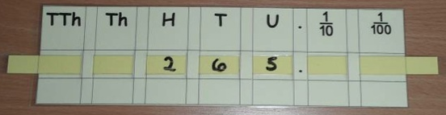
Year 7/10 Intervention
Mentor Guides
Place Value
Loop assessment
Numbers between (ordering)
Rounding
X and ÷ by 10, 100 and 1,000
Place Value Bingo
Final loop
Notes:
We didn’t look at these slides on the day but they are here in case you are interested.

Slide 21

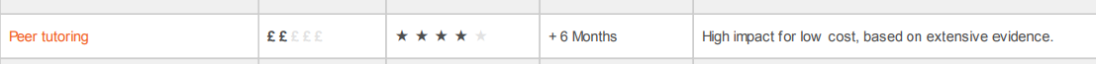
How we know mentoring works
Notes:
6 months more progress than the average child in class who does not receive peer tutoring

Slide 22
The project aims to:
foster a positive attitude to mathematics;
improve basic mathematical knowledge and understanding;
enable students to engage with and make progress within the KS3 Mathematics Curriculum;
improve fluency and recall of number facts (including times tables);
improve fluency in mental calculation strategies;
improve place value understanding (including decimals);
improve understanding of fractions, decimals and %;
improve knowledge of measures;
improve knowledge of properties of 2D shapes.
Collect some evidence of the impact of the intervention
by supporting students to:

Slide 23
How the activities work
They build towards a deeper understanding in each area of maths
They are progressive so need to be done in order
The skills learned in one activity will be applied in the next
Activities may be supported by suggested resources
Resources need to be understood by the mentor and the student if they are going to be effective
Activities are often games which the mentor plays with the Y7 student
Activities may only last for one session but may run into more than one if needed or be used in many sessions
Notes:
We talked to secondary colleagues about who to target, who would be a good mentor, what the mentors would get out of it and the logistics of setting up a trial

Slide 24
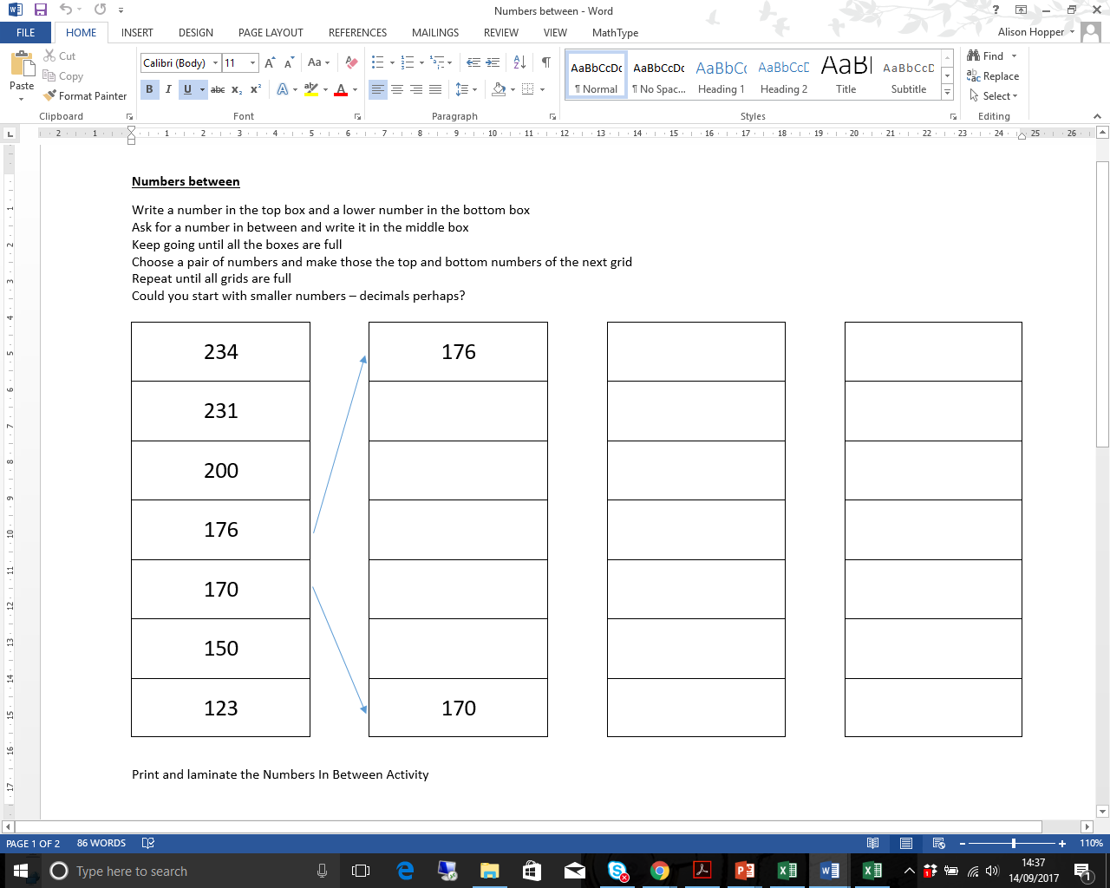
Place Value – Numbers Between
Year 7/10 Intervention
Mentor Guides
Aim
The aim of this activity is to find numbers which are between a pair of given numbers. As the activity continues, the numbers get closer together and decimals are needed.
Take two neighbouring numbers from the middle of the list to become the top and bottom numbers of the next list. Continue across the lists and add more if you want to!
Possible Difficulties
You might have to remind the student that there are numbers between whole numbers. You could use the place value slider from another of the activities to demonstrate this. You could also draw a number line and ask the student what numbers are between e.g. 171 and 172 on a number line.
Remember that the numbers are going from biggest to smallest down the list!
Your student may use whole numbers only until they run out. You might what to encourage them to use a different strategy next time.
Your student may not be confident with decimals. You could turn this into a game where you take it in turns to write numbers in the boxes. The first person to have to write a decimal loses. This way you could encourage the student to talk about decimals without having to use them if they are not confident.
Questions to Ask
Is there a big gap between these numbers?
Which pair of numbers would you choose to have the biggest gap?
Are there enough whole numbers to fill the boxes in between?
What will we have to do if there aren’t?
What would be the most difficult numbers to have in the top and bottom boxes? Why would those be difficult?
What number is half way between these numbers? How could we work it out?
Going Deeper
Encourage the student to start with a list of decimal numbers all with the same ‘ones’ digit e.g. 3.45, 3.76, 3.91 etc.
Notes:
You have this activity on your table.
This, after an assessment loop, is the start of the place value set of resources.

Slide 25
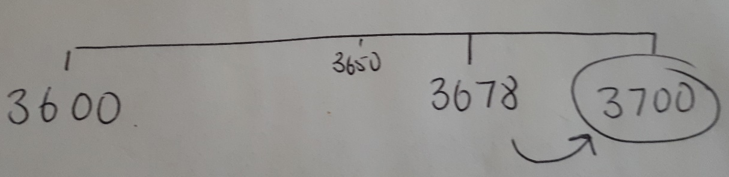
Place Value – Rounding Loop Cards
Year 7/10 Intervention
Mentor Guides
Possible Difficulties
Students may not remember to look at the digit to the right of the one they are rounding to
Positioning numbers on a number line between the multiples of 10/100/1 000 on either side can support students in thinking about which one the number is closest to.
e.g. 3 678 rounded to the nearest 100
Putting in the number which is half way can also support the student
Sometimes students, when rounding to the nearest hundred, ignore any higher value digits so 3 678 rounded to the nearest hundred could become 700 and not 3 700. The number line can again help to address this misunderstanding.
Aim
The aim of these cards is to practice rounding numbers.
The first set looks at rounding whole numbers to the nearest 10, 100 or 1 000
The second set involves rounding decimals to tenths, hundredths, 1 or 2 decimal places. This is a more challenging set of cards and may not be suitable for your student certainly at the start of your work on place value.
Questions to Ask
Which digit are you looking at when you are rounding to the nearest ten (or hundred or thousand)?
How do you decide whether to round up or down?
Is there a rule or a way of remembering?
Children may talk about the ‘High 5’ rule which is often taught in Primary Schools (5 and above rounds up, 4 and below rounds down)
When is it useful to round numbers?
Think about times when you need to estimate

Slide 26
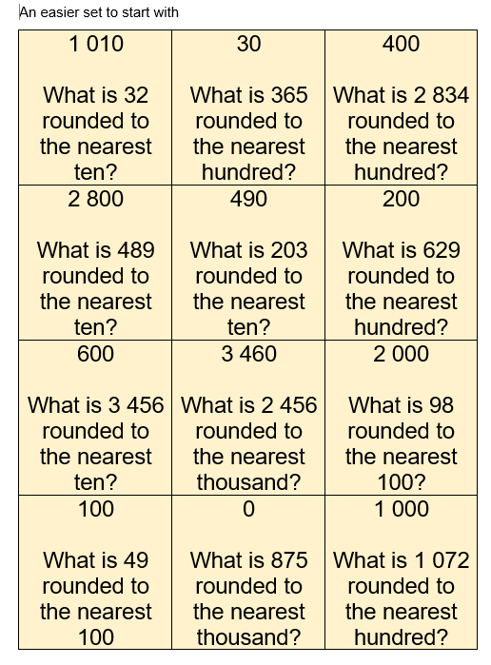
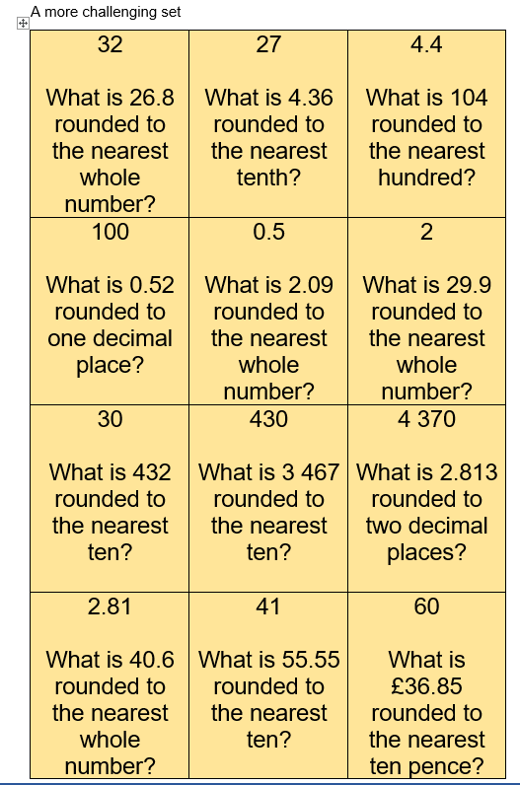
Notes:
Have a go and think about what skills and knowledge are being rehearsed.
Why might a student be struggling with this?
What will a gap here mean in the future?

Slide 27
Place Value – Place Value Slider
Year 7/10 Intervention
Mentor Guides
Aim
The aim of this resource is to secure understanding of moving the digits to multiply and divide by 10, 100 and 1 000 and to use the language of ‘ten times bigger’ ‘ten times smaller’ to describe what is happening.
Use the template to make the slider and ask your link teacher to have it laminated after the first session.
Once the slider is made, use the digit and function cards to practice multiplying and dividing by 10, then by 100, then by 1 000 and then by mixing up all the cards.
Some students may need lots of practice of each one individually before they are confident enough to mix up the 10, 100 and 1 000 cards. Take your time!
Possible Difficulties
Students may find it more difficult when there are place holding zeroes in the numbers. You need to make sure that they have understood that the order of the digits in the original number stays the same so e.g. The ‘0’ will always be between the ‘4’ and the ‘3’ whether the ‘4’ is in the Thousands, Hundreds, Tens, Ones column etc.. The ‘403’ will always be together.
Students may talk about ‘adding a zer0’ or ‘taking away a zero’. This works some of the time but not when decimals are involved. Encourage them to talk about ‘moving the digits’ rather than adding and taking away noughts.
Questions to Ask
What happens to the digits in the number when you multiply/divide by 10/100/1 000?
What is changing? (Point out that the value of the digit changes when it moves position)
What is staying the same? (Point out that the order of the original digits stays the same)
What calculation would you need to do to get back to the number you started with?
How many times bigger/smaller is your final number from your starting number?
What do you notice about the zeroes in your number?

Slide 28
Place Value – Place Value Chart
Year 7/10 Intervention
Mentor Guides
Aim
The aim of this activity is to encourage the student to see the patterns when multiplying and dividing by 10, 100 and 1,000. Encourage them to talk about what they can see and how the same pattern applies whether it they are working with whole numbers or decimals. The activities are then designed to encourage them to apply what they have noticed to solve simple problems.
The activity requires the student to fill in empty boxes to complete calculations starting.
You could encourage the student to use the Place Value Slider alongside the chart.
Possible Difficulties
The student may be able to see the pattern of adding/removing zero but not see that the numbers are moving columns to the left and right.
Make sure that they can explain what is happening when decimals are involved. If this is difficult, stick to the whole number part of the chart to start with.
The student may not see that moving the digit makes it ten times bigger because it is now two 10s and not two 1s etc.
Encourage them to say, for example:
‘When we multiply by 10, the digits move one place to the left and we add a zero if it is needed’
‘When we divide by 100, the digits move two places to the right’
You may need to ask for some place value resources to support this such as dienes.
Questions to Ask
What patterns can you see in the chart?
Why do you think this happens?
What do you notice about the numbers you have chosen to complete the calculation?
What numbers would you have to choose if you were multiplying/dividing by [10, 100, 1,000]?
When is it not ok to say ‘You just add/take a way zero’?
1000 | 2000 | 3000 | 4000 | 5000 | 6000 | 7000 | 8000 | 9000
100 | 200 | 300 | 400 | 500 | 600 | 700 | 800 | 900
10 | 20 | 30 | 40 | 50 | 60 | 70 | 80 | 90
1 | 2 | 3 | 4 | 5 | 6 | 7 | 8 | 9
0.1 | 0.2 | 0.3 | 0.4 | 0.5 | 0.6 | 0.7 | 0.8 | 0.9
0.01 | 0.02 | 0.03 | 0.04 | 0.05 | 0.06 | 0.07 | 0.08 | 0.09
0.001 | 0.002 | 0.003 | 0.004 | 0.005 | 0.006 | 0.007 | 0.008 | 0.009

Slide 29
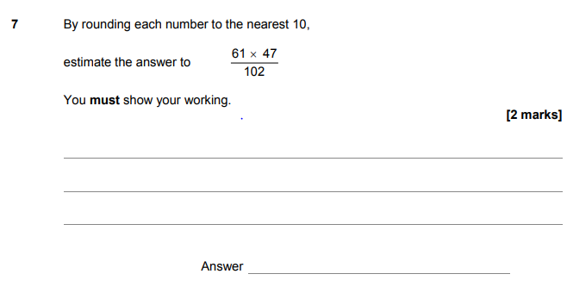
At GCSE
Notes:
Need to decide whether to start with the GCSE question and work back to KS2 or start in KS2 and work up?
Think that starting with the GCSE will make the secondary audience feel more ‘at home’ then we can move into the less familiar territory of KS2 maths
Rounding seeds are sown in Y2 and formally in Y3
Multiples of 10 start in Y1
Using place value to x/div by 10 and 100 starts in Y4
Multiplying 60 x 50 and dividing 3000 by 100 would be a Y5 expectation
Way it is written with the horizontal line is really the only bit that is beyond Y5 maths here
The report on this paper states:
Question 7 Most students did attempt an estimate although some attempts at a full accurate calculation were seen. It was quite common to see an error in the calculation 60 × 50 with very few ‘cancelling zeros’ to make the calculation easier.

Slide 30
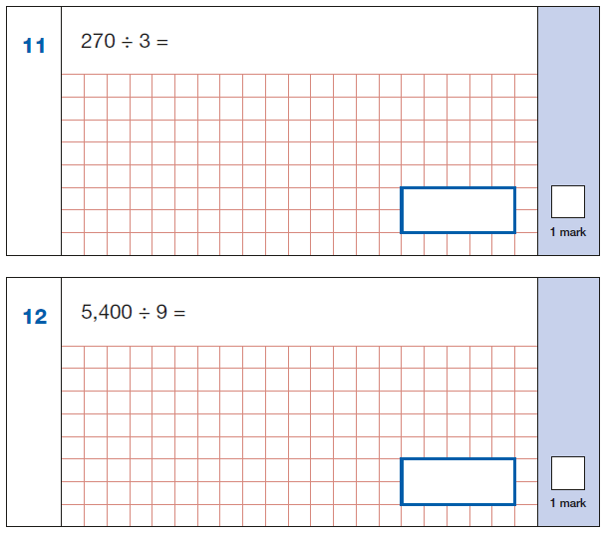
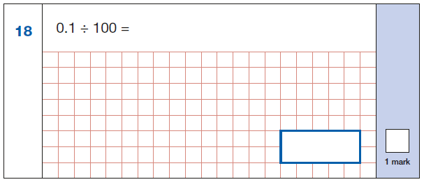
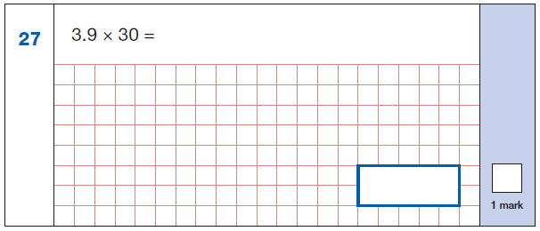
The importance of reasoning:
Think before you calculate!
Notes:
From KS2 arithmetic paper 2018
It’s not just about number crunching
There is a clear move in KS2 SATs papers towards reasoning
The arithmetic paper is no longer just a chance to show off your written calculation strategies and successful students look at the numbers involved before then dive into a written method as there is often a simpler way. Spotting these questions save them time which can then be spent on the inevitable long multiplication and division questions later in the paper.

Slide 31
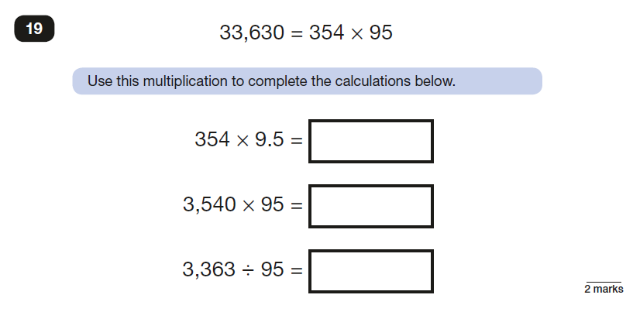
Notes:
Reasoning – using what you know to work out what you don’t
Understanding the structures of multiplication and division and what happens when you change the scale of a factor or a divisor

Slide 32
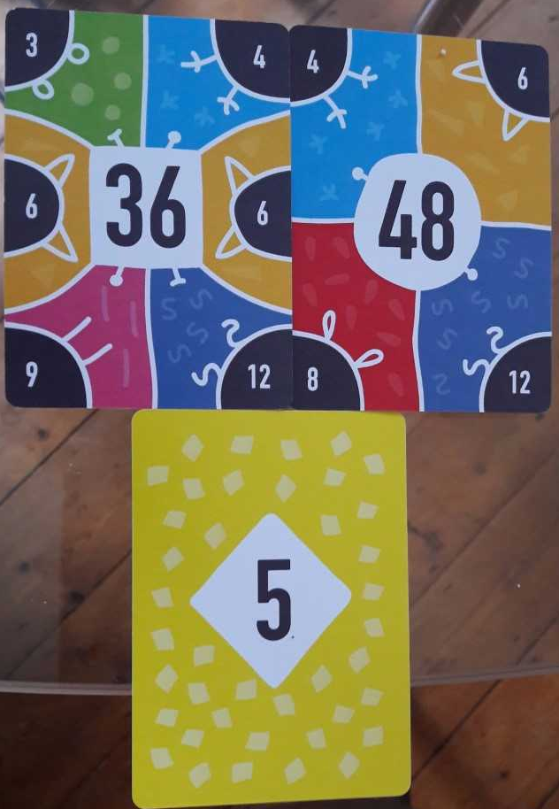
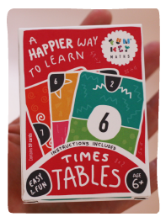
FunKey Maths

Slide 33
About MEI
Registered charity committed to improving mathematics education
Independent UK curriculum development body
We offer continuing professional development courses, provide specialist tuition for students and work with employers to enhance mathematical skills in the workplace
We also pioneer the development of innovative teaching and learning resources

