Slide 1
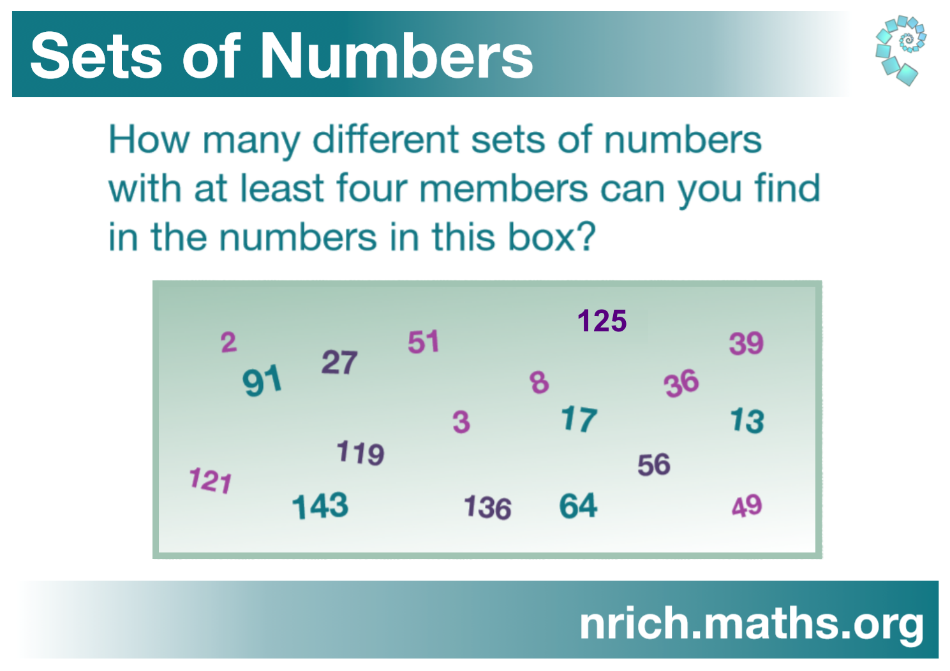
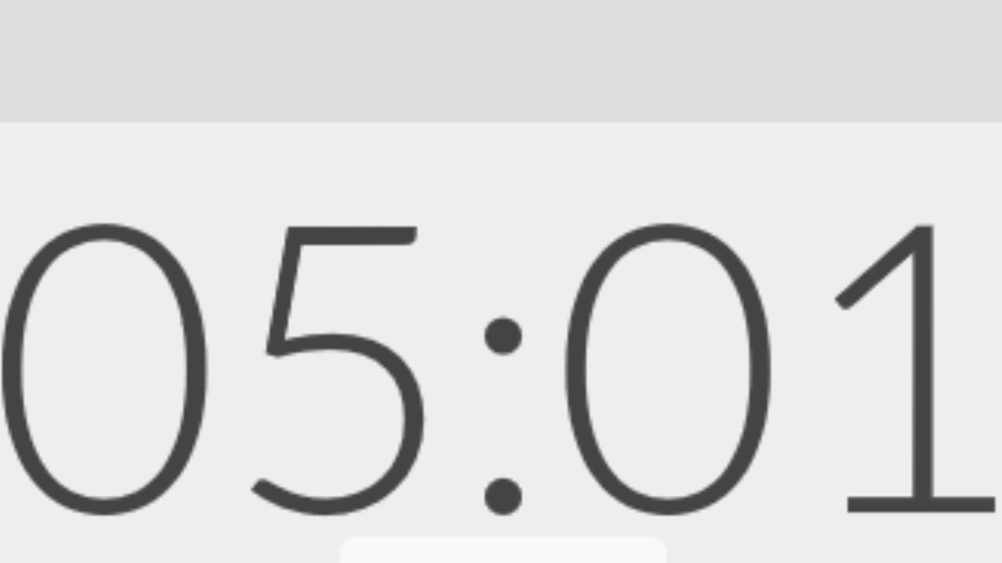
NRICH Webinar warm-up task
The webinar will start in:

Slide 2
Neighbourly Addition
7+9+11=27
15+17+19=51
What other totals can you make by adding together three consecutive odd numbers?
What do you notice about your totals?

Slide 3
When I add together three consecutive odd numbers, the total is always:
  odd
  a multiple of three.
Can you explain why?
What other mathematical questions could you explore?

Slide 4
Thank you for participating
Find the live task at nrich.maths.org/housenumbers
Send us your thoughts and solutions by Monday 8 July

