Slide 1
Mathematical Reasoning, Justification & Proof
PTI New Teachers’ Day
London – January 2024
Charlie Gilderdale
cfg21@cam.ac.uk

Slide 2
nrich.maths.org/pti2024

Slide 3
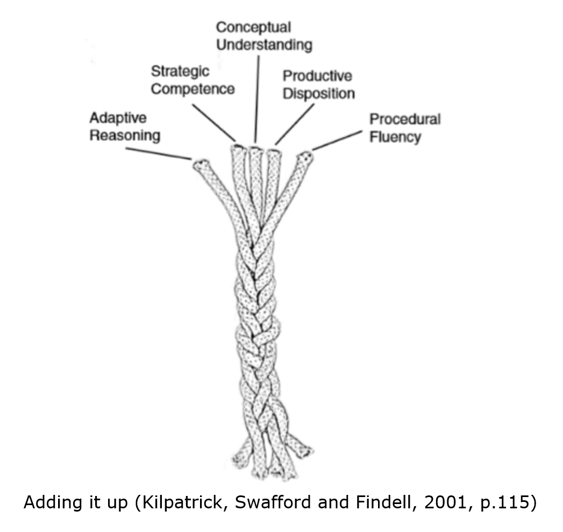
Mathematical Proficiency
Notes:
Our vision, reminder…

Slide 4
Conceptual understanding -
comprehension of mathematical concepts, operations, and relations
Procedural fluency -
skill in carrying out procedures flexibly, accurately, efficiently, and appropriately
Strategic competence -
ability to formulate, represent, and solve mathematical problems
Adaptive reasoning -
capacity for logical thought, reflection, explanation, and justification
Productive disposition -
habitual inclination to see mathematics as sensible, useful, and worthwhile, coupled with a belief in diligence and one’s own efficacy.

Slide 5
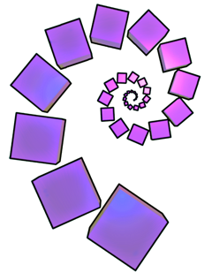
Thank you

