Slide 1
Summing consecutive numbers
15 = 7 + 8 15 = 4 + 5 + 6 15 = 1 + 2 + 3 + 4 + 5

Slide 2
Which countries have the most naturally athletic populations?
We could check out the London 2012 Olympics final medal table…

Slide 3
Egyptian Fractions
Unit fractions (fractions which have numerators of 1)
can be written as the sum of two different unit fractions...
e.g. ½ = ⅓ + ⅙

Slide 4
Take Three from Five
Can you come up with a set of five whole numbers that don't include a subset of three numbers that add up to a multiple of 3?

Slide 5

Odds and Evens
Here is a set of numbered balls used for a game:
To play the game, the balls are mixed up and two balls are randomly picked out together.
The numbers on the balls are added together.
If the total is even, you win. If the total is odd, you lose.
Is the game fair?

Slide 6
Find your partner
Your partner has either half your number or twice your number…
If you are a multiple of 3, go to one corner of the room.
If you are 1 more than a multiple of 3, go to a different corner.
If you are 2 more than a multiple of 3, go to a third corner.
Where is your partner?

Slide 7
Litov’s Mean Value Theorem
Start with two numbers, say 8 and 2.
Let's generate a sequence where the next number is the mean of the previous two numbers.
So the sequence continues: 8, 2, 5, 3.5, …
What would happen if you continued this process indefinitely?

Slide 8
What’s Possible?
Many numbers can be expressed as the difference of two perfect squares.
For example:
12 = 4² – 2²
40 = 7² – 3²

Slide 9
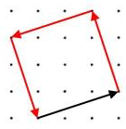
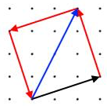
Vector Journeys
Imagine you like to go for walks around a square park…
Imagine your friend likes to walk across parks diagonally…

Slide 10
Pythagorean Triples x² + y² = z²
A partial list of ordered primitive Pythagorean Triples
x | y | z
3 | 4 | 5
5 | 12 | 13

Slide 11
Pythagorean Triples x² + y² = z²
Another partial list of ordered primitive Pythagorean Triples
x | y | z
8 | 15 | 17
12 | 35 | 37

Slide 12
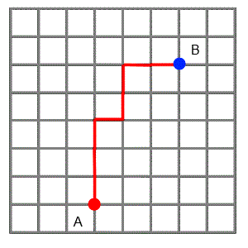
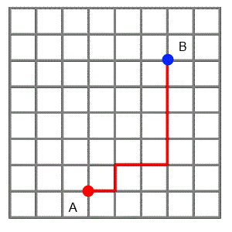
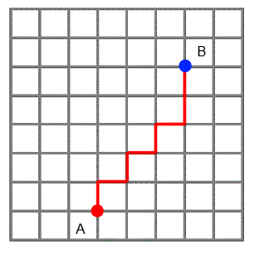
Getting Round the City
The grid below represents a city laid out in "blocks" with all the roads running north-south, or east-west.
The red line shows three ways of getting from A to B.

Slide 13
Same Number!
Write down a whole number between 1 and 1000.
Do you think it's likely that everyone's number will be different?

