Slide 1
NRICHing the Secondary Curriculum
nrich.maths.org/ukmt2016

Slide 2
Completing Quadrilaterals
Join dots on each grid to make the named quadrilateral. You must use the side given, you can't shorten or extend it. If there is more than one possibility, try to find the one with the largest area.
Solution

Slide 3
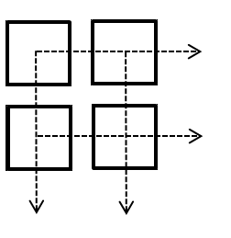
Add to 200
Choose any four digits and place them in the cells.
Read the two 2-digit numbers across and add them together. Read the two 2-digit numbers down and add them too. Then add these two totals together.
Can you make a total of 200? How many ways are there of doing this?

Slide 4
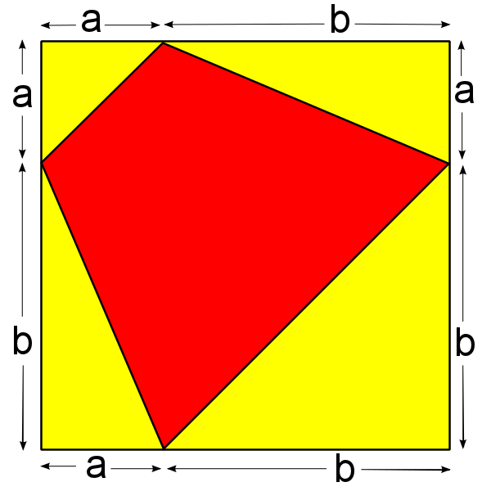
Quadrilaterals in a Square

Slide 5
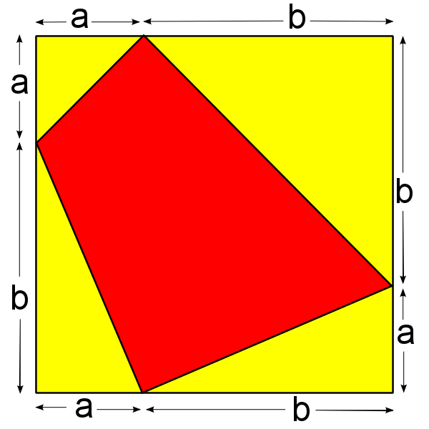

Slide 6
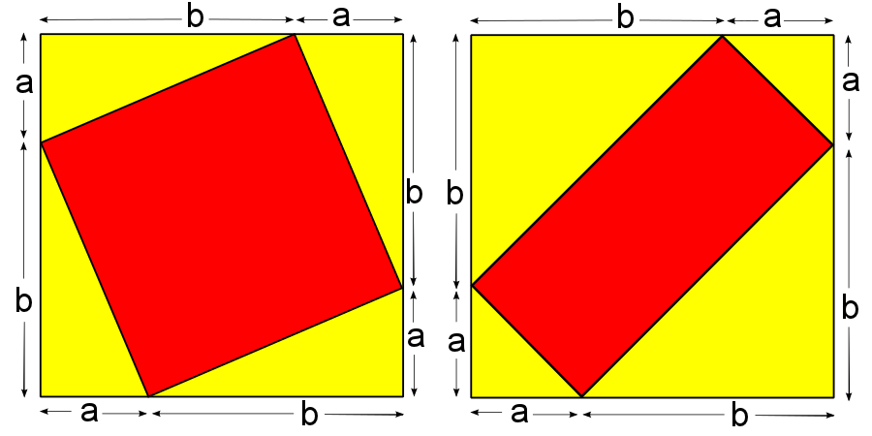

Slide 7
Wipeout
1, 2, 3, 4, 5, 6

Slide 8
Keep in touch!
nrich.maths.org/newsletter
twitter.com/nrichmaths
facebook.com/nrichmaths
youtube.com/nrichmaths

