Slide 1
If you want to build higher, dig deeper

Slide 2
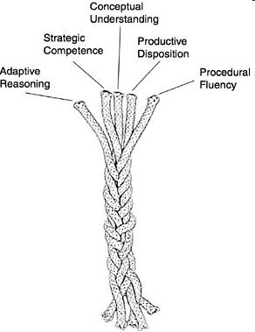
Five strands of mathematical proficiency
NRC (2001)
Adding it up: Helping children learn mathematics

Slide 3
Conceptual understanding -
comprehension of mathematical concepts, operations, and relations
Procedural fluency -
skill in carrying out procedures flexibly, accurately, efficiently, and appropriately
Strategic competence -
ability to formulate, represent, and solve mathematical problems
Adaptive reasoning -
capacity for logical thought, reflection, explanation, and justification
Productive disposition -
habitual inclination to see mathematics as sensible, useful, and worthwhile, coupled with a belief in diligence and one’s own efficacy.

Slide 4
Enriching the secondary curriculum:
http://nrich.maths.org/enriching

Slide 5
Engaging learners
Consolidating with rich tasks to:
  Develop fluency
  Deepen understanding
  Build connections

Slide 6
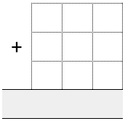
Dicey operations
Find a partner and a 1-6 dice,
or preferably a 0-9 dice.
Each of you draw an addition grid.
Take turns to throw the dice and decide which of your cells to fill - either fill in each cell as you throw the dice or collect all your numbers and then decide where to place them.
Throw the dice nine times each until all the cells are full.
Whoever has the sum closest to 1000 wins.

Slide 7
Mind Reader?
Choose any two digit number, add together both digits and then subtract the total from your original number…
http://www.flashlightcreative.net/swf/mindreader/
Always a Multiple?
http://nrich.maths.org/7208

Slide 8
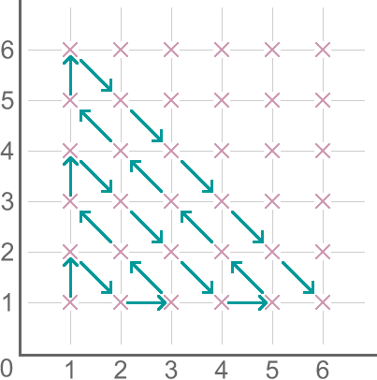
Route to Infinity
Which point will it visit after (18,17)?
How many points will it visit before reaching (9,4)?

Slide 9
M, M and M
Can you find five positive whole numbers
that satisfy the following properties:
Mean = 4
Mode = 3
Median = 3
Can you find all the different sets of five positive whole numbers that satisfy these conditions?
Notes:
Rationale: Working collaboratively in pairs. The answer is not immediately obvious, so students can be invited to convince each other, highlighting the importance within the mathematical community of explaining and justifying your ideas to others. Convince yourself…

Slide 10
Underlying principles
Consolidation tasks can address both content and process skills.
Rich tasks can replace routine textbook tasks, they are not just an add-on for students who finish first.

Slide 11
Break

Slide 12
Valuing mathematical thinking
If I ran a school, I’d give all the average grades to the ones who gave me all the right answers, for being good parrots. I’d give the top grades to those who made lots of mistakes and told me about them and then told me what they had learned from them.
Buckminster Fuller, Inventor
Notes:
Possible examples:
Make 37
Odds and Evens
Mention TIRED

Slide 13
Mathematics is not a spectator sport
Exploring
→ Noticing Patterns
→ Conjecturing
→ Generalising
→ Explaining
→ Justifying
→ Proving
Notes:
Low Threshold, High Ceiling tasks:Offer students genuine choice Give all students the chance to work mathematically
Creativity in English – reading others’ work and writing work of your own. Creativity in maths – as well as being exposed to important mathematical results, creating mathematics of your own. LTHC – everyone has the right to get stuck and make mistakes in a safe environment, everyone has an entitlement to work mathematically.

Slide 14
  Valuing mathematical thinking
    Thinking strategically
    Exploring and Justifying
    Reasoning and Convincing

Slide 15
Thinking Strategically

Slide 16
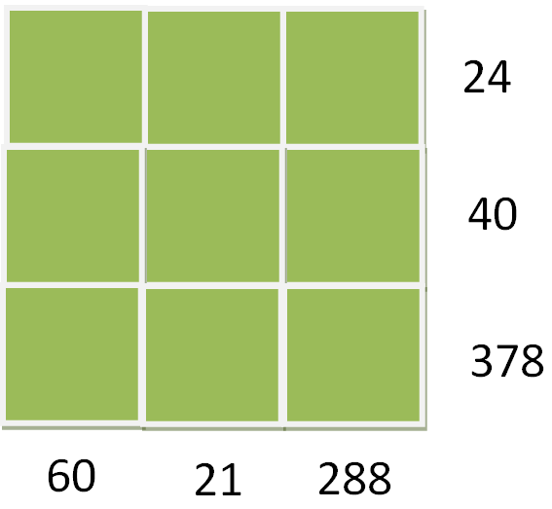
Gabriel’s Problem

Slide 17
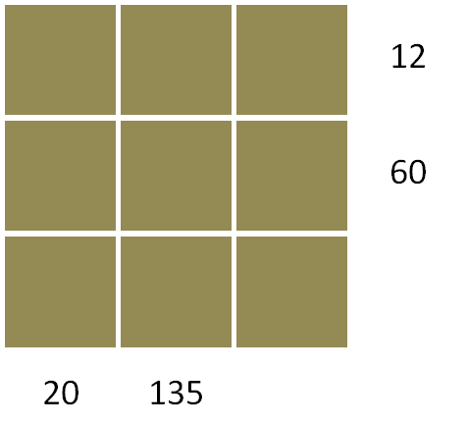
For this grid, Gabriel used the numbers
1, 2, 3, 4, 5, 6, 9, 10 and 12.

Slide 18
Reflecting Squarely

Slide 19
The Factors and Multiples Game
A game for two players.
You will need a 100 square grid.
Take it in turns to cross out numbers, always choosing a number that is a factor or multiple of the previous number that has just been crossed out.
The first person who is unable to cross out a number loses.
Each number can only be crossed out once.
Notes:
19

Slide 20
The Factors and Multiples Challenge
This time, try to find the longest sequence of numbers that can be crossed out.
Again, choose a number that is a factor or multiple of the previous number that has just been crossed out.
Each number can only appear once in a sequence.

Slide 21
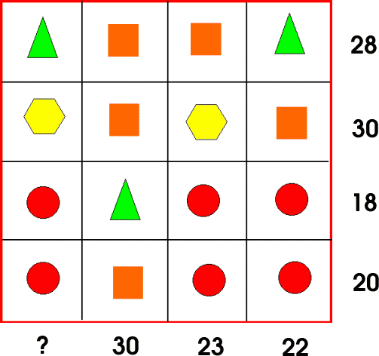
What’s it Worth?
Each symbol has a numerical value.
The total for the symbols is written at the end of each row and column.
Can you find the total of the first column?
Notes:
Once one solution has been found: “Can you find the solution in a different way?” then “Here are eight different starting points for solutions, can you finish them all off?” (worksheet in TN) Finally, discuss which approaches are most elegant, pleasing, whatever.
Rationale for using What’s it Worth?
The main focus is not the solution but the approaches taken. We are interested in reasoning and justification, and people being able to make sense of each other’s thinking.

Slide 22
Follow-up material on
NRICH spreadsheet

Slide 23
Lunch

Slide 24
Exploring and Justifying

Slide 25
The most exciting phrase to hear in science, the one that heralds new discoveries, is not Eureka!, but rather,
“hmmm… that’s funny…”
Isaac Asimov
mathematics

Slide 26
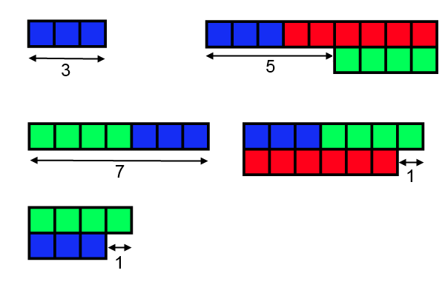
Combining Lengths

Slide 27
Pythagorean Triples x² + y² = z²
A partial list of ordered primitive Pythagorean Triples
x | y | z
3 | 4 | 5
5 | 12 | 13
7 | 24 | 25
8 | 15 | 17
9 | 40 | 41
12 | 35 | 37

Slide 28
Pythagorean Triples x² + y² = z²
A partial list of ordered primitive Pythagorean Triples
x | y | z
3 | 4 | 5
5 | 12 | 13
7 | 24 | 25
9 | 40 | 41

Slide 29
Pythagorean Triples x² + y² = z²
A partial list of ordered primitive Pythagorean Triples
x | y | z
8 | 15 | 17
12 | 35 | 37

Slide 30
Break

Slide 31
Reasoning and Convincing

Slide 32
Dozens http://nrich.maths.org/559

Slide 33
Unequal Averages
Can you find five positive whole numbers
that satisfy the following properties:
Mean = Mode = Median = Range
Notes:
Rationale: Working collaboratively in pairs. The answer is not immediately obvious, so students can be invited to convince each other, highlighting the importance within the mathematical community of explaining and justifying your ideas to others. Convince yourself…

Slide 34
Can you find five positive whole numbers
that satisfy the following properties:
Mode < Median < Mean
Mode < Mean < Median
Mean < Mode < Median
Mean < Median < Mode
Median < Mode < Mean
Median < Mean < Mode
Notes:
Rationale: Working collaboratively in pairs. The answer is not immediately obvious, so students can be invited to convince each other, highlighting the importance within the mathematical community of explaining and justifying your ideas to others. Convince yourself…

Slide 35
Five strands of mathematical proficiency
NRC (2001)
Adding it up: Helping children learn mathematics

Slide 36
What can we offer learners?
low threshold, high ceiling tasks
opportunities to exhibit their thinking and refine their understanding
a conjecturing culture where it is OK to make mistakes
a careful use of guiding questions and prompts
opportunities to practice skills in an engaging way: HOTS not MOTS
frequent opportunities for talk (about maths)
teachers who model mathematical behaviour
teachers who emphasise mathematical behaviours that they wish to promote.

Slide 37
Guy Claxton’s Four Rs
Resilience: being able to stick with difficulty and cope with feelings such as fear and frustration.
Resourcefulness: having a variety of learning strategies and knowing when to use them.
Reflection: being willing and able to become more strategic about learning. Getting to know our own strengths and weaknesses.
Reciprocity: being willing and able to learn alone and with others.

Slide 38
Reflecting on today: the next steps
    Think big, start small
    Think far, start near to home
    A challenge shared is more fun

Slide 39
What next?
Enriching the secondary curriculum:
http://nrich.maths.org/enriching
Teachers can Register for our half-termly newsletter

Slide 40
I don't expect, and I don't want, all children to find mathematics an engrossing study, or one that they want to devote themselves to either in school or in their lives. Only a few will find mathematics seductive enough to sustain a long term engagement. But I would hope that all children could experience at a few moments in their careers ... the power and excitement of mathematics ... so that at the end of their formal education they at least know what it is like and whether it is an activity that has a place in their future.
David Wheeler

