Slide 1
Mastery for LA Learners NRICH/Parents/Reasoning
Tuesday 13th October 2015
David Joyce
North Harringay Primary School

Slide 2

A worrying trend in school was a stubbornly large group of lower achievers.

Slide 6
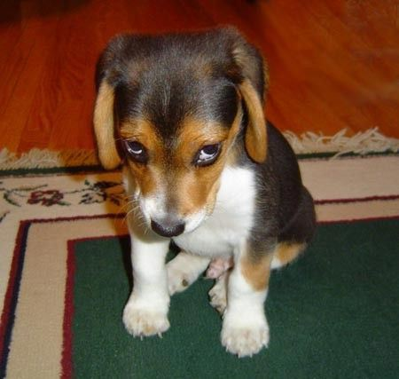


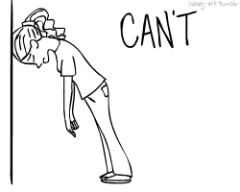



Causes

Slide 7

Leading on from developing self-assessment to reasoning in Maths and explaining.
“Is like….when you…..”

Slide 8
After many years watching and designing mathematics lessons, it has become clear to me that most of the attention is on 'answer-getting', not on improving the quality of the reasoning.
As soon as pupils get the answer, they are moved onto a fresh problem, they don't reflect much on the process they went through.
Reasoning is not improved because it does not become the object of attention.
Most reasoning remains invisible it stays inside people's heads.
In order for students to improve their reasoning, it needs to be made visible and audible through oral or written explanations.
Malcolm Swan, NRICH, Cambridge University.

Slide 9

What is ________________?
Why is it _______?
Freak out!
The great Reasoning movement began…

Slide 10

You are absolutely correct.
Well done. Now, why are you correct?
Or
Why is she correct?

Slide 11
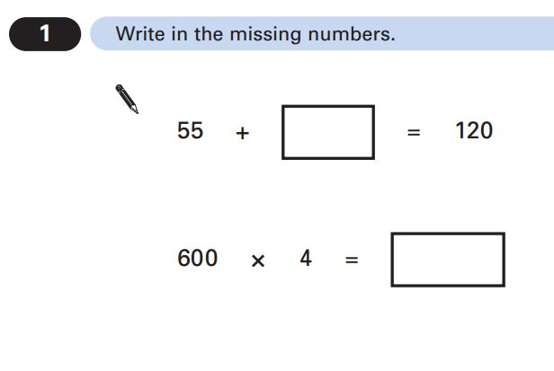
Okay, prove it!

Slide 12
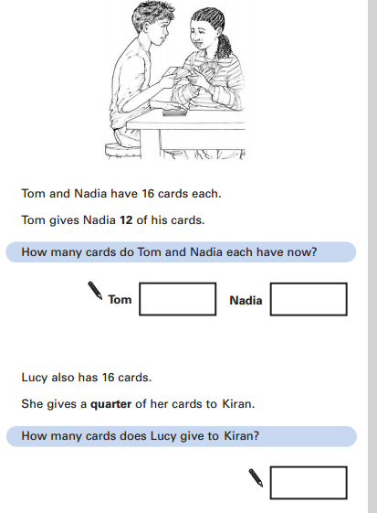
I don’t care what the answer is, just tell me how to go about getting it…
No, no. Tell me what to do!

Slide 13
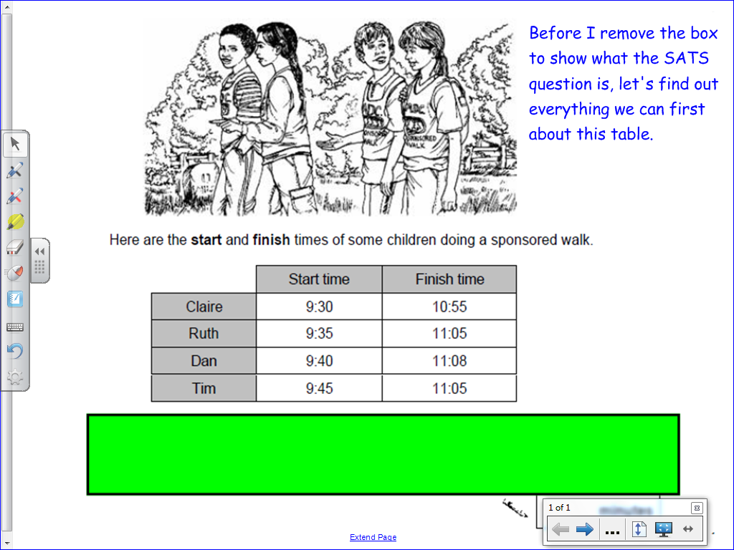

Slide 14
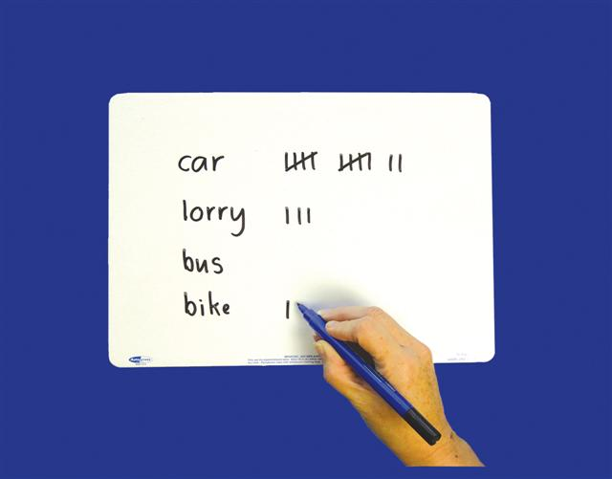
Tip Time!
Write your tip on your whiteboard
then give your whiteboard to another
person to read out.

Slide 15
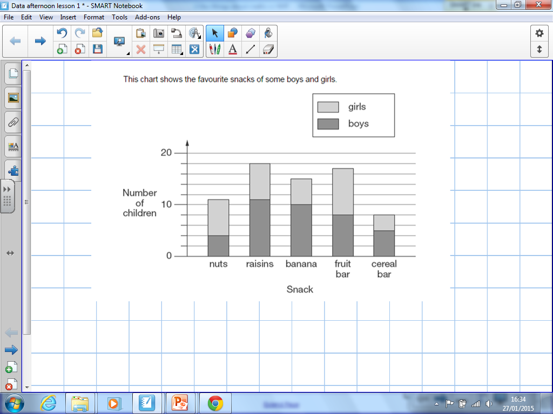

Slide 16
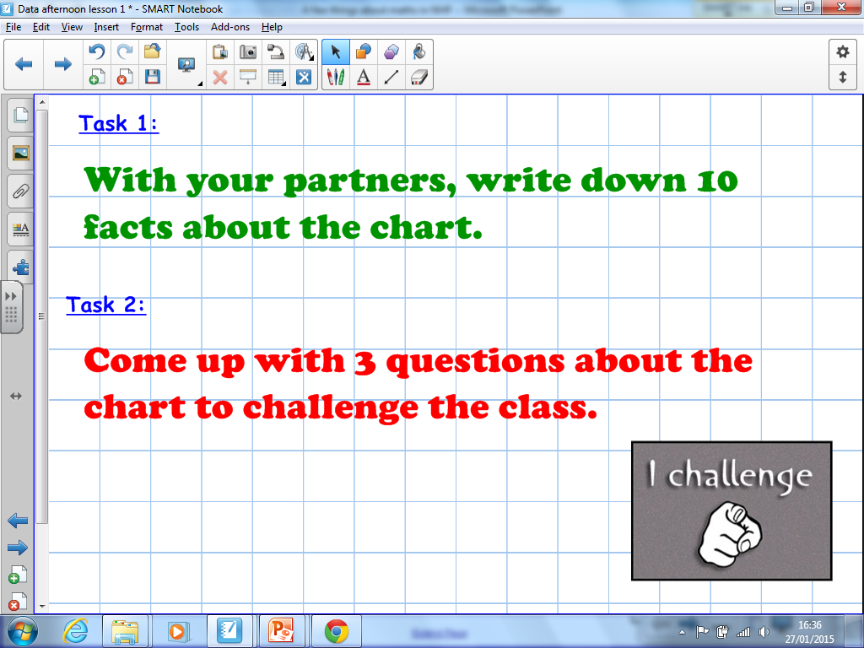

Slide 17
In a problem:
Reasoning is necessary when:
The route through the problem is not clear
There are some conflicts in what you are given or know
There are some things you don’t know
There is no structure to what you’re given
There are different possible solutions
All of which require mental work….

Slide 18
Reasoning is…
A critical skill to knowing and doing maths
Enabling – it allows children to make use of all the other mathematical skills – it’s the glue that helps maths to make sense.

Slide 19

Progression in reasoning
Step 1: Describing
Step 2: Explaining
Step 3: Convincing
Step 4: Justifying
Step 5: Proving

Slide 20
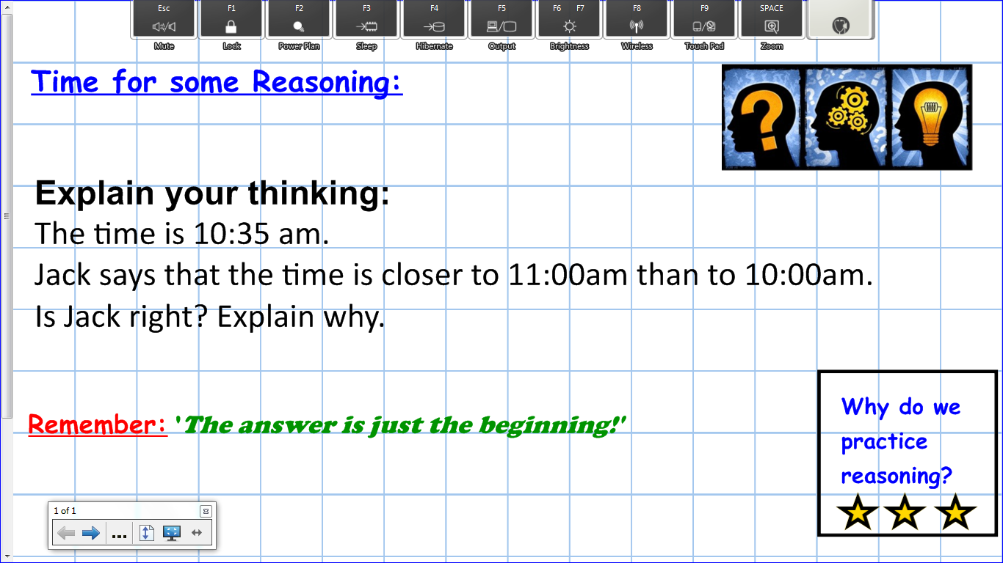
Scaffold for staff

Slide 21
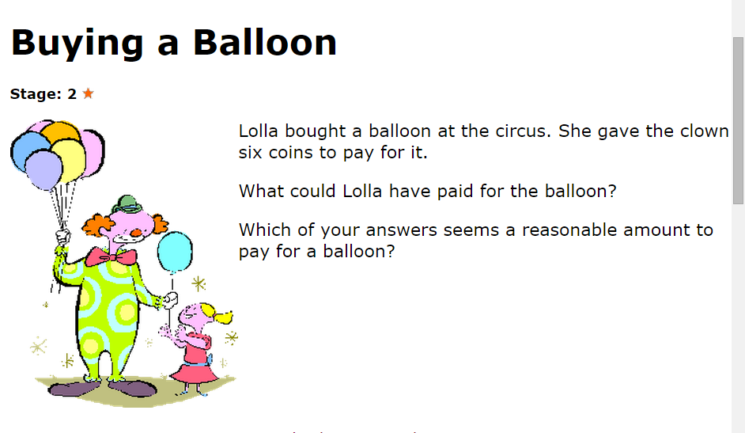
Let’s look at some activities.

Slide 22
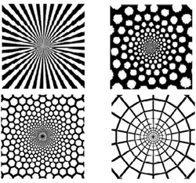
‘The search for pattern’
Try using only 1p or 5p coins – what combinations do you come up with.
Now try using only 1p and 10p coins – do you see a pattern?

Slide 23

Pupil premium parent group
NRICH exposes the same weaknesses amongst the parents as we see in the classroom –
ability to reason
understanding written English
choosing strategies
simple willingness to have a go
fear of failure – trial & improvement
confusion
following instructions.
NRICH tasks lend themselves wonderfully to English language training as there is so much to draw out from a problem and discuss.

Slide 24
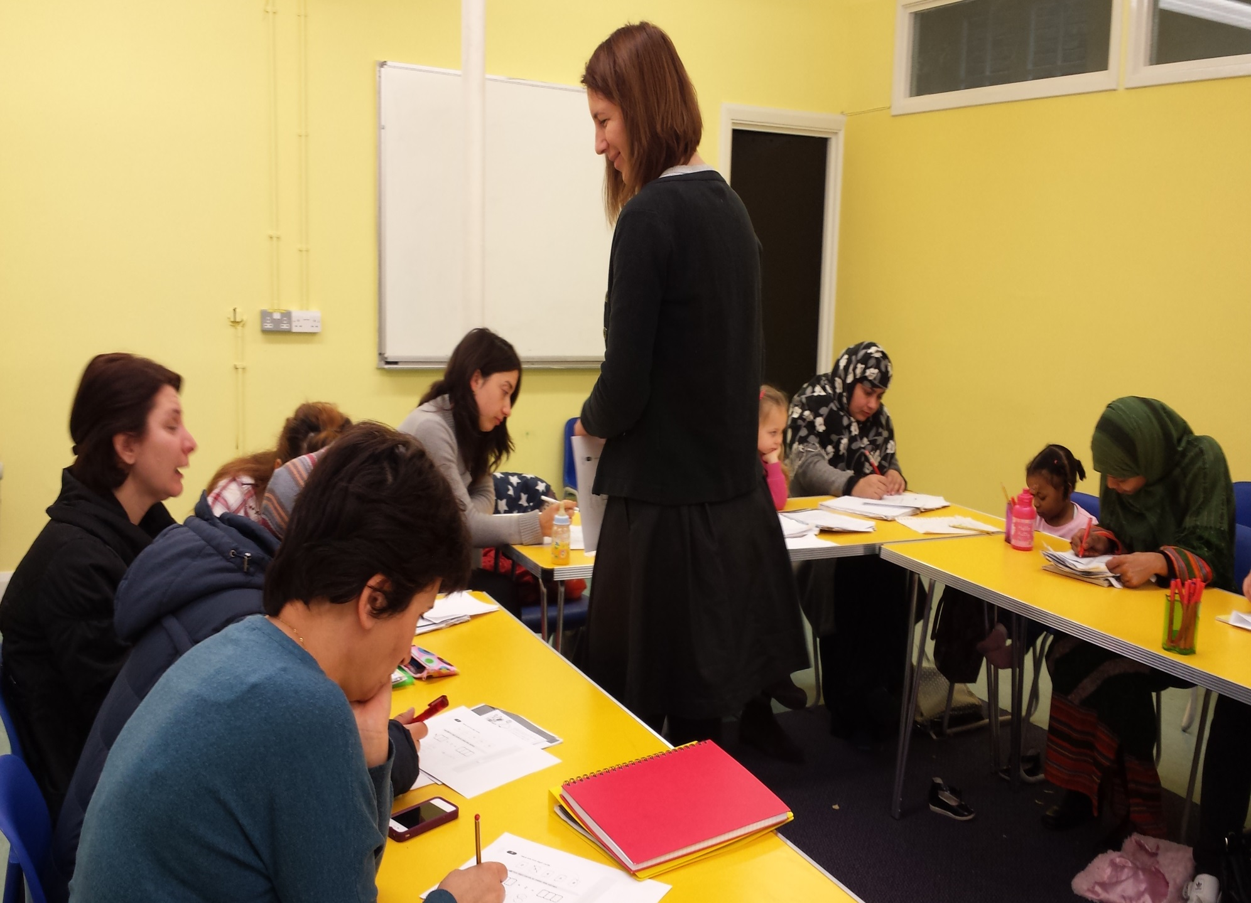

Slide 25
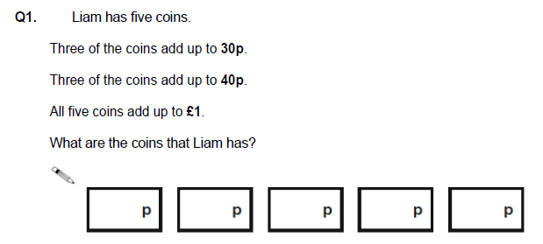
Using & Applying

Slide 26
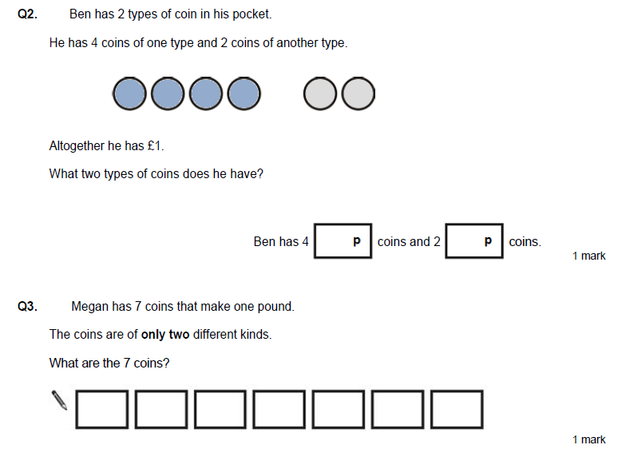

Slide 27
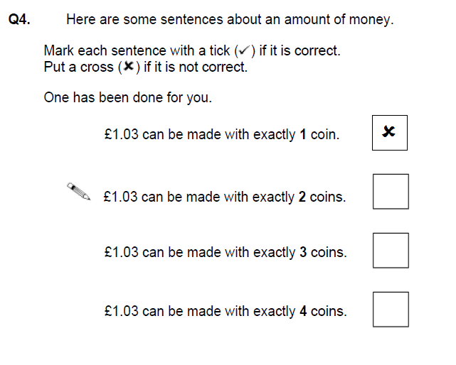
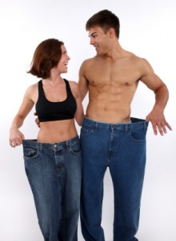
Reasoning - Prove it!
Before & Now

Slide 28
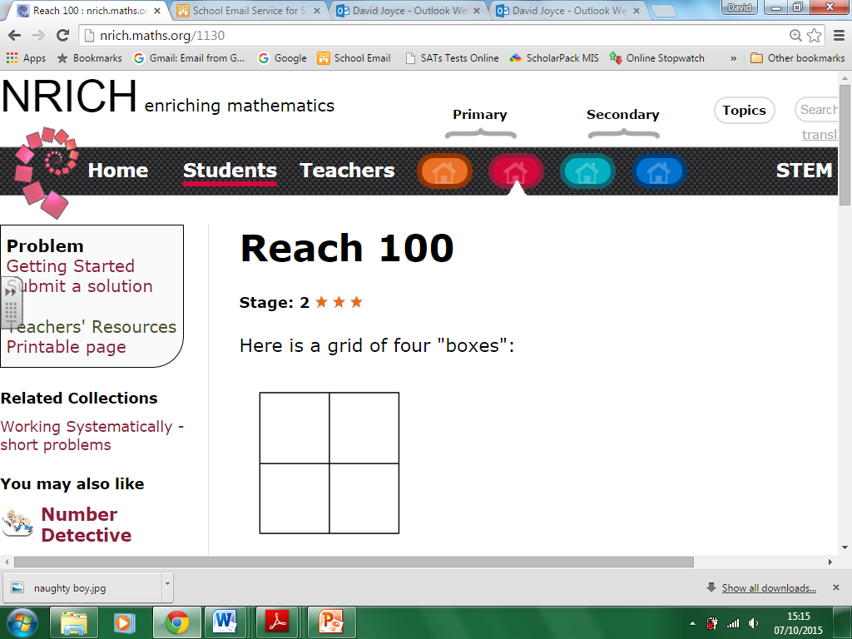
Perseverance

Slide 29
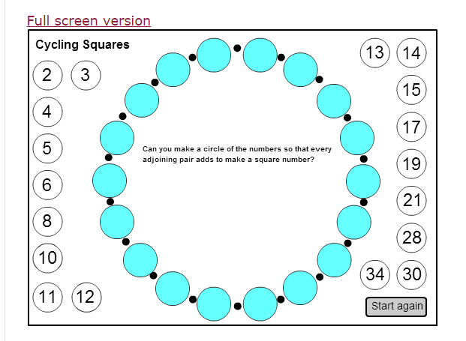
Cycling Squares

Slide 30
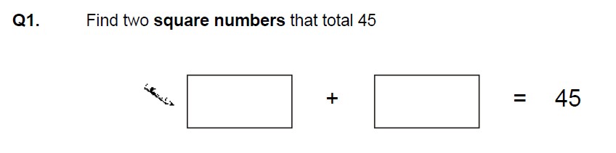
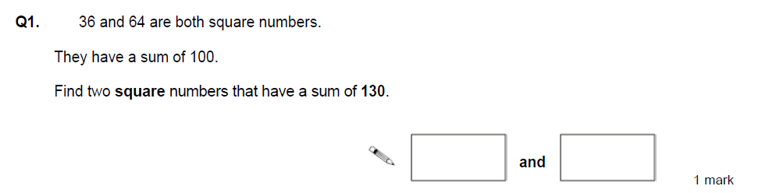
Using & Applying

Slide 31
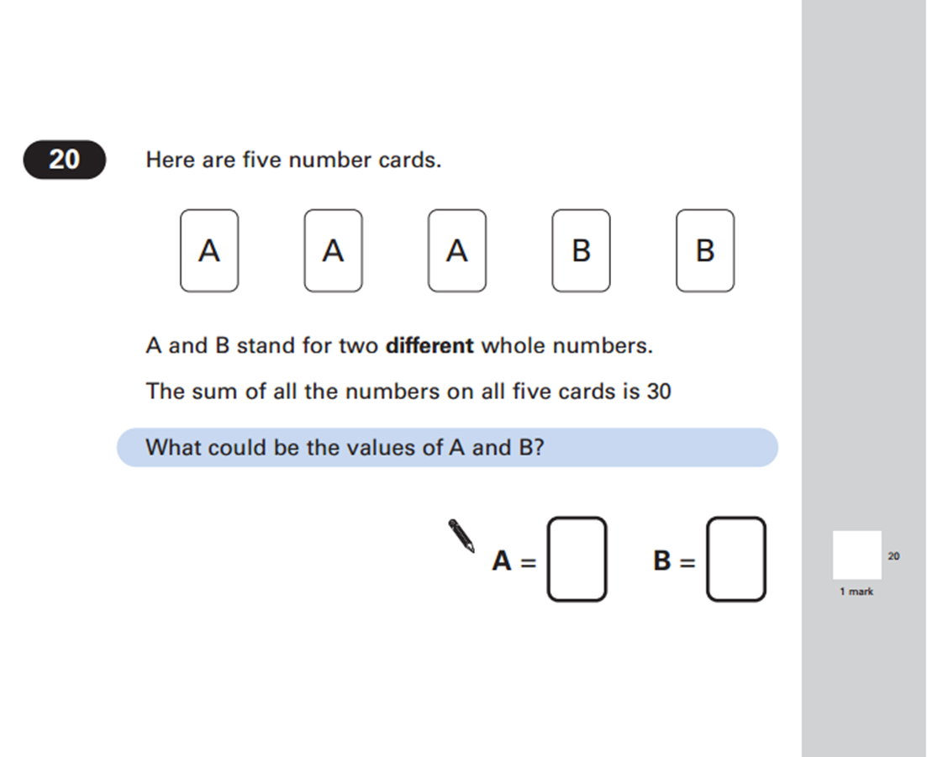

Slide 32

The results.
Key Stage 1:
Maths
Level 3 28.9%
Level 2B+ 83%
Level 2C+ 93.2%
From 2014-2015
14% increase in children achieving Level 3 in maths.
Key Stage 2:
From 2014-2015
Level 4+ 88%
Level 4B+ 80%
Level 5 41%
19% increase in children achieving Level 4+ in maths.
Exceeding or equalling national average in all three.

Slide 33
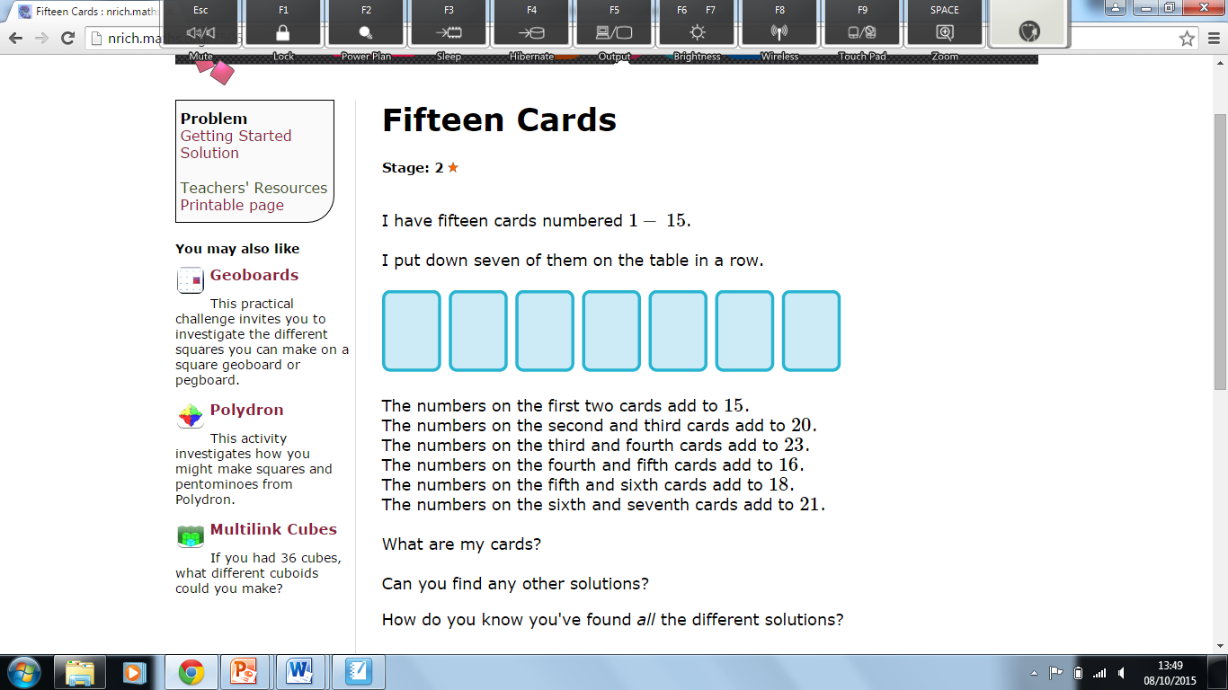

Slide 34
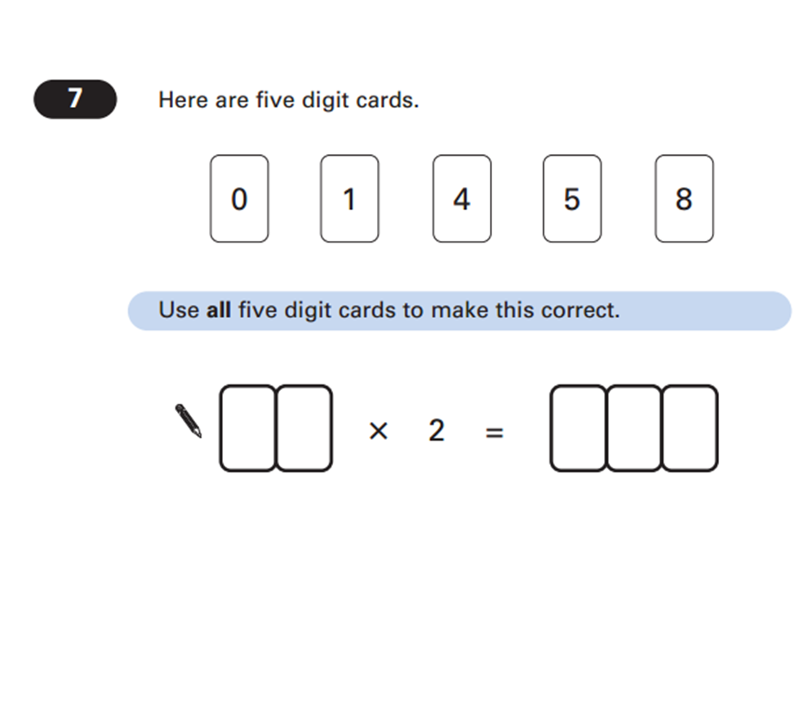
Parents

Slide 35
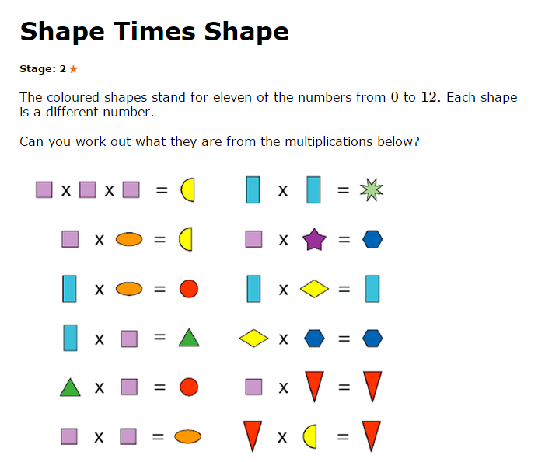

Slide 36
Using & Applying

Slide 37
