Slide 1


Key Stage 1 Maths Day
Thursday 23rd April 2015

Slide 2

What do your children do in Years 1 and 2?
Develop confidence and mental fluency with whole numbers, counting and place value
Develop the ability to recognise, describe, draw, compare and sort different shapes and use the related vocabulary
Length, mass, capacity/volume, time and money
Number bonds to 20
Read and spell mathematical vocabulary

Slide 3

The 3 Aims of the New Maths Curriculum
Fluency
pupils develop conceptual understanding and the ability to recall and apply knowledge rapidly and accurately.
Problem Solving
Reasoning

Slide 4

Progression in reasoning
Step 1: Describing
Step 2: Explaining
Step 3: Convincing
Step 4: Justifying
Step 5: Proving

Slide 5

Maths is for everybody
the search for pattern
the use of logic
making predictions
and generality
Mason and Johnston-Wilder, (2004) Fundamental constructs in Mathematics education

Slide 6
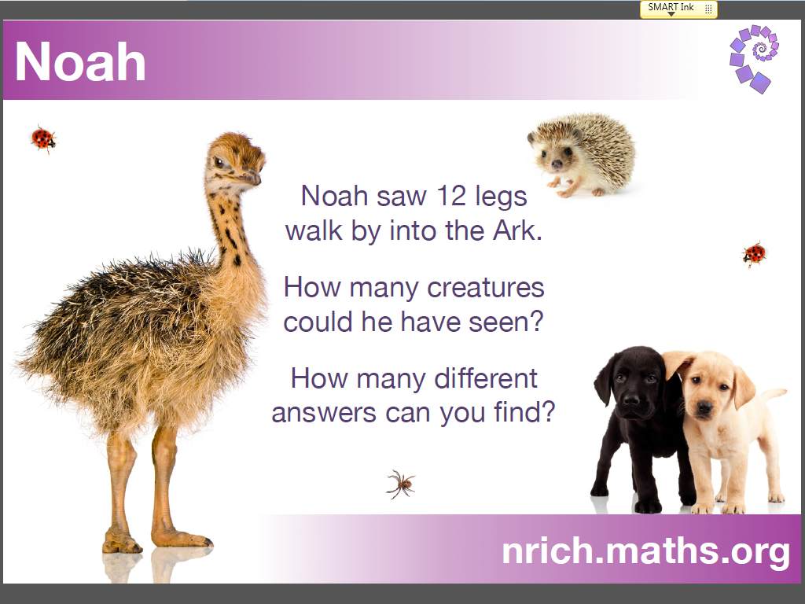

Slide 7
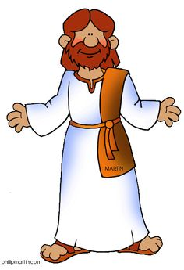
Think about this…
What creatures could there be?
How many legs do they each have?
What's the greatest number of creatures he could have seen?
What's the smallest number of creatures he could have seen?

Slide 8
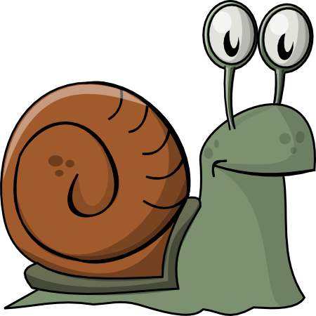
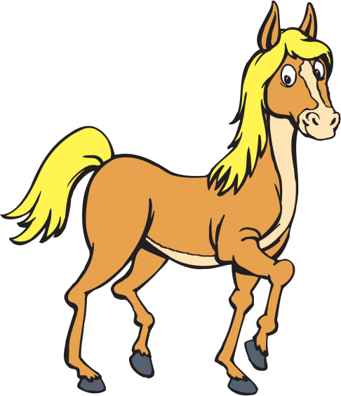


What is different?

Slide 9
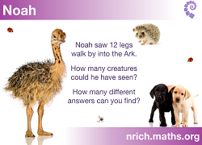
Why do this problem?
The 3 aims – no more 4 + 8 =
Humour adds to enjoyment
Meaningful practice
Everyone can have a different answer
Low threshold - High ceiling
What if questions - more legs...18, 24, 19...or fewer?

Slide 10
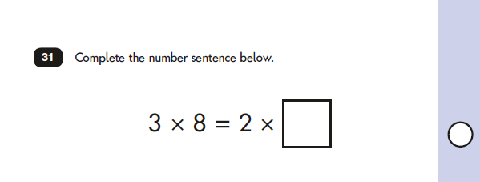
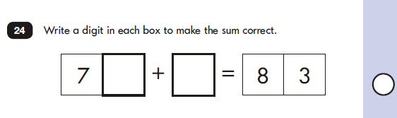
The 3 Aims

Slide 11
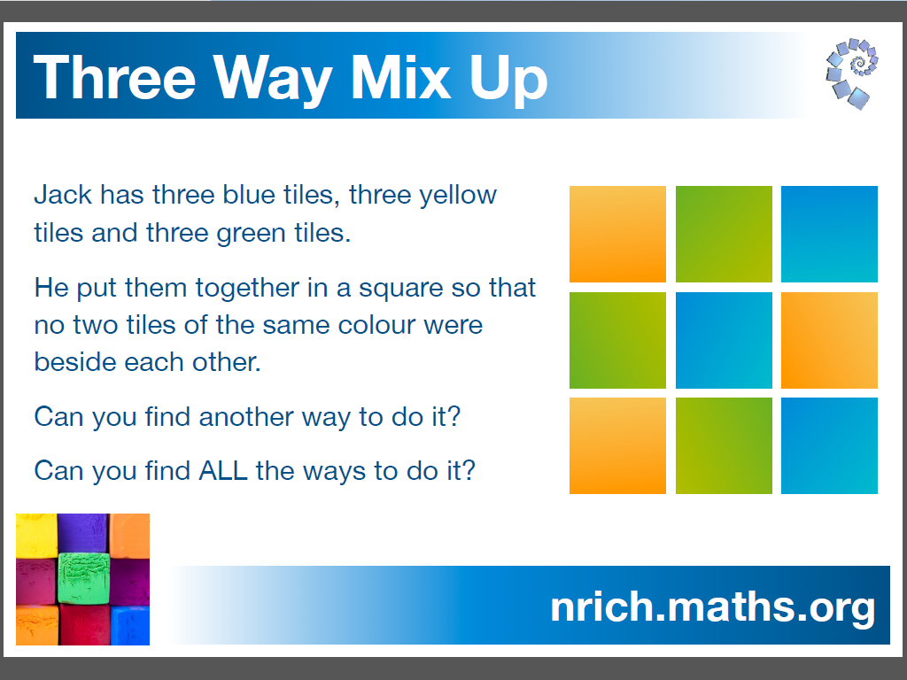

Slide 12
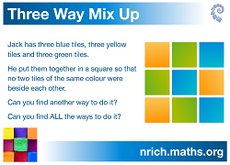
Why do this problem?
Promotes talk and therefore reasoning – The 3 Aims
Children can share their observations
Mathematical vocabulary – row/column/left of/right of/more/less/next to
Different answers
Follow a set of rules
Work systematically

Slide 13
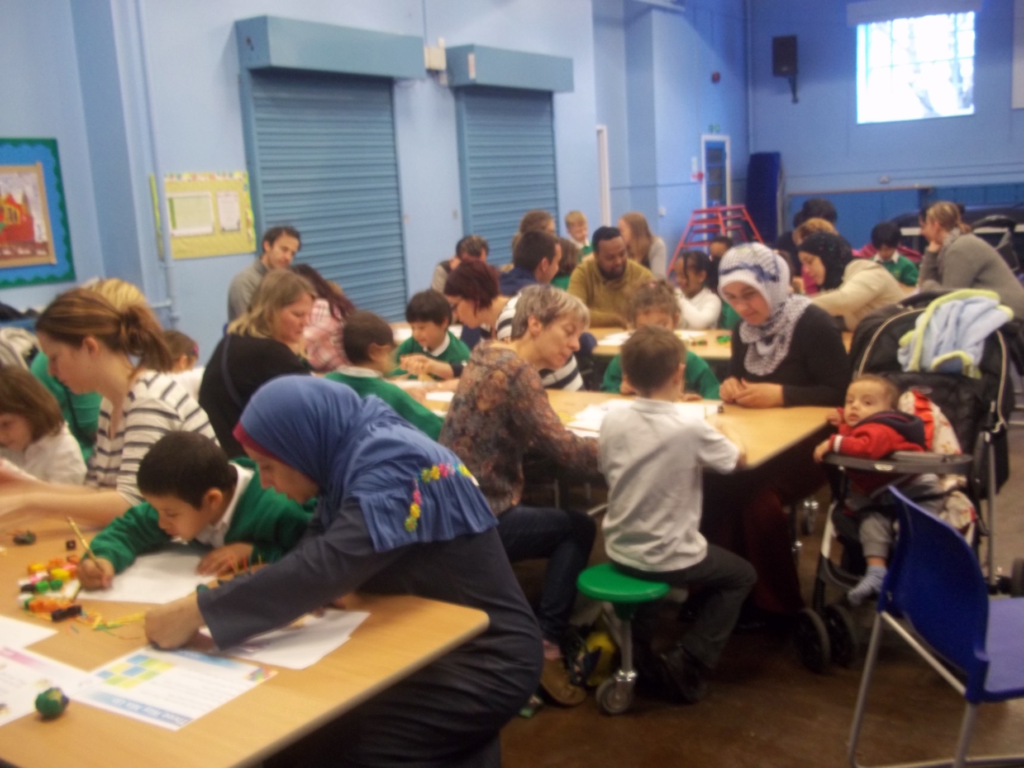

Slide 14
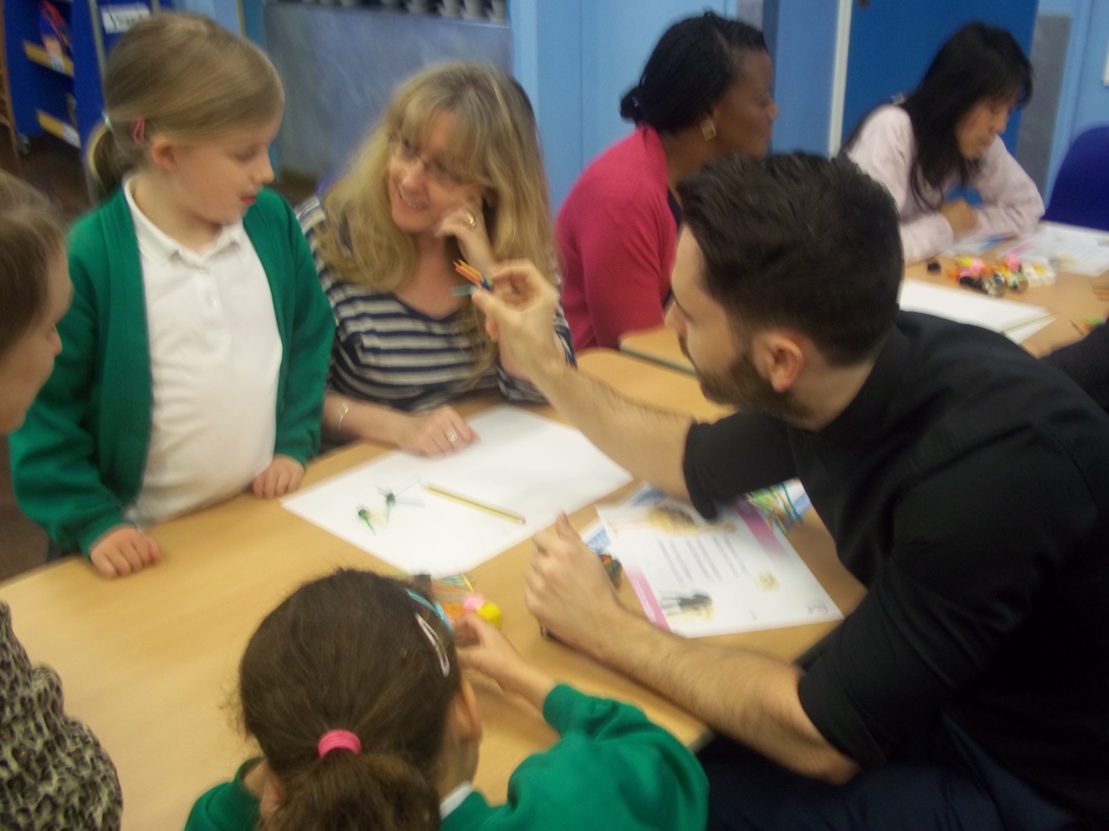

Slide 15
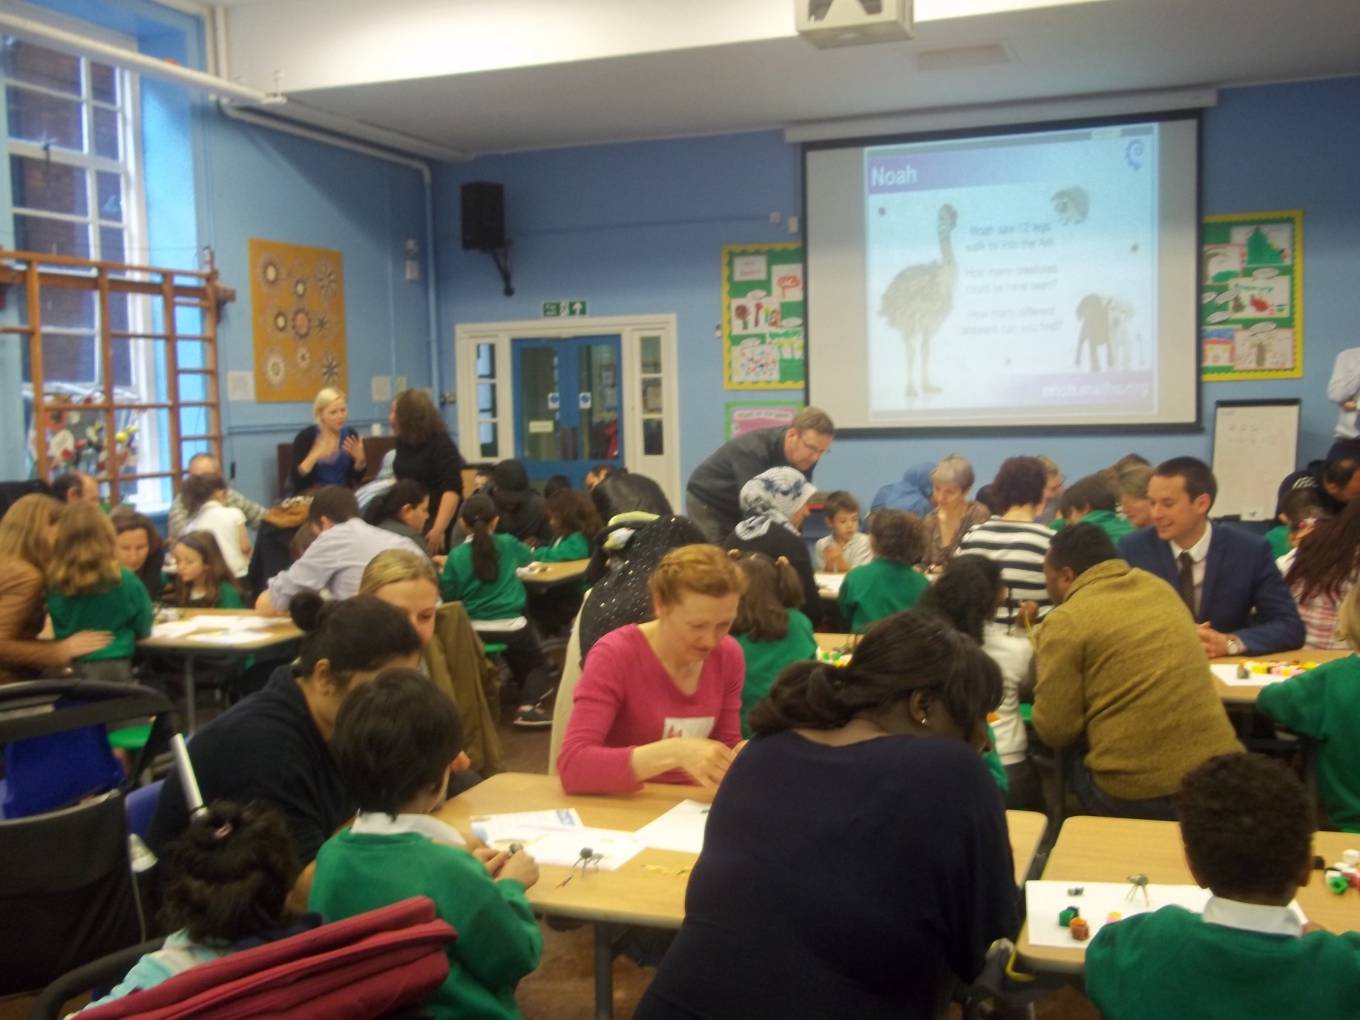

Slide 16
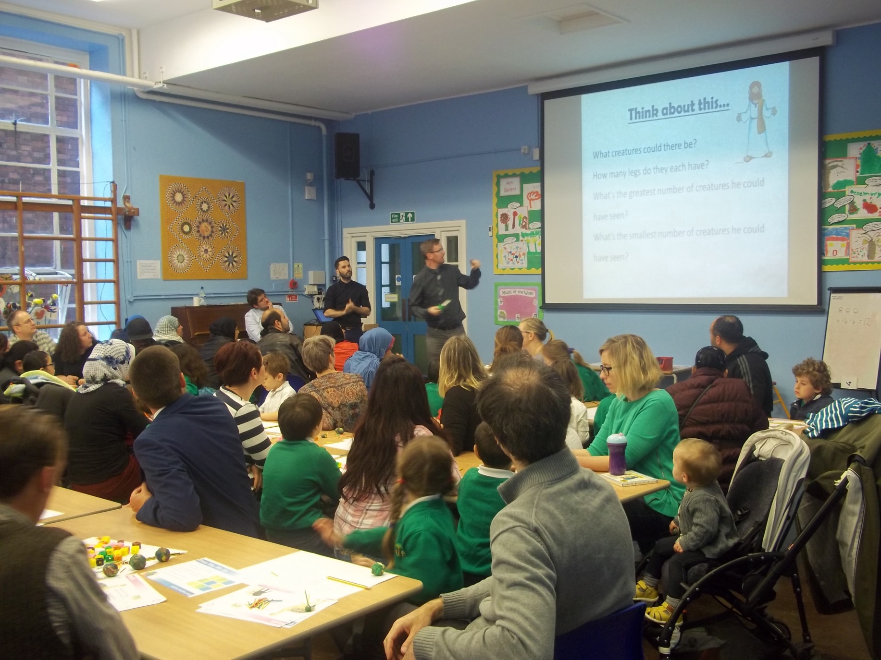

Slide 17
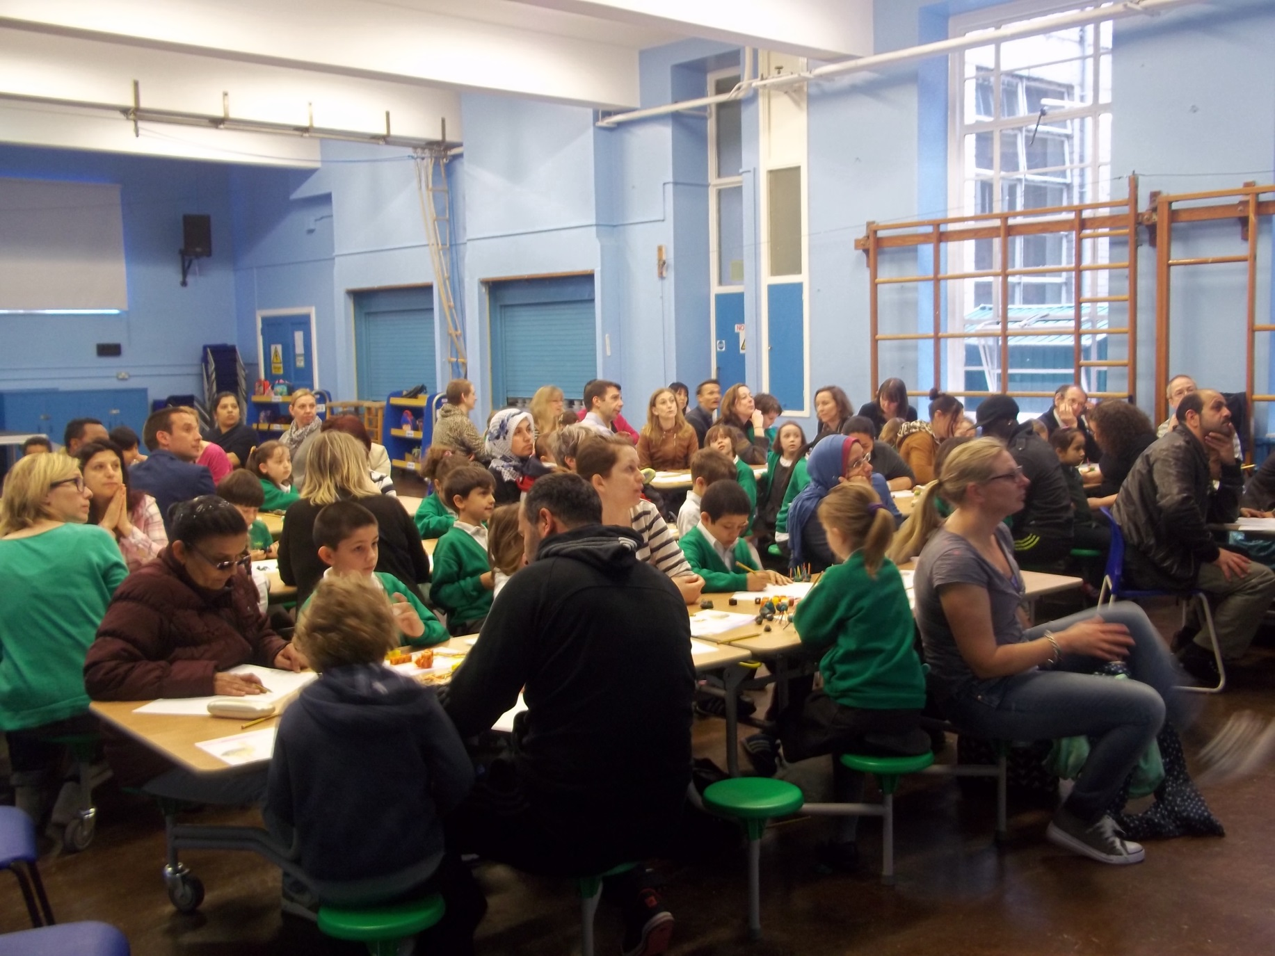

Slide 18
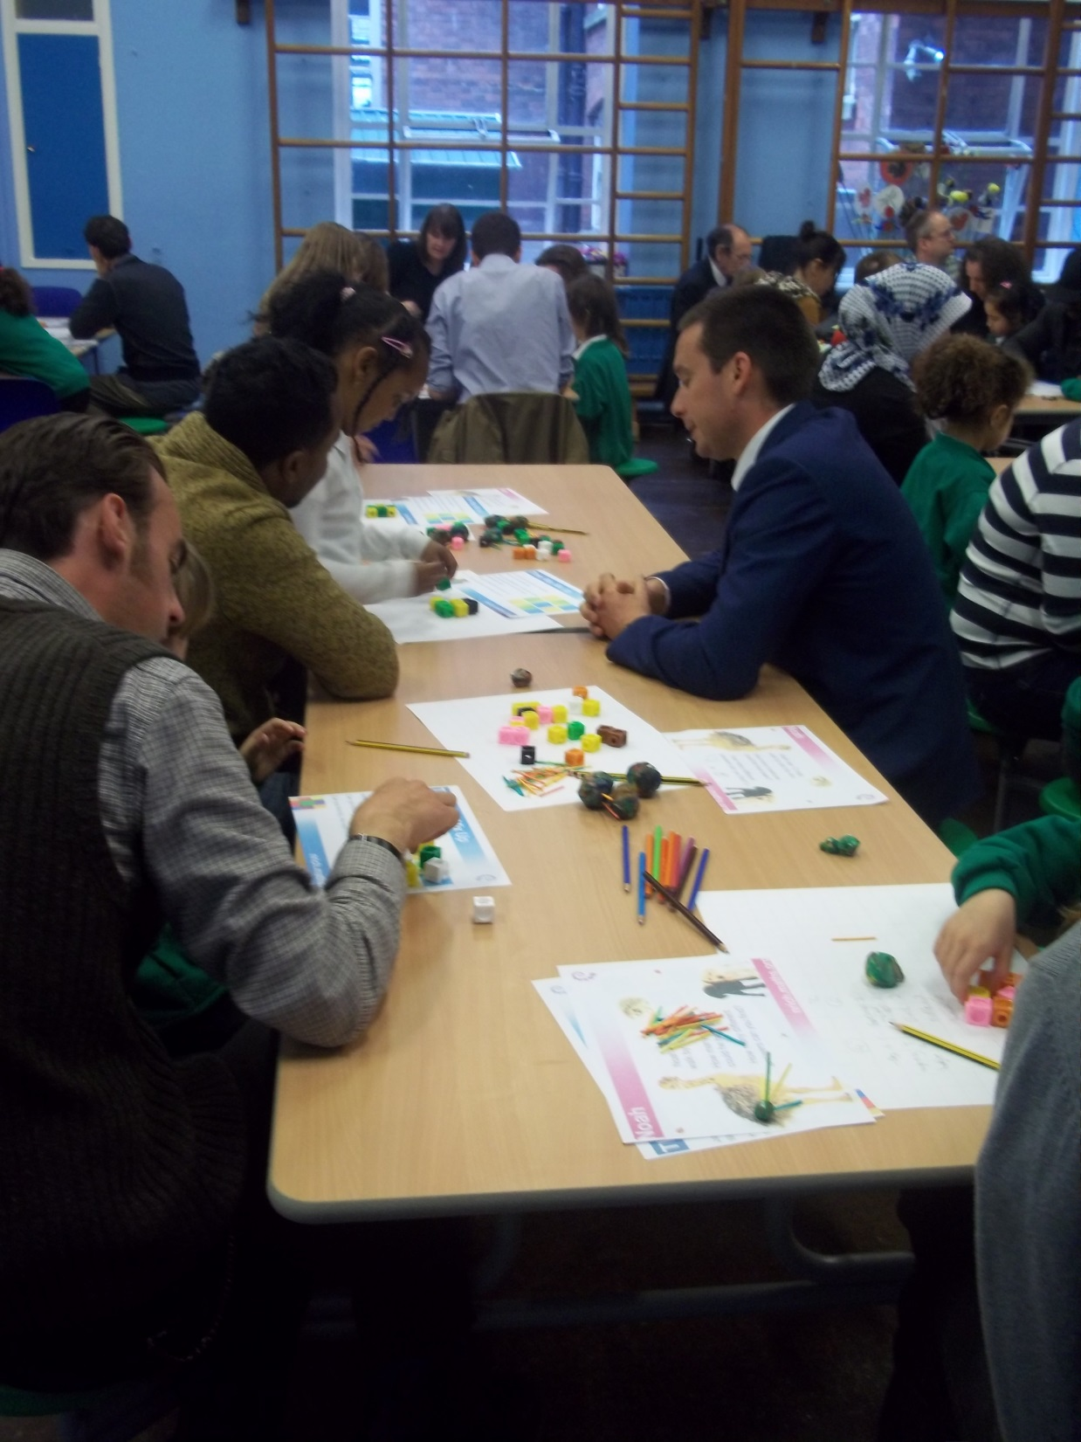

Slide 19
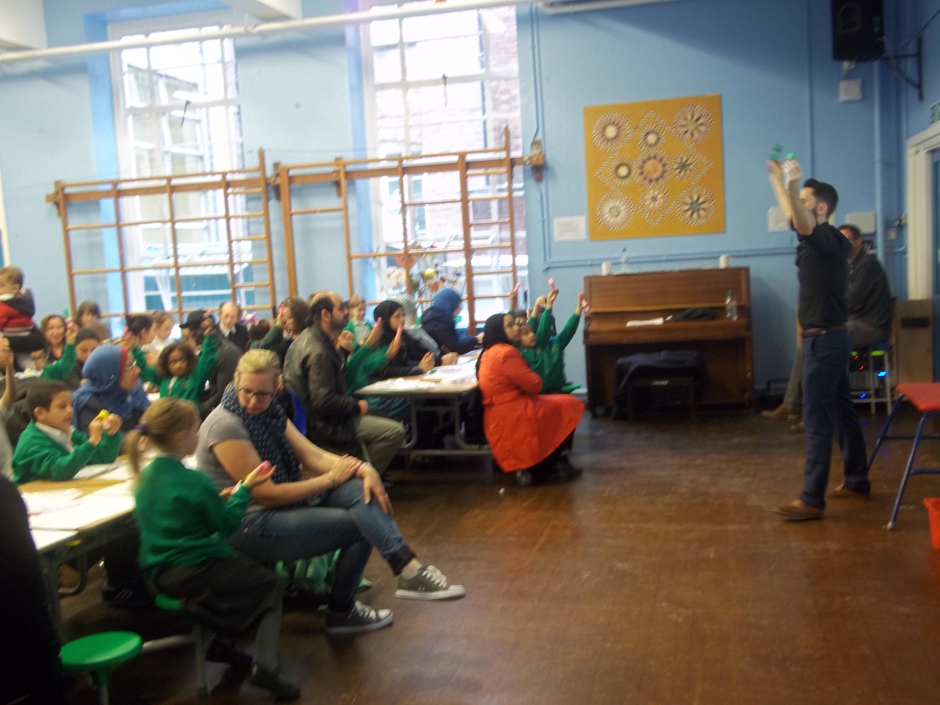

Slide 20
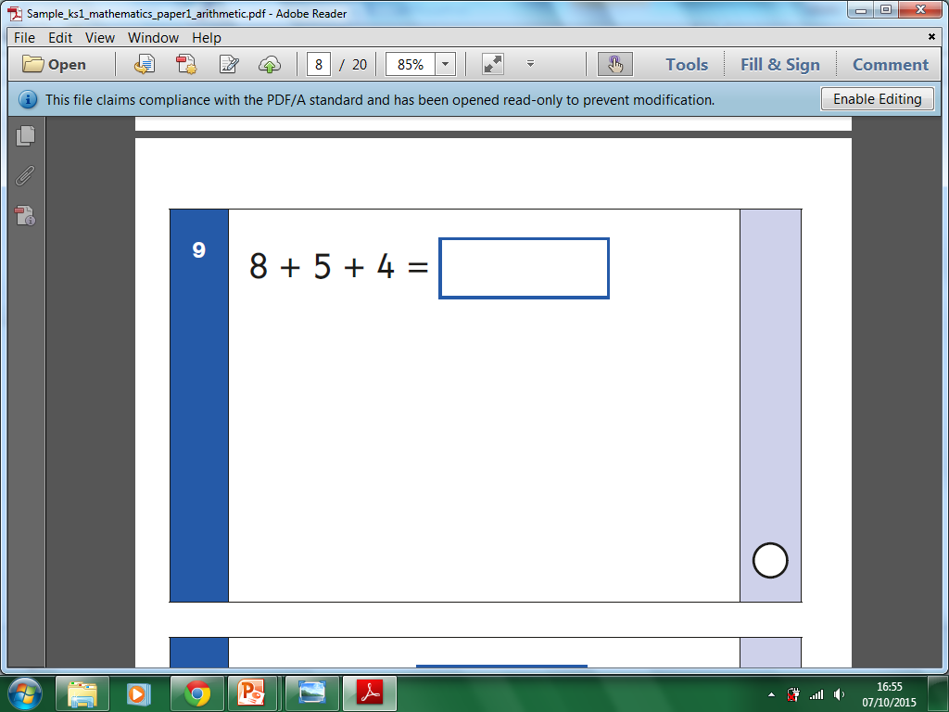
Using & Applying

Slide 21
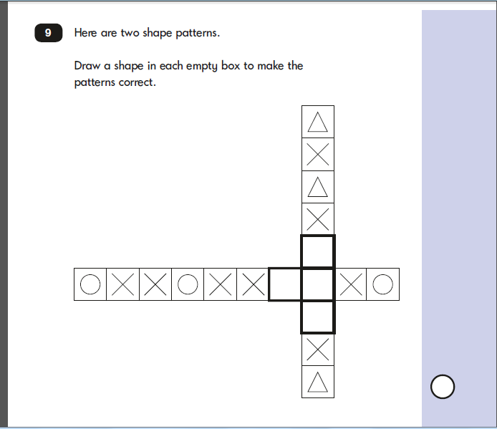
Using & Applying

