Slide 1
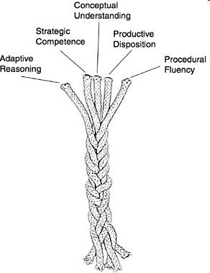
Five strands of mathematical proficiency
NRC (2001) Adding it up: Helping children learn mathematics

Slide 2
Conceptual understanding - comprehension of mathematical concepts, operations, and relations
Procedural fluency - skill in carrying out procedures flexibly, accurately, efficiently, and appropriately
Strategic competence - ability to formulate, represent, and solve mathematical problems
Adaptive reasoning - capacity for logical thought, reflection, explanation, and justification
Productive disposition - habitual inclination to see mathematics as sensible, useful, and worthwhile, coupled with a belief in diligence and one’s own efficacy.

