Slide 1
Tweaking Exam Questions

Slide 2
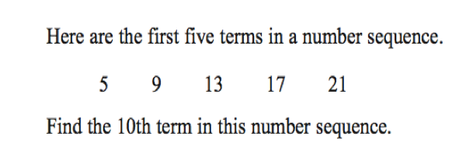
Notes:
http://nrich.maths.org/7024
https://nrich.maths.org/900

Slide 3
Related NRICH tasks
Charlie’s Delightful Machine
Attractive Tablecloths

Slide 4
Notes:
https://nrich.maths.org/7283

Slide 5
Related NRICH task
Perimeter Expressions

Slide 6
Notes:
https://nrich.maths.org/1783
https://nrich.maths.org/6402

Slide 7
Related NRICH Tasks
Remainders
The Remainders Game

Slide 8
Notes:
https://nrich.maths.org/2382
https://nrich.maths.org/708

Slide 9
Related NRICH Tasks
Ben’s Game
Fair Shares

