Slide 1
Lightning

Slide 2
Things to do with chance
David Spiegelhalter
winton professor for the public understanding of risk,
churchill college
university of cambridge
NQT Inspiration Day 2015

Slide 3

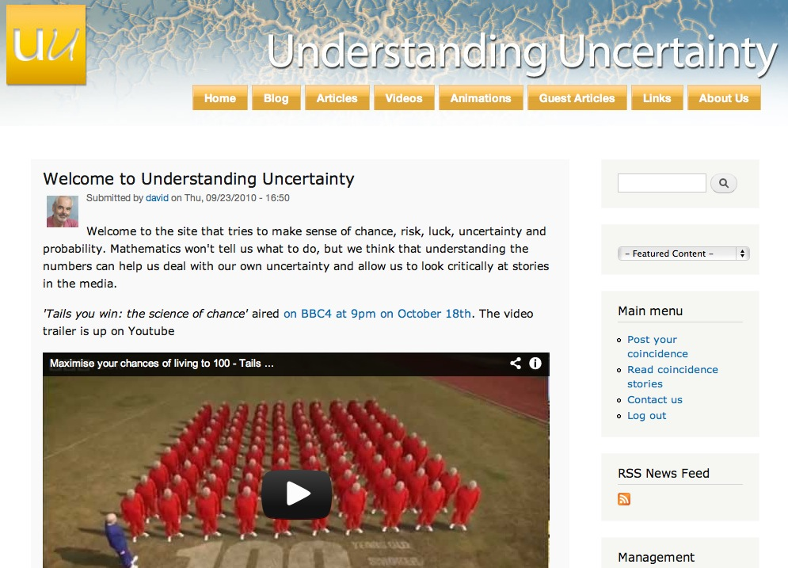
www.understandinguncertainty.org

Slide 4
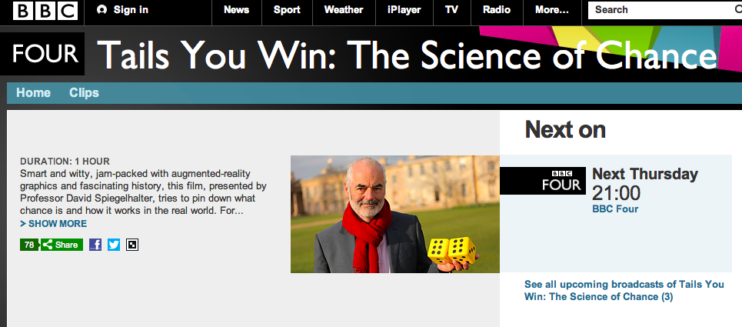


Slide 5


Slide 6
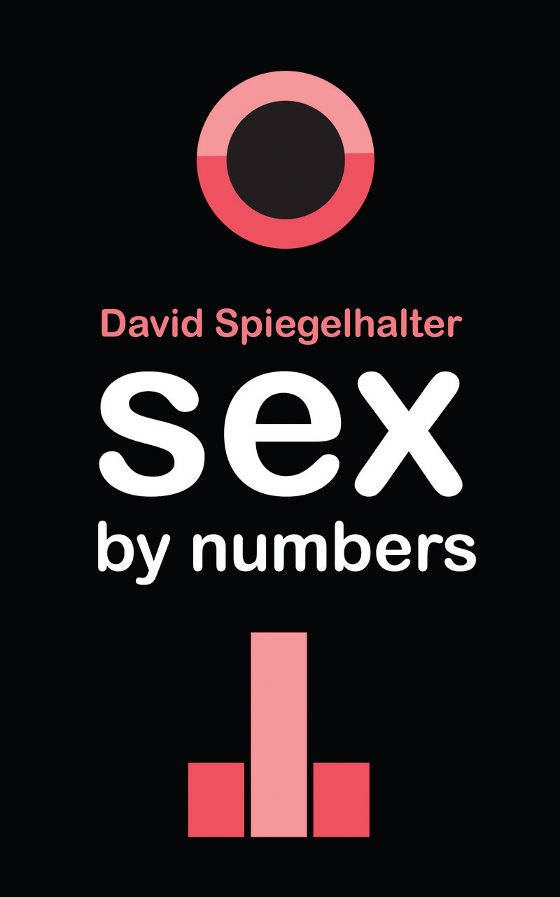
Book cover

Slide 7
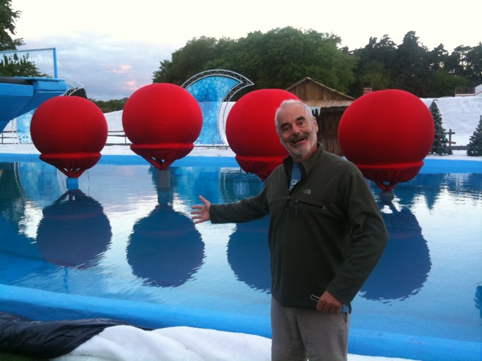

Slide 10

video

Slide 11
People have trouble with numbers

Slide 12
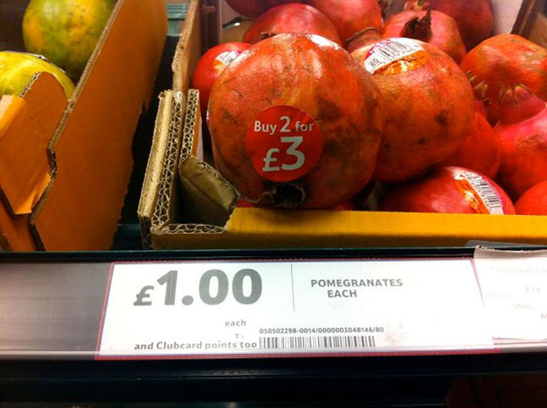

Slide 13
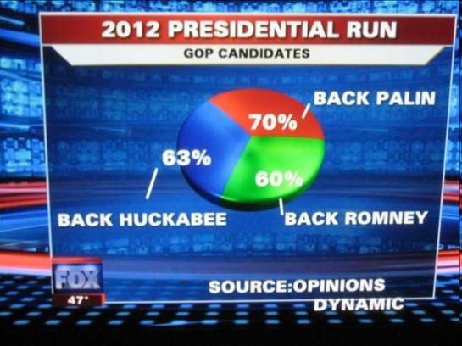

Slide 14
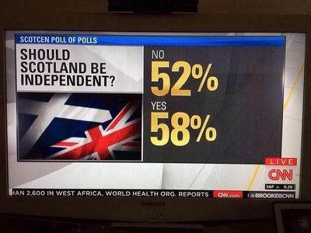

Slide 15
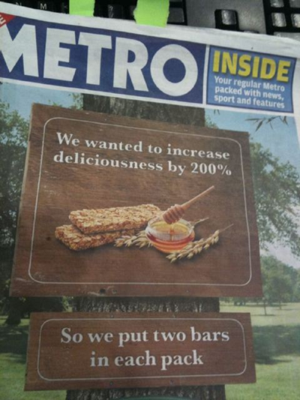

Slide 16
Dice and duplo

Slide 17
What does ‘random’ look like?

Slide 18
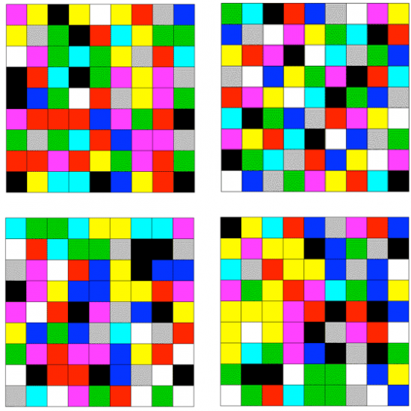

Slide 19
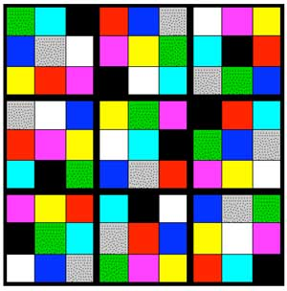

Slide 20
How long before you get 4 in a row?

Slide 21
Creating a distribution
How many coin-flips before you have 4-in-a-row?
Create empirical distribution from class
Then from simulations
Density and cumulative distribution
What is 50% and 95% point?

Slide 22
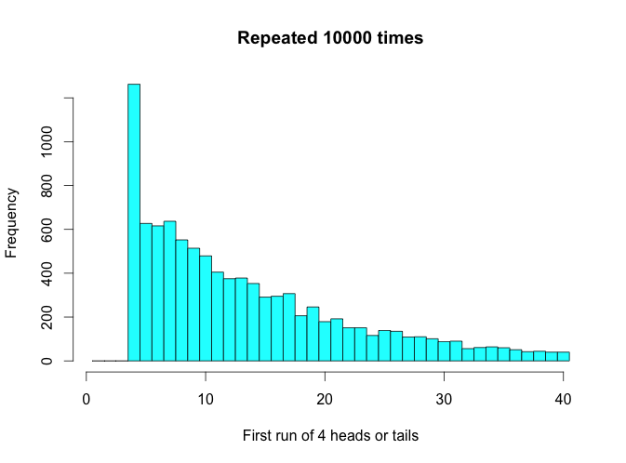

Slide 23
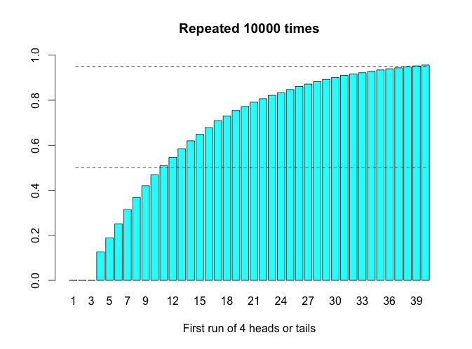

Slide 24
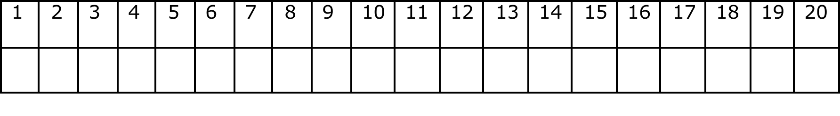
Record 20 imaginary and 20 real coin flips
Write ‘fake’ or ‘real’ lightly on back of slip
Swop with next table
Guess which are fake and which are real

Slide 25
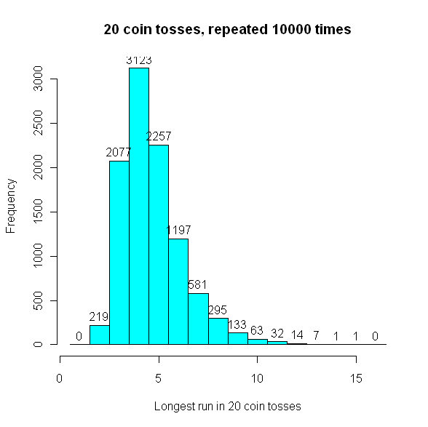
What is the longest sequence of heads or tails in 20 coin flips?
Try simulating 20 coin flips 10,000 times and count them!

Slide 26
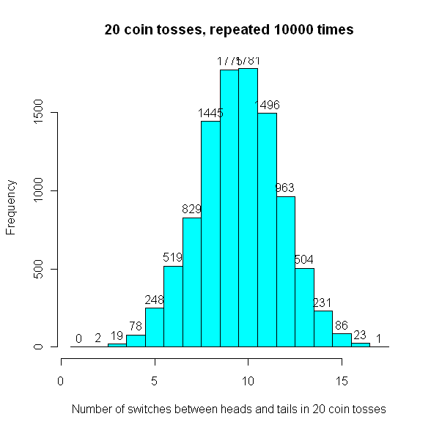
How many times is there a ‘switch’ between heads and tails?
Try simulating 20 coin flips 10,000 times and count them!

Slide 28
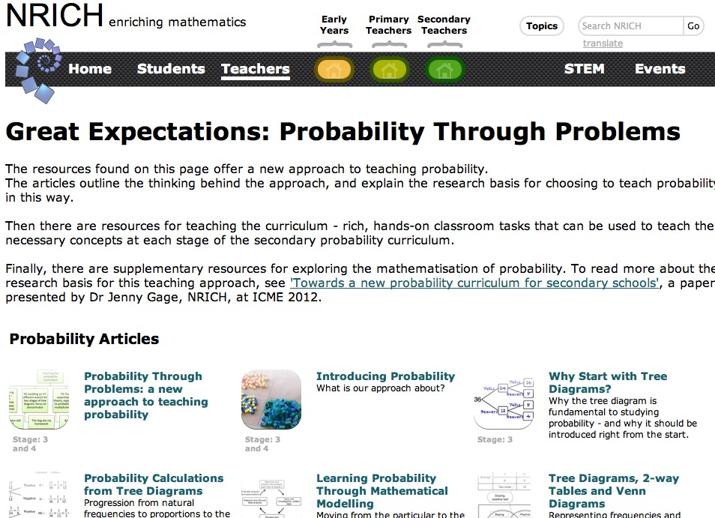
Teaching probability using ‘expected frequencies’

Slide 29
The dog ate my homework!
A teacher, Mr L I Detector, claims he can tell when students are lying about why they have not done their homework
This is true
Unfortunately, he also accuses some (1 in 6) students who are telling the truth
Suppose 1 in 6 students are actually lying
Out of the students that Mr Detector accuses, what fraction are wrongly accused?

Slide 30
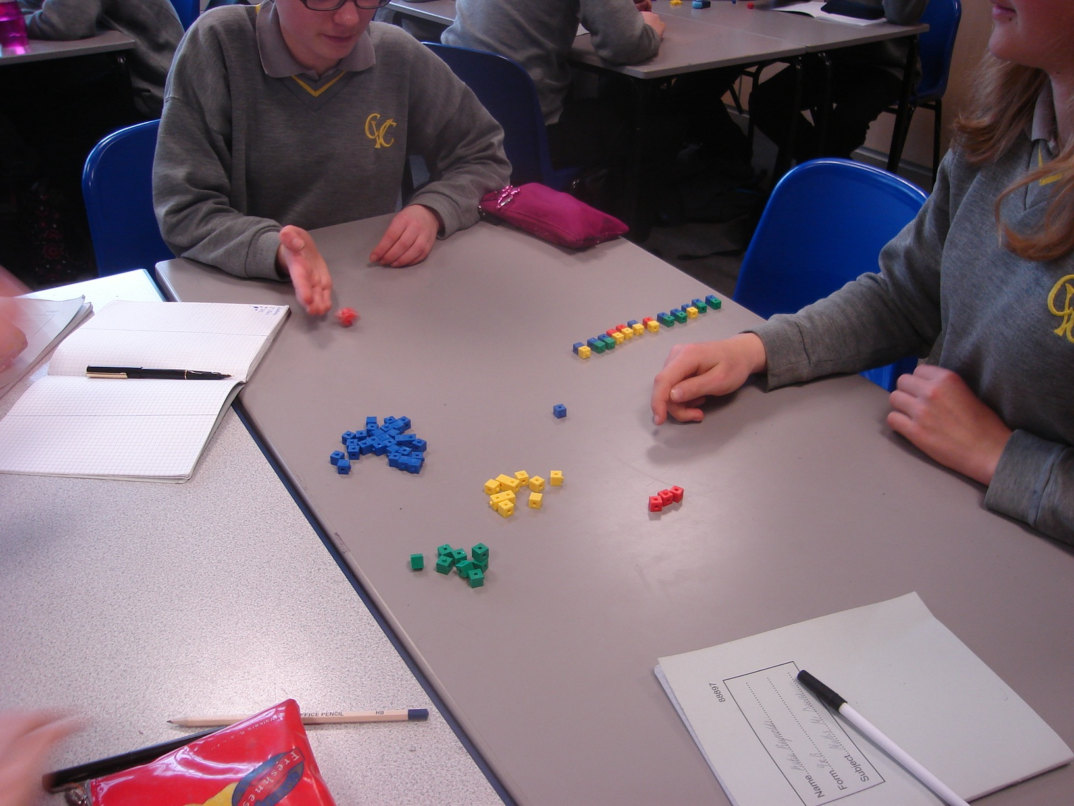
Experiment!
Throw dice to decide if lying:
  6 = lying = red brick
  Not 6 = truthful = blue brick
Throw dice to decide if truthful are accused:
  6 = accused = yellow brick
  Not 6 = not accused= green brick
All liars are accused (yellow brick)

Slide 32
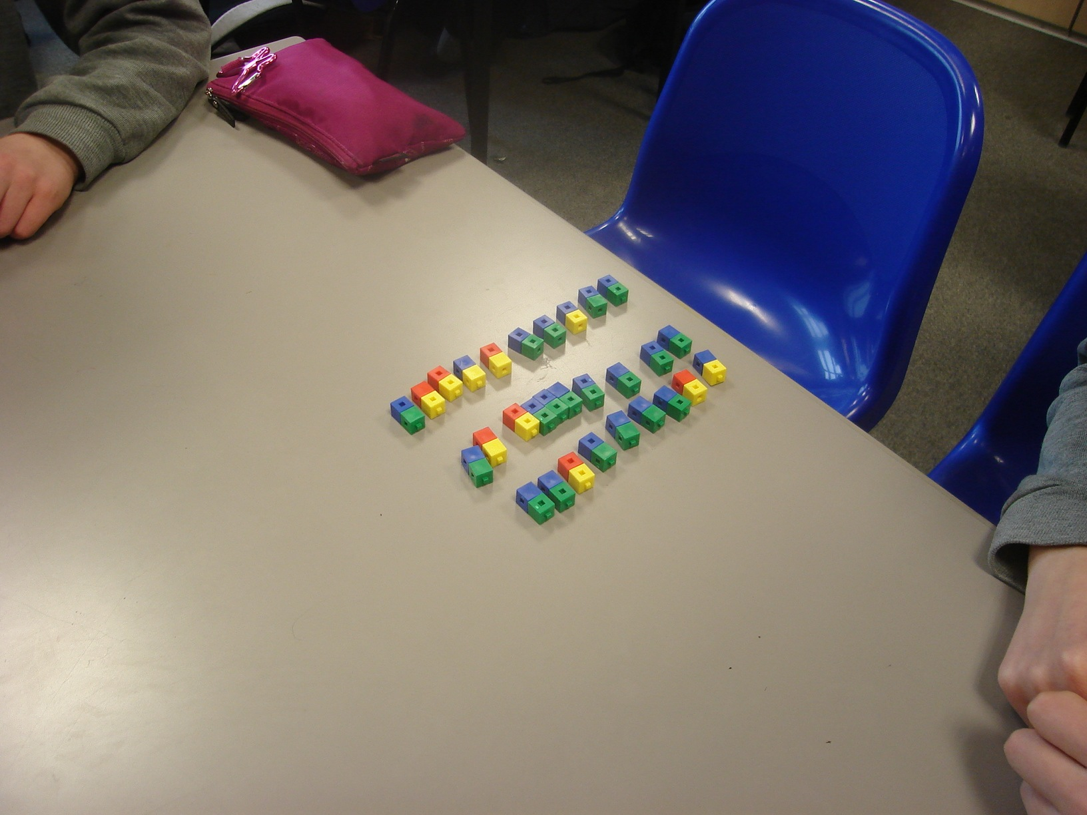

Slide 33
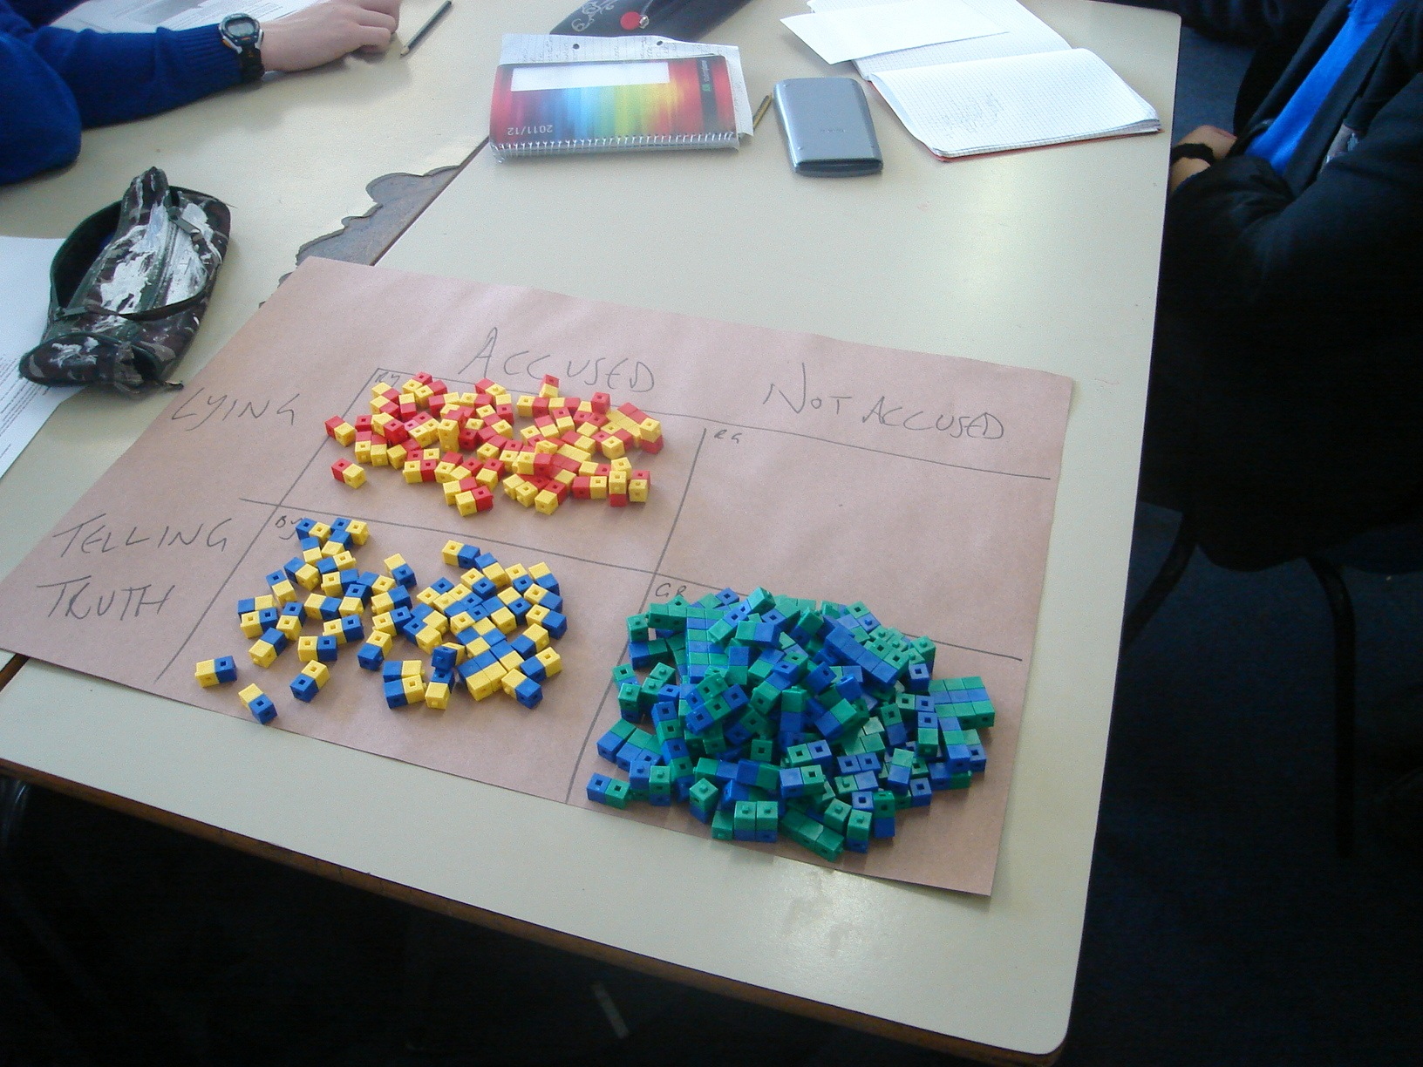

Slide 34
What do we expect to happen in 36 experiments?
 | Accused | Not accused
Lying | 6 | 0 | 6
Telling truth | 5 | 25 | 30
 | 11 | 25 | 36
Out of 11 accused, 5 are wrongly accused

Slide 35
Arrange as ‘expected frequency tree’
6
Accused
6
Lying
36
Class
5
Accused
30
Telling truth
25
Not accused

Slide 36
Derive probability tree
6
Accused
1
Accused
6
Lying
Lying
1/6
36
Class
5
Class
Accused
1/6
Accused
30
5/6
Telling truth
Telling truth
25
Not accused
Not accused
5/6

Slide 37
Sociable cards

Slide 38
I ‘know’ that at least two people in this room have the same birthday

Slide 39
Coincidences
Birthdays:
23 people: 51% chance that 2 share a birthday
35 people: 81% chance that 2 share a birthday
80 people: 99.99% chance that 2 share a birthday

Slide 40
Why does this happen?
Imagine 35 people in a line
First birthday can be anything
2nd birthday must be different from first: probability 364/365 = 0.997
3rd birthday must be different from 1st and 2nd: probability 363/365 = 0.995
…..
Probability that all 35 are different =
0.997 x 0.995 x …. 0.907 = 0.19

Slide 41
Useful approximate formulae
(Diaconis and Mosteller)
Suppose a single ‘match’ between 2 people has a chance 1/K
eg same birthday: K = 365
Then for a 50% chance of a match, need around 1.2√K people (eg 1.2 x √365 = 23)
Then for a 95% chance of a match, need around 2.5√K people (eg 2.5 x √365 = 48)

Slide 42
Where does this come from?
Suppose have N people
Number of pairs = N(N+1)/2 ≈ N² / 2
Expected number of matches ≈ N² / 2K
Assume Poisson, then
P₀ = Pr(no matches) = exp(-N² / 2K)
So N = √(- 2K log_{e} P₀ );
[ √(- 2 log_{e} 0.5 ) = 1.2; √(- 2 log_{e} 0.05 ) = 2.5 ]
K = [ N/ √ (- 2 log_{e} P₀ ) ]²
E.g. N = 30 in class, for 95% chance of match, need K = [30 / 2.5 ] ² = 144; adjacent birthdays, K = 120

Slide 43
Gap between birthdays | Odds of 2 random people ‘matching’ 1 in K K | Number needed for chance of match = 50% 1.2 √K | Number needed for chance of match = 95% 2.5 √K
Same day | 365 | 23 | 48
Within 1 day | 122 | 13 | 28
Within 3 days | 52 | 9 | 18
Within 1 week | 24 | 6 | 12
Within 2 weeks | 13 | 4 | 9

Slide 44
Trying to be different

Slide 45
20 people picking numbers between 1 and 100?
First number can be anything
2nd number must be different from first: probability 99/100 = 0.99
3rd number must be different from 1st and 2nd: probability 98/100 = 0.98
…..
Probability that all 20 are different =
0.99 x 0.98 x …. 0.81 = 0.13

Slide 46
Generalise
Assume N friends choosing numbers between 1 and T
If T = (N/2)² , then probability that all choose different numbers is 0.13
Eg N = 20; T = 100
N = 40; T = 400
N =400; T = 40000

Slide 47
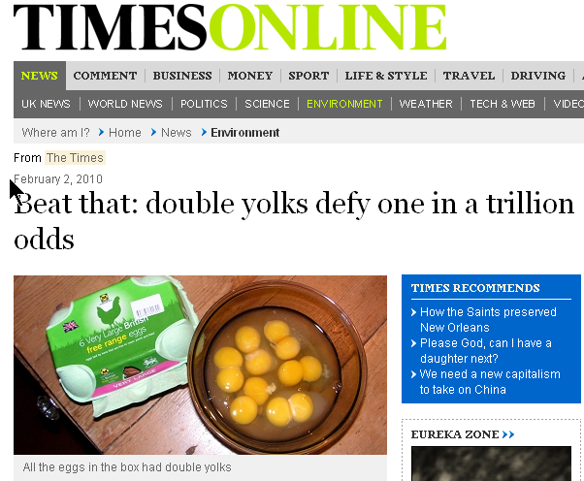
Egg Council said 1/1000 eggs double-yoked
So chance of 6 eggs = 1/1000 x 1/1000 …
= 1 in 1,000,000,000,000,000,000
What’s wrong with this?

Slide 48
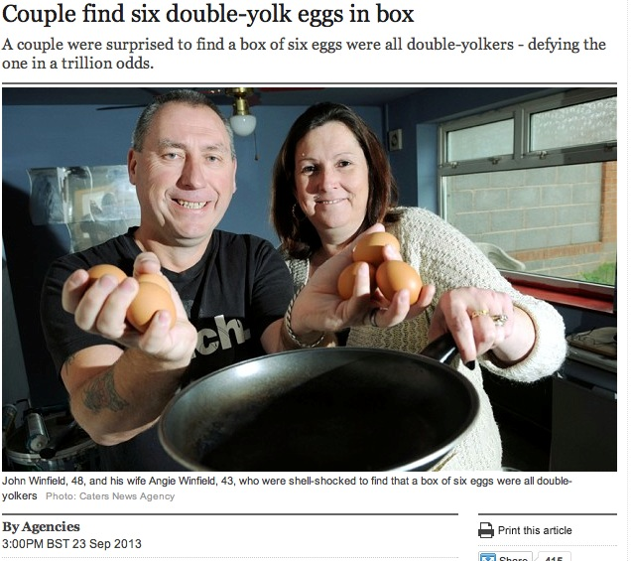

Slide 49
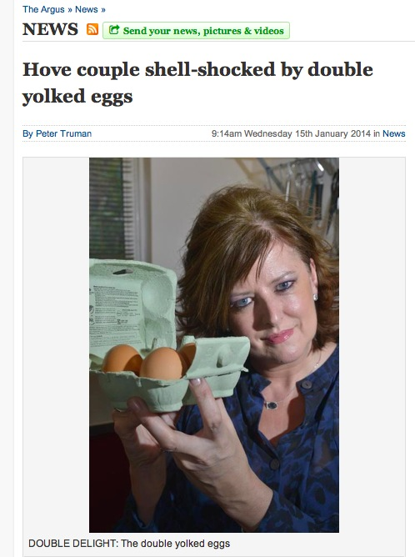

Slide 50
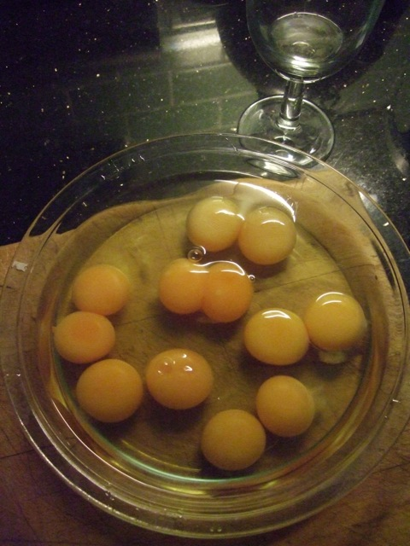
eggs
I had 6 double-yolks in the next box of eggs I bought!!

Slide 51
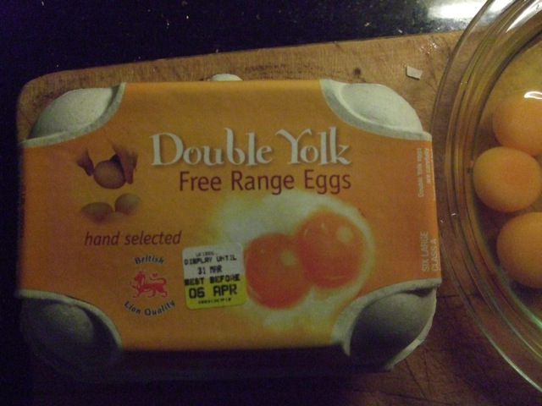
£2.49 from my local Waitrose

