Slide 1
Structure & Freedom: Preparing for the unexpected in mathematics lessons.
Mike Askew
info@mikeaskew.net
#mikeaskew26

Slide 2
Experienced teachers do two apparently contradictory things: They use more structures, and yet they improvise more. … The challenge facing every teacher and every school is to find the balance of creativity and structure that will optimise student learning.
Sawyer

Slide 3
Freedom
Structure

Slide 4
National curriculum aims
All pupils:
• become fluent in the fundamentals of mathematics, ….
• reason mathematically by following a line of enquiry, conjecturing relationships and generalisations, and developing an argument, justification or proof using mathematical language
• solve problems by applying their mathematics to a variety of routine and non-routine problems …

Slide 5
Fluency
Reasoning
MATHE-
MATICS
Problem
solving

Slide 6
Objects of learning
Indirect
Direct
Fractions
Multiplication
3-D shapes
Reasoning
Problem solving
Fluency
PROFICIENCY
CONTENT

Slide 7
Learning

Slide 8
Learning: Engineered

Slide 9
Learning: Emergent

Slide 10
I can engineer fluencies - skills, facts, procedures. I can provoke reasoning and problem solving to emerge.

Slide 11
I can engineer fluencies - skills, facts, procedures. I can provoke reasoning and problem solving to emerge.

Slide 12
12

Slide 13
12
0
12

Slide 14
12
-4
7

Slide 15
12
1/3
1/2

Slide 16
Reflect
What was similar across each example?
What mathematical reasoning did you engage in?
How could you adapt the activity?

Slide 17
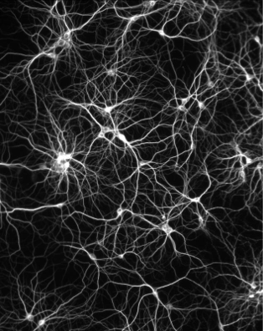
Conditions for emergence
Brent Davis
Neighbour interactions
Diversity
Redundancy
Distributed control
Enabling constraints

Slide 18
Conditions for emergence
Brent Davis
Neighbour interactions
Diversity
Redundancy
Distributed control
Enabling constraints

Slide 19
Reasoning mini-lesson
12 x 8
6 x 16
4 x 24
Over to you ….
With your partner create two calculations with the same product as:
12 x 9
19

Slide 20
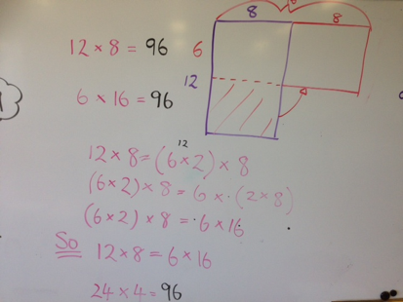

Slide 21
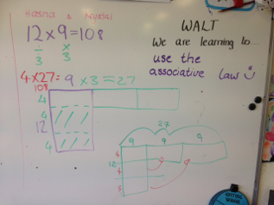

Slide 22
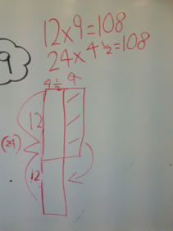

Slide 23
Reasoning mini-lesson
Structure
Calculations revealed one at a time
Constructed to connect and build
Freedom
Student choice of method
Teacher real time adjustments
23

Slide 24
Planning
Preparing

