Slide 1
Workshop: The Visiting Expert Mark Dawes / Euan Willder Comberton Village College
StemNRICH TI Day 17th April 2013

Slide 2
Timings
13:45 The Visiting Expert
– explanation and examples
14:00 Workshop time to create ideas
14:30 Sharing the ideas & discussion

Slide 3
A Chinese Proverb
Give a man a fish and you feed him for a day.
Teach a man to fish and you feed him for a lifetime.
This session is not “resources”, but “a way of working”.

Slide 4
The Visiting Expert
‘Overlap’ topic
A maths lesson, or a science lesson
The ‘expert’ visits for 10 mins

Slide 5
Example 1: Science Lesson – Lung Capacity
Very low attaining Yr 8 pupils
Capacity of lungs
Balloons
Buckets of water to test volume, calculated by displacement of water

Slide 6
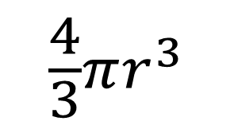
Visiting Mathematical Expert
Volume of a sphere …

Slide 7
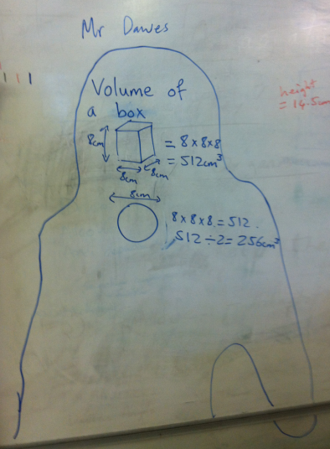
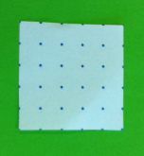
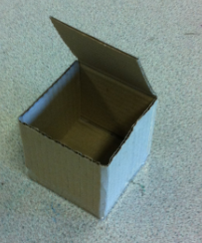
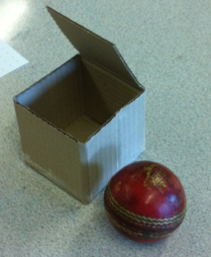

Slide 8
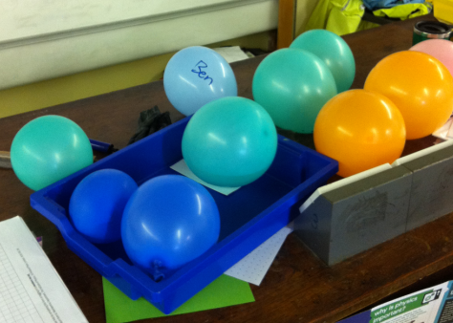
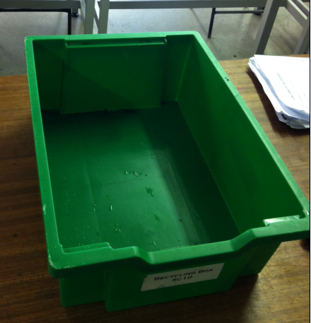

Slide 9
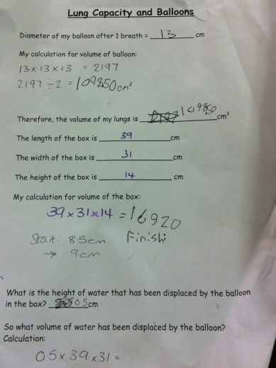
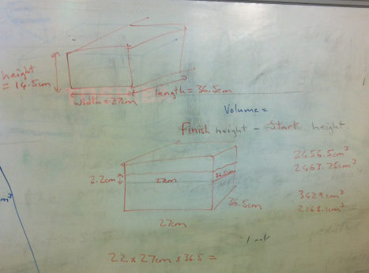
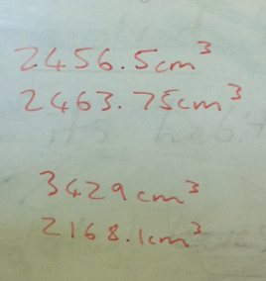

Slide 10
Notes/Reflection immediately after Science lesson (Euan)
Students surprised by Mark’s presence. “Why are we doing Maths?”. Students very engaged and able to follow work to an extent. Students able to cope with concepts and said at the end they enjoyed the lesson. Some students commented that they were “rubbish at Maths” or in bottom set for everything so they are rubbish at all subjects. Students said they could see the use of Maths to solve a science problem and that they did not know this before.

Slide 11
Example 2: Maths Lesson – Reflection
Multiple Mirrors

Slide 12
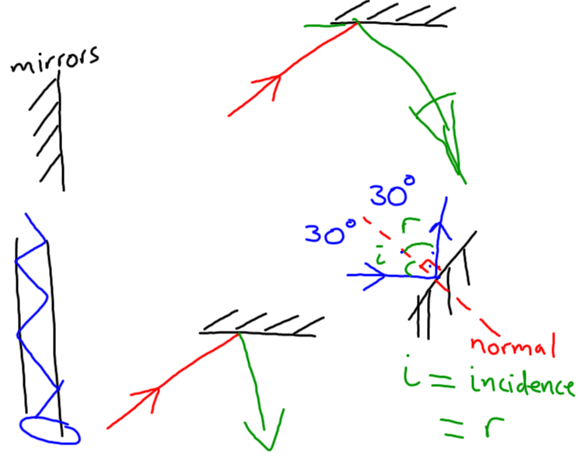
Visiting Science Expert

Slide 13
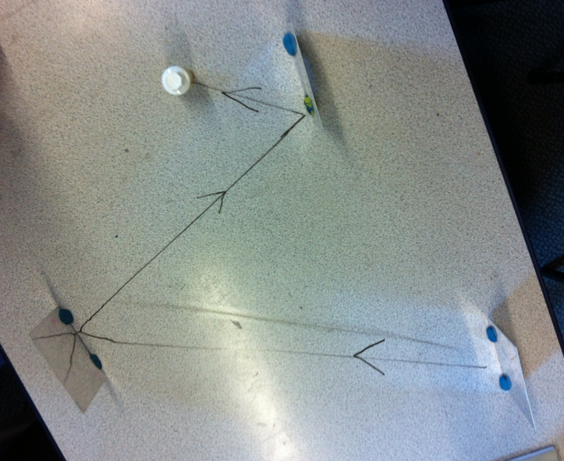
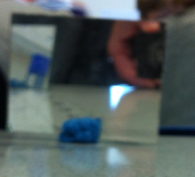
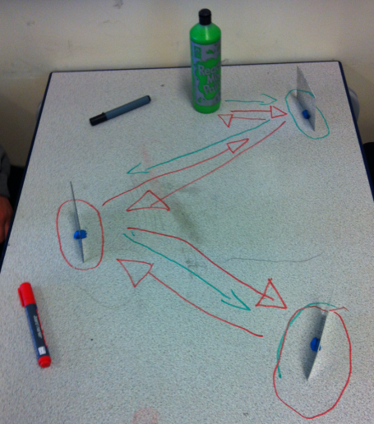
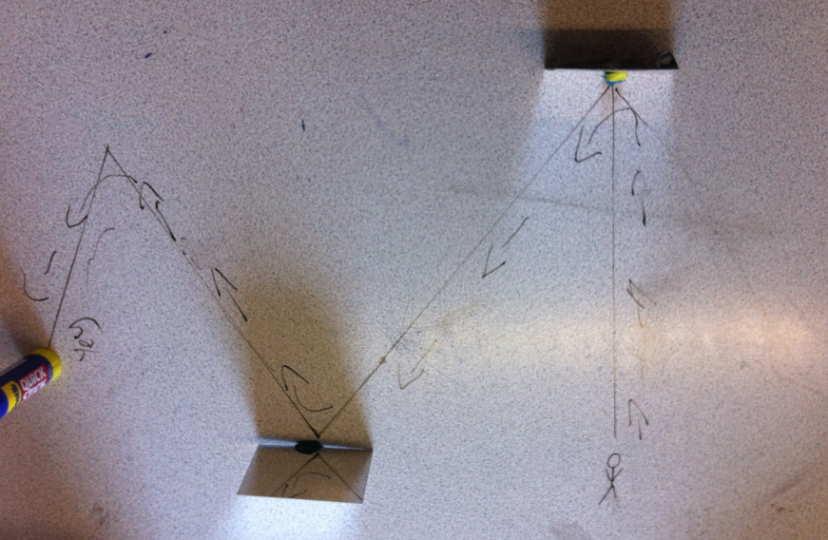
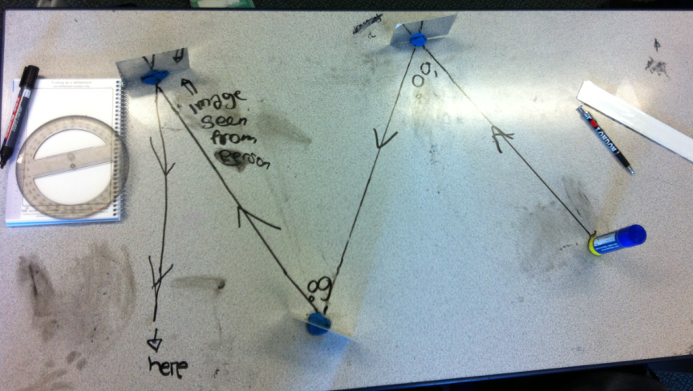
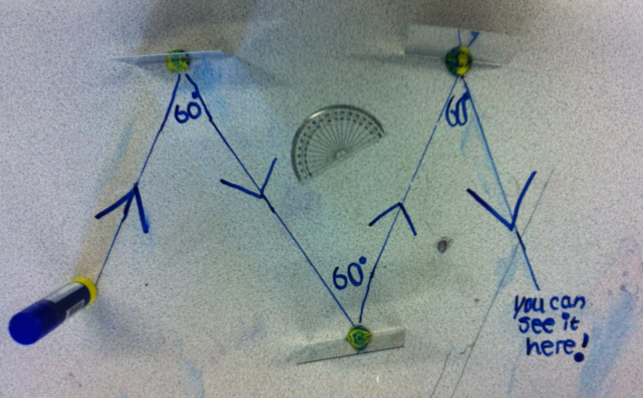

Slide 14
Maths lesson plenary
Snooker
Maths & Science
Topics that were used
Positive feedback

Slide 15
Your thoughts?

Slide 16
Our thoughts
This is meaningful. It gives a clear reason for the collaboration between maths and science
We observed the less well-motivated students really engage in the lessons
It is fairly straightforward. Euan can plan his science bits and as long as Mark knows roughly what Euan is going to say and how long he will take, he don't need the full detail in advance.
It is logistically possible. We only need a couple of minutes to go to another lesson, rather than requiring cover for a full lesson.

Slide 17
Over to you…
Use the large paper to come up with ideas for your own “visiting expert” lesson.
Perhaps some other considerations:
Timing in lesson (does not have to be at start!)
Key stage
Ability of students
How to assess the impact

Slide 18
Other lessons
Maths & DT

Slide 19
Workshop time
Work with your partner to produce an outline for lessons – one maths and one science
We will share these later

Slide 20
Alternative methods
Using Video

Slide 21
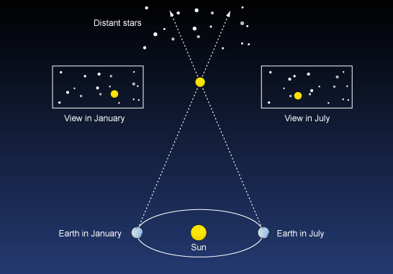

Slide 22
Parallax Challenge
What is the distance to our nearest star Proxima Centauri in metres?
1AU = 149.6 x 10⁶ km (distance Earth to Sun)
Parallax angle = 0.76 arc seconds
1 Light Year = 9.46 x 10¹⁵m
Extension:
What is the distance in AU (astronomical units?)
What is the distance in light years?
What is the parallax angle of a star that is 10 Light years away?

Slide 23
Mr Willder’s Notes!
Be careful with units (AU, km, m, LY)
The parallax angle is so small in degrees that we use arc seconds as a unit. 1 arc second = 1/3600 of a degree.
We use SOH CAH TOA lots in A Level Physics!
Draw a diagram of the problem so you can visualise what is happening.
Is my standard form correct mathematically or are Physicists just lazy?

