Slide 1
The NRICH Project University of Cambridge

Slide 2
Secondary mathematics – what has changed?
higher expectation overall - benchmarked against age-related expectations in other nations
less detailed than primary and set out by key stage – secondary school teachers will need to set out the detail in their school curriculum by year.
consolidating understanding - Key Stage 3 builds on Key Stage 2
probability and statistics treated separately
mathematics set out in more detail than current National Curriculum – with less specification of generic skills
2

Slide 3
Consultation
Includes questions on:
proposed aims for the new National Curriculum
changes to the Programmes of Study for all subjects and key stages (except English, mathematics and science at Key Stage 4)
a proposal to replace the ICT programme of study with a new computing programme of study
the implementation of the new National Curriculum
the disapplication of aspects of the current National Curriculum for a limited period from September 2013
the likely equalities implications of reforms

Slide 4
Wider implementation
Initial teacher training: TA aligning training from September 2013 and exploring subject specialists role
Subject associations and learned societies: encouraged to develop further guidance and plans to support schools to develop their school curriculum
Inspection: implications for Ofsted in their inspection of schools’ “broad and balanced curriculum”
Curriculum resources: publication and resources market actively working to respond to schools’ needs.

Slide 5
Looking ahead
Spring term 2013
Primary assessment and accountability proposals
September 2013 – Final National Curriculum published
September 2014 – First teaching of National Curriculum
May 2016 – First Key Stage 1 and 2 assessment

Slide 6
Millennium Maths Project
PLUS
Maths and Sport
STIMULUS, MiR
NRICH
AskNRICH
Roadshows
Notes:
NRICH biggest part of Millennium Maths project
These are the other parts; screen dumps following

Slide 7
http://plus.maths.org
Notes:
Public understanding of maths and science. For 14 years upwards

Slide 8
http://sport.maths.org
Notes:
Done for Olympics

Slide 9
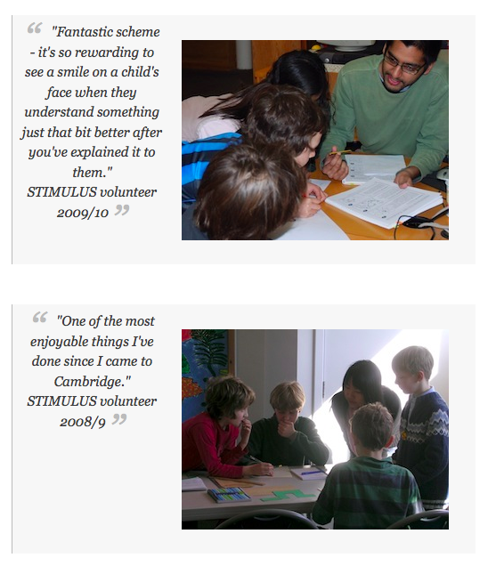
STIMULUS students work as volunteer Teaching Assistants in the classroom, alongside the class teacher in local schools, helping with Maths, Science, ICT or Technology lessons.
Notes:
Putting students into schools as volunteers

Slide 10
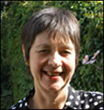
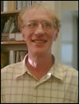
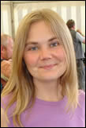
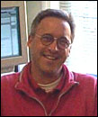
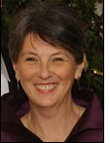
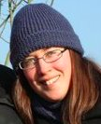
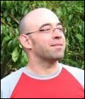
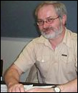
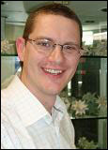
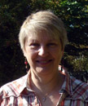
Who are we?
Notes:
Introducing the team
Top left clockwise:
Lynne McClure director
Liz Woodham, Jennie Pennant, Bernard Bagnall, primary team, Alison Kiddle Charlie Gilderdale, Steve Hewson, Jenny Gage, secondary team, Mike Pearson, Owen Smith, technical team.

Slide 11
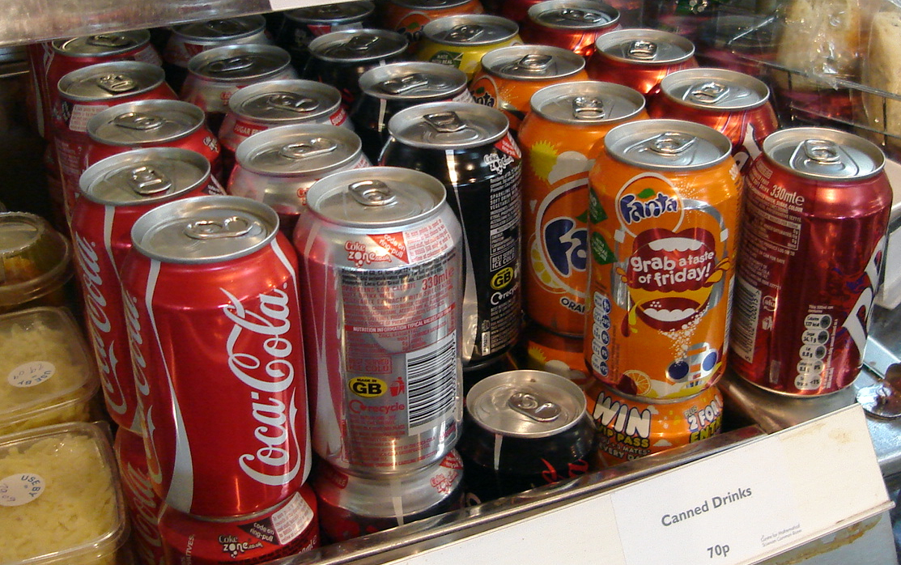
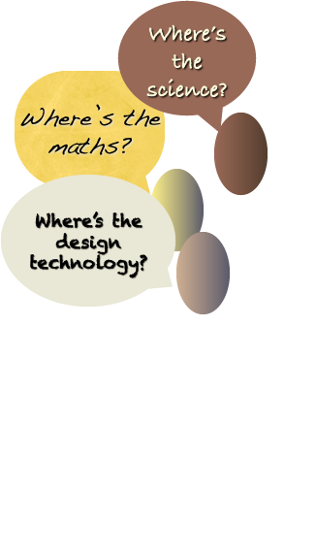

Slide 12
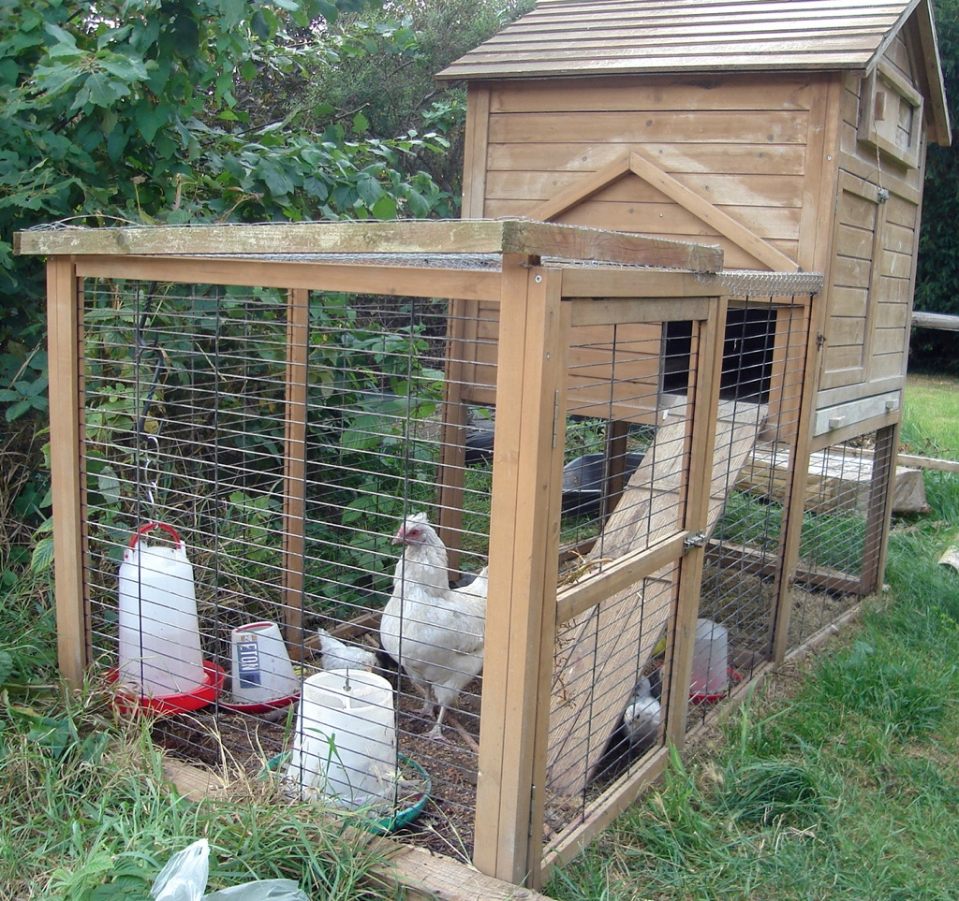

Slide 13
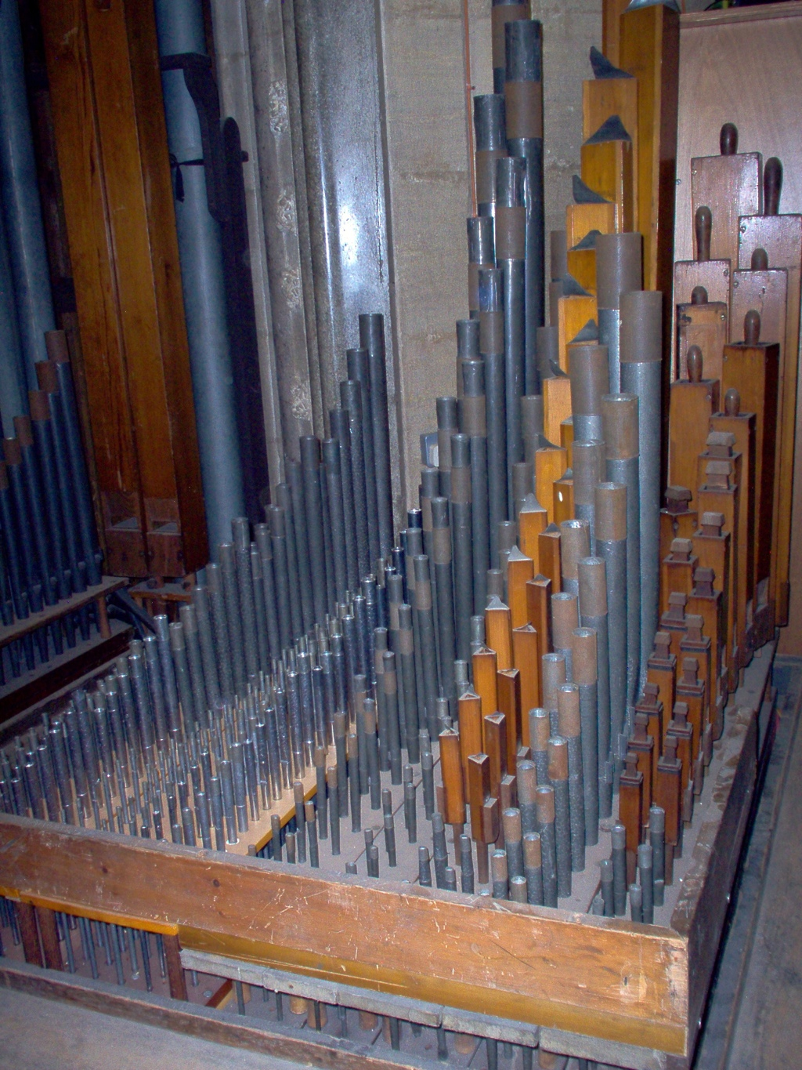

Slide 15
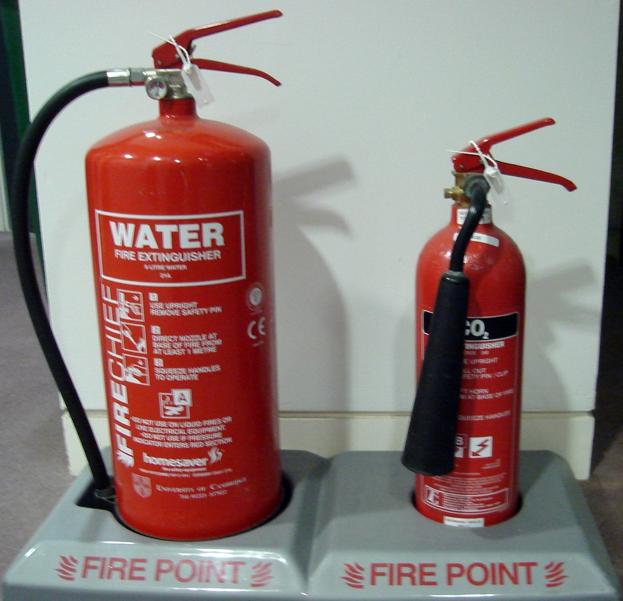

Slide 16
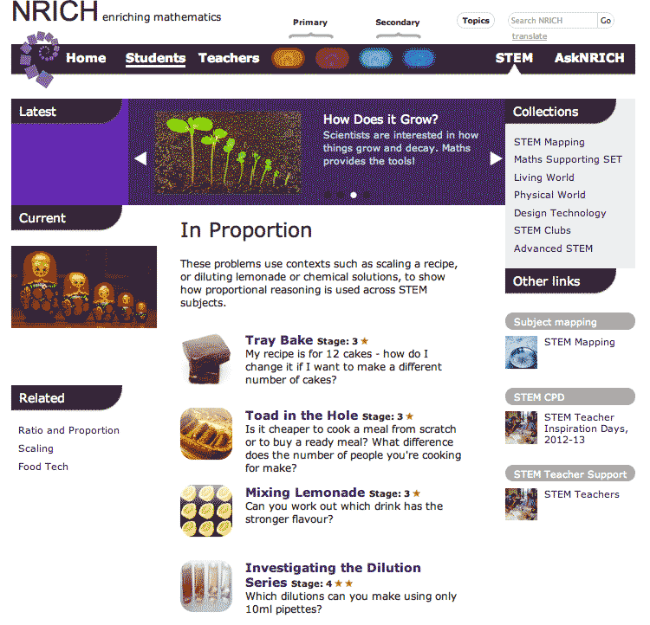
nrich.maths.stemnrich

