Slide 1
The NRICH Project University of Cambridge

Slide 2
Millennium Maths Project
PLUS
Maths and Sport
STIMULUS, MiR
NRICH
AskNRICH
Roadshows
Notes:
NRICH biggest part of Millennium Maths project
These are the other parts; screen dumps following

Slide 3
http://plus.maths.org
Notes:
Public understanding of maths and science. For 14 years upwards

Slide 4
http://sport.maths.org
Notes:
Done for Olympics

Slide 5
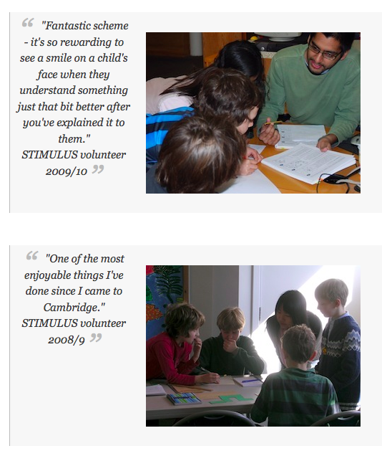
STIMULUS students work as volunteer Teaching Assistants in the classroom, alongside the class teacher in local schools, helping with Maths, Science, ICT or Technology lessons.
Notes:
Putting students into schools as volunteers

Slide 6
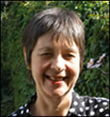
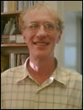
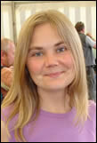
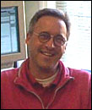
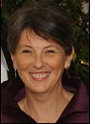
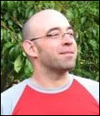
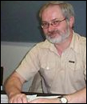
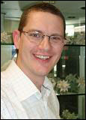
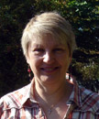
Who are we?
Notes:
Introducing the team
Top left clockwise:
Lynne McClure director
Liz Woodham, Jennie Pennant, Bernard Bagnall, primary team, Alison Kiddle Charlie Gilderdale, Steve Hewson, Jenny Gage, secondary team, Mike Pearson, Owen Smith, technical team.

Slide 8
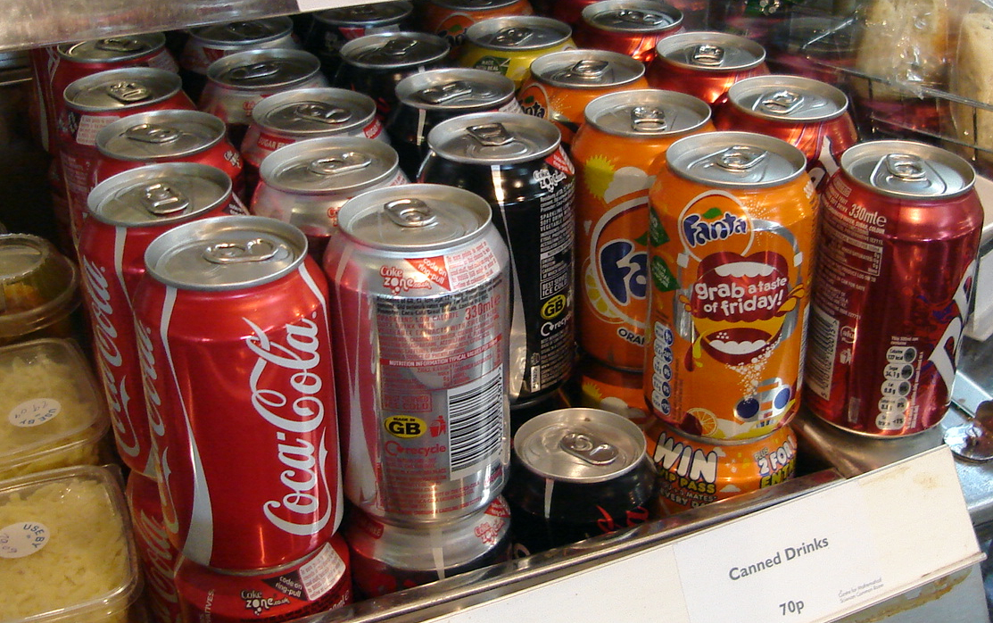
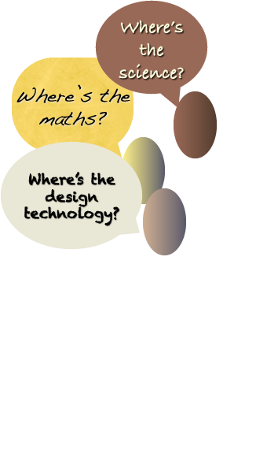

Slide 9
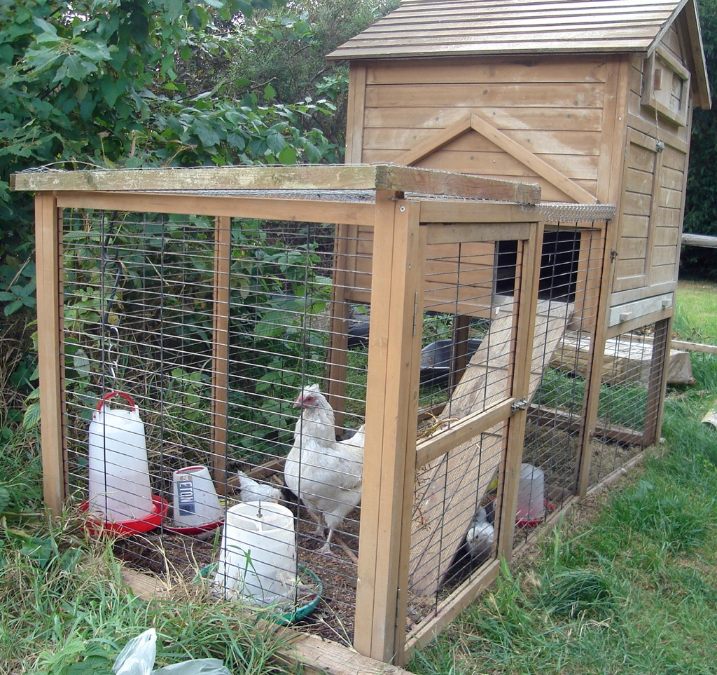

Slide 10
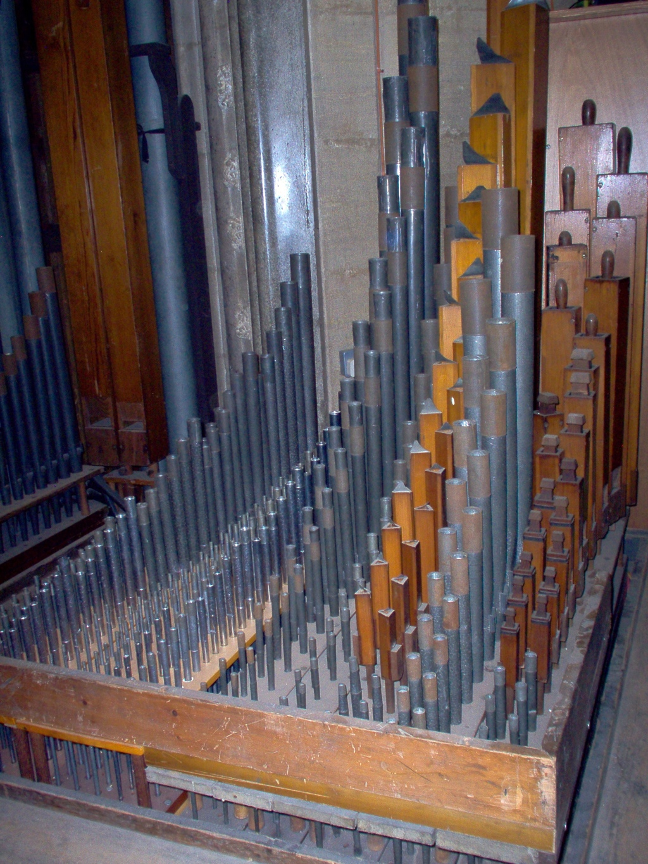

Slide 12
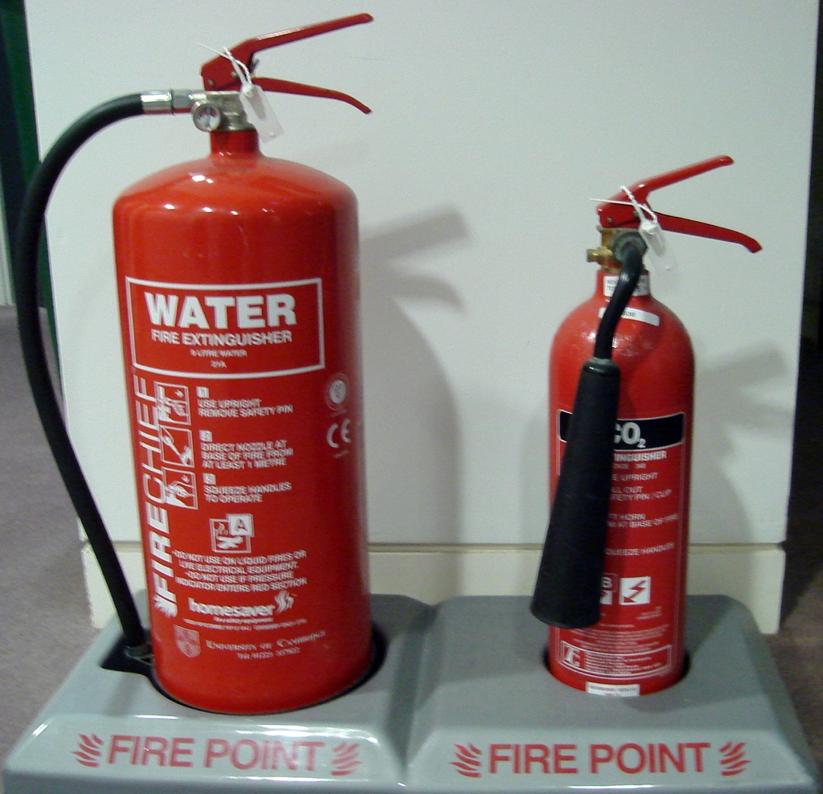

Slide 13
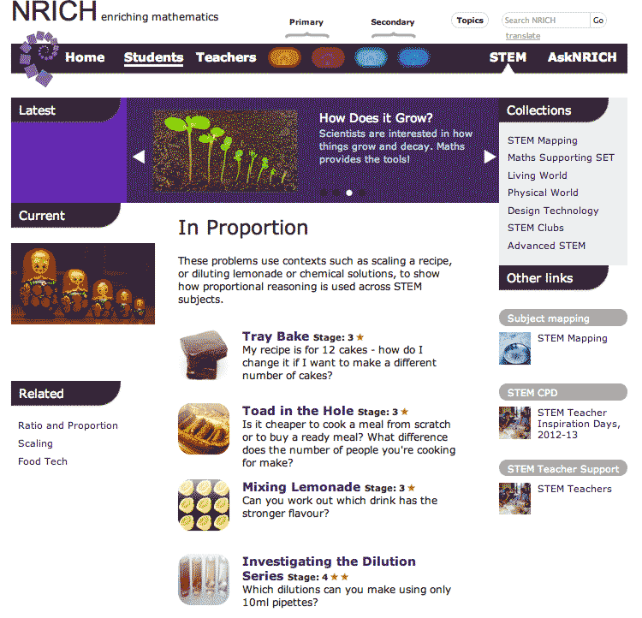
nrich.maths.stemnrich

Slide 14
Vicky Wong
Kings College, London
Victoria.wong@kcl.ac.uk

