Slide 1
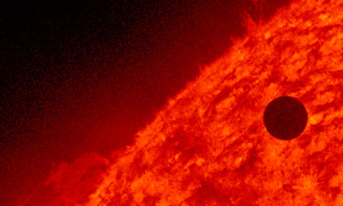
Image 1
Transits of Venus across the disk of the Sun are among the rarest of planetary alignments. Until now, only 8 transits have occurred since the invention of the telescope:
December 7, 1631 | December 9, 1874
December 4, 1639 | December 6, 1882
June 6, 1761 | June 8, 2004
June 3, 1769 | June 6, 2012

Slide 2
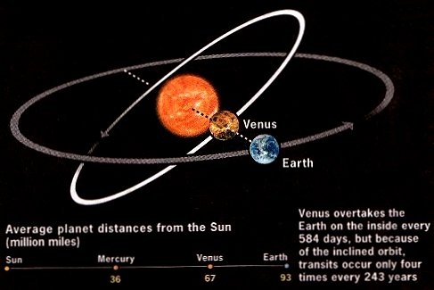
Orbit time in days:
Earth 365.24
Venus 224.7
Image 2
Venus overtakes the Earth on the inside every 584 days, but because of the inclined orbit, transits occur only 4 times every 243 years
Average planet distances from the Sun (million kilometres)
Sun
Mercury
Venus
Earth
57
107
149

Slide 3
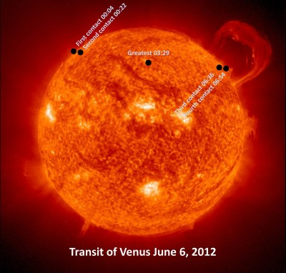
Image 3
http://www.apsmuseum.org/tov-event/

Slide 4
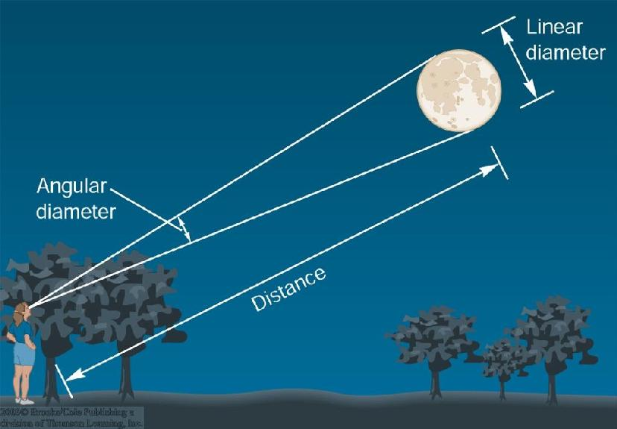
Image 4
Venus

Slide 5
