Slide 1
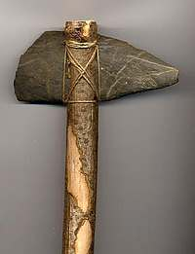
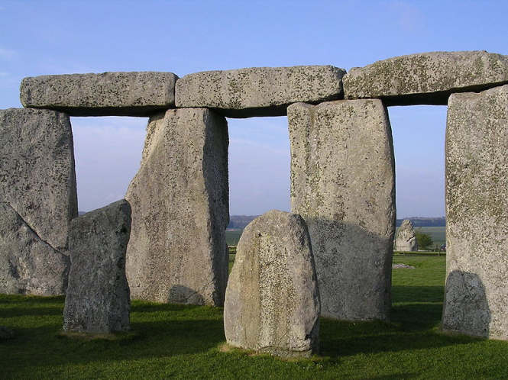
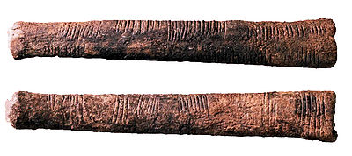
BACKGROUND TO S&M and ET
Once upon a time ....
Science and physics were born
Then humans used them – ET was born
A bit later, chem and biol got going

Slide 2
Historical background to stemNRICH
What? Rich, interesting tasks to provoke thought and engagement with the mathematical concepts underlying post-16 science.
Why? Because students can’t access their quantitative courses or are mathematically uninspired.

Slide 3
Comparison: ‘closed’ vs ‘rich’
What is the average of 12, 17, 19, ... , 87, 93.
Do 9 other questions.
Do half of the students taking a test score less than the average mark?
Convert 12 Celsius into Fahrenheit.
Do 9 other questions.
Is there a temperature at which Celsius and Fahrenheit readings are the same?

Slide 4
What problems do school leavers face in STEM?
Overly procedural thinking
Inability to translate mathematical meaning to biological meaning
Inability to make estimates or approximations
Poor problem solving skills
Lack of practice
Lack of confidence
Lack of mathematical interest

Slide 5
What did we do?

Slide 6
http://nrich.maths.org/stemnrich
Interlude 1

Slide 7
Investigating the dilution series
A four stage dilution is made in multiples of 10 ml
Can you make 10, 100, 160, 20, 125, 1875 per ml?

Slide 8
What do we hope to achieve by all of this?
Teachers feeling supported and able to increase student motivation in and enjoyment of STEM.
Make students better prepared for GCSE, A-levels and university - making them happier, more skilled and better informed.
Enrichment of maths and SET classrooms, making full use of the varied histories and experiences of teachers, such as non-subject specialists teaching maths/science.
Notes:
New – good teachers might well have been doing this for ages!

Slide 9
Three levels of STEM engagement
3
Use of cross-curricular tasks in the learning of the standard curriculum
2
Active reference in lessons to timetabled curriculum links across departments as will be encountered by the students
Raise awareness of general connections across subjects
1

Slide 10
Some key elements of good STEM practice
Respect for different departments and no sense of any subject being better or more important or more fundamental than any other: differences are great, but there are also commonalities.
Use positive language when talking about mathematics/other subjects: it is unfortunately seen as OK to dismiss maths as un-cool, pointless or geeky and this has a very negative impact on subject perceptions amongst students.
Build on learning from other subjects, rather than trying to teach things from scratch that students might have encountered elsewhere.
Realise that all SET teachers will have to teach maths at some points in the curriculum.
Don't assume that the maths is easy for students when it is located in a context where they wouldn't expect to find it.
Try to find the hidden gems in any topic area, even if it is not your personal favourite.
Be aware that the important role of the teacher is as a learning facilitator in many cross-curricular activities, rather than the transmitter of all of the knowledge.
It is OK not to know 'all' the answers. In fact, it is desirable to provide contexts in which you do not know all the answers to all possible questions!

Slide 11
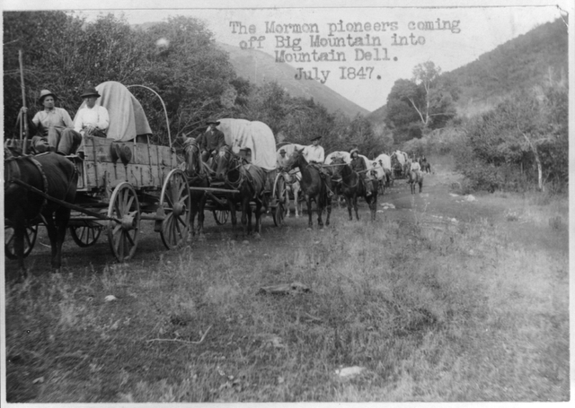
What next?

